Slide 1
Conceptual Design of A Medium Energy Polarized Electron-Ion Collider at JLab
Yuhong Zhang
for
Jefferson Lab EIC Study Group
Physics with Secondary Hadron Beams in the 21st Century
April 7, 2012, Ashburn, VA

Slide 2
Electron-Ion Collider (EIC) at JLab
Over the decade, JLab has been developing a conceptual design of an EIC as its future science program beyond 12 GeV CEBAF upgrade
The future science program, as NSAC LRP articulates, drives the EIC design, focusing on:
    High luminosity (above 10³³ cm⁻²s⁻¹) per detector over multiple detectors
    High polarization (>80%) for electrons and (>70%) for light ions
Presently, we focus on a Medium-energy Electron-Ion Collider (MEIC) as an immediate goal, as the best compromise between science, technology and project cost
We maintained a well defined path for future upgrade to higher energies and high luminosity
The JLab EIC machine design is based on
  CEBAF as full-energy electron injector
  A new ion complex and collider rings optimized for polarization

Slide 3
MEIC Design
Energy
  Full coverage in s from a few hundred to a few thousand
  Bridging the gap of 12 GeV CEBAF and HERA/LHeC
  Electron 3 to 11 GeV, proton 20 to 100 GeV, ion 12 to 40 GeV/u
  Design point: 60 GeV proton on 5 GeV electron
Ion species
  Polarized light ion: p, d, ³He and possibly Li
  Un-polarized ions up to A=200 or so (Au, Pb)
Detectors
  Up to three interaction points, two for medium energy (20 to 100 GeV)
  One full-acceptance detector (primary), 7 m between IP & 1st final focusing quad, our initial priority with a more challenging design
  One high luminosity detector (secondary), 4.5 m between IP and 1st final focusing quad

Slide 4
MEIC Design (cont.)
Luminosity
  About 10³⁴ cm⁻² s⁻¹ (e-nucleon) optimized at s=2000 GeV²
  Greater than 10³³ cm⁻² s⁻¹ for s=500-2500 GeV²
Polarization
  Longitudinal at the IP for both beams
  Transverse at IP for ions only
  All polarizations >70% desirable
  Spin-flip of both beams (at least 0.1 Hz) being developed
Upgradeable to higher energies and luminosity
  20 GeV electron, 250 GeV proton and 100 GeV/u ion,
  facility fits the JLab site
Positron beam highly desirable
  Positron-ion collisions with similar luminosity

Slide 5
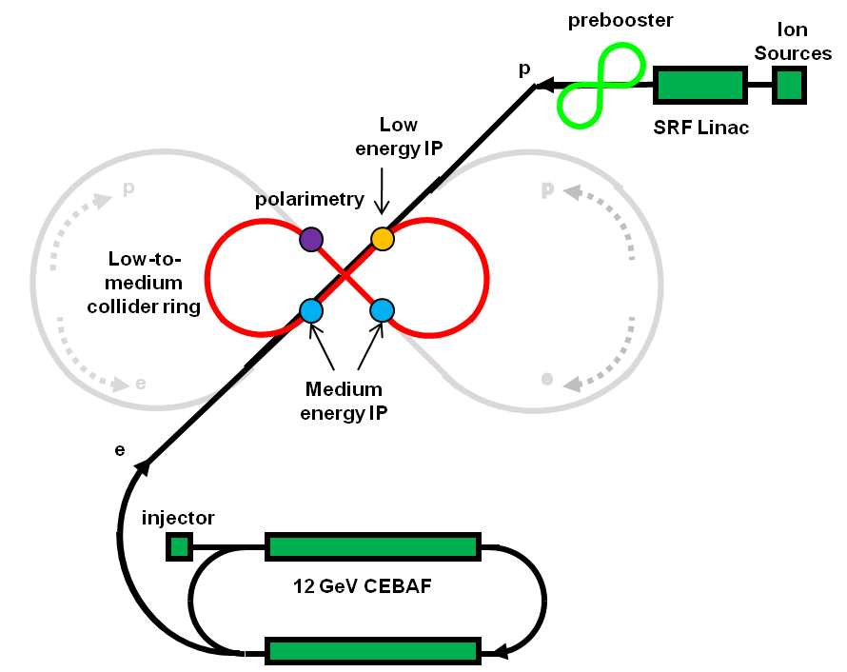
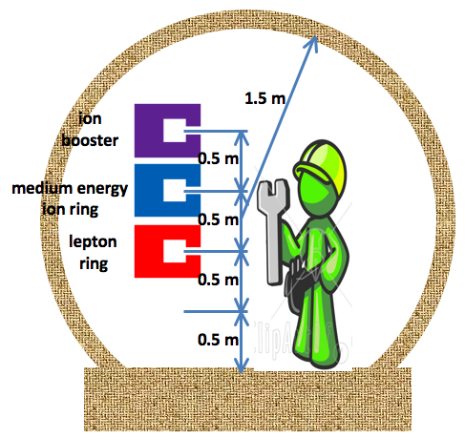
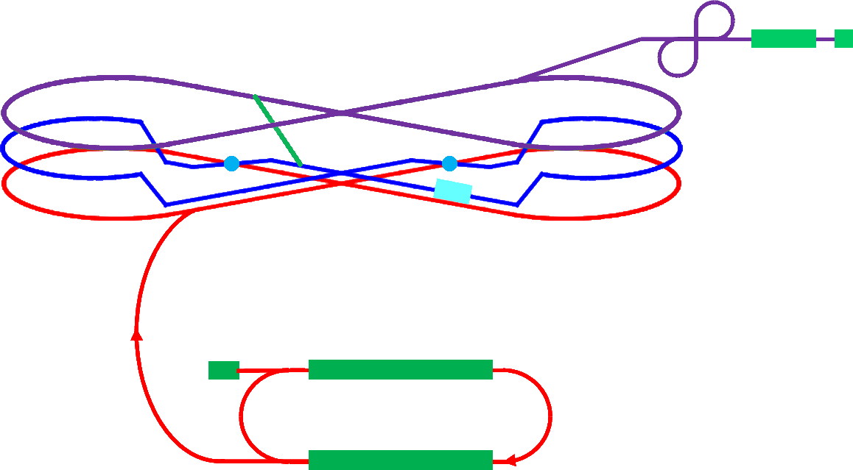
MEIC Layout
medium energy IP
Three compact rings:
3 to 11 GeV electron
Up to 20 GeV/c proton (warm)
Up to 100 GeV/c proton (cold)
low energy IP
Prebooster
Ion
source
Warm large booster
(up to 20 GeV/c)
Ion transfer beam line
SRF linac
Cold 97 GeV/c proton collider ring
Three Figure-8
rings stacked vertically
Medium energy IP with
horizontal crab crossing
Electron ring
Injector
12 GeV CEBAF

Slide 6
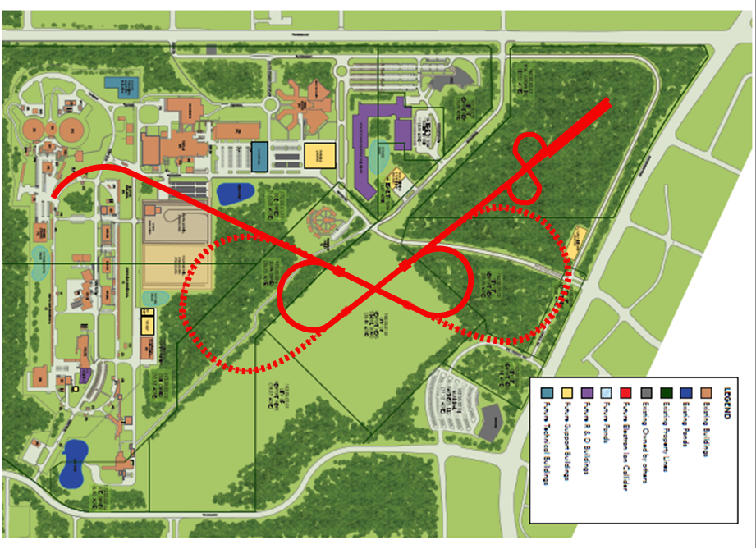
MEIC and Upgrade on JLab Site Map

Slide 7
Luminosity Concept: High Bunch Repetition Rate
Luminosity of KEKB and PEP II follow from
  Very small β* (~6 mm)
  Very short bunch length (σ_{z}~ β*)
  Very small bunch charge (5.3 nC)
  High bunch repetition rate (509 MHz)
➔ KEK-B already over 2x10³⁴ /cm²/s
JLab is poised to replicate same success in electron-ion collider:
  A high repetition rate electron beam from CEBAF
  A new ion complex (so can match e-beam)
  Electron cooling to allow short ion bunches
 |  | KEK B | MEIC
Repetition rate | MHz | 509 | 750
Particles per bunch | 10¹⁰ | 3.3 / 1.4 | 0.42 / 2.5
Beam current | A | 1.2 / 1.8 | 0.5 / 3
Bunch length | cm | 0.6 | 1 / 0.75
Horizontal & vertical β* | cm | 56/0.56 | 10 / 2
Luminosity per IP, 10³³ | cm⁻²s⁻¹ | 20 | 5.6 ~ 14

Slide 8
Parameters for Full Acceptance Interaction Point
 |  | Proton | Electron
Beam energy | GeV | 60 | 5
Collision frequency | MHz | 750 | 750
Particles per bunch | 10¹⁰ | 0.416 | 2.5
Beam Current | A | 0.5 | 3
Polarization | % | > 70 | ~ 80
Energy spread | 10⁻⁴ | ~ 3 | 7.1
RMS bunch length | mm | 10 | 7.5
Horizontal emittance, normalized | µm rad | 0.35 | 54
Vertical emittance, normalized | µm rad | 0.07 | 11
Horizontal β* | cm | 10 | 10
Vertical β* | cm | 2 | 2
Vertical beam-beam tune shift |  | 0.014 | 0.03
Laslett tune shift |  | 0.06 | Very small
Distance from IP to 1st FF quad | m | 7 | 3.5
Luminosity per IP, 10³³ | cm⁻²s⁻¹ | 5.6
Notes:
8

Slide 9
Parameters for High Luminosity Interaction Point
 |  | Proton | Electron
Beam energy | GeV | 60 | 5
Collision frequency | MHz | 750 | 750
Particles per bunch | 10¹⁰ | 0.416 | 2.5
Beam Current | A | 0.5 | 3
Polarization | % | > 70 | ~ 80
Energy spread | 10⁻⁴ | ~ 3 | 7.1
RMS bunch length | mm | 10 | 7.5
Horizontal emittance, normalized | µm rad | 0.35 | 54
Vertical emittance, normalized | µm rad | 0.07 | 11
Horizontal β* | cm | 4 | 4
Vertical β* | cm | 0.8 | 0.8
Vertical beam-beam tune shift |  | 0.014 | 0.03
Laslett tune shift |  | 0.06 | Very small
Distance from IP to 1st FF quad | m | 4.5 | 3.5
Luminosity per IP, 10³³ | cm⁻²s⁻¹ | 14.2

Slide 10
The Current Design Status
The electron complex
CEBAF as a full energy injector
  Already exist! Possible top-off mode
Electron collider ring
  Linear optics design: done!
The ion Complex
  Ion sources
  Identified ABPIS for polarized H⁻/D⁻, light ions
  Identified ECR/EBIS for heavy ions
Linac
  Technical design: done!
  Design of component (RFQ, cavity, etc): done!
Pre-booster
  Linear optics design: done!
  Injection, accumulation, acceleration: done!
  Conventional DC electron cooling exist!
Large booster
  Ring optics design: done!
Ion collider ring
  Llinear optics design: done!
Interaction region
  Electron IR
    Optics design & chromatic correction: done!
    Tracking & dynamic aperture: in progress
  Ion IR
    Optics design & chromatic correction: done!
    Tracking & dynamic aperture: in progress!
  Crab cavity: Has a design!
  SR and detector background: checked!
Beam polarization
Electron polarization design: done!
Proton/deuteron polarization design: done!
Spin matching & tracking: in progress!
Electron cooling in collider ring
Staged electron cooling concept: done!
ERL-circulator e-cooler concept: done!
Fast kicker development: has a concept
Beam synchronization: done!

Slide 11
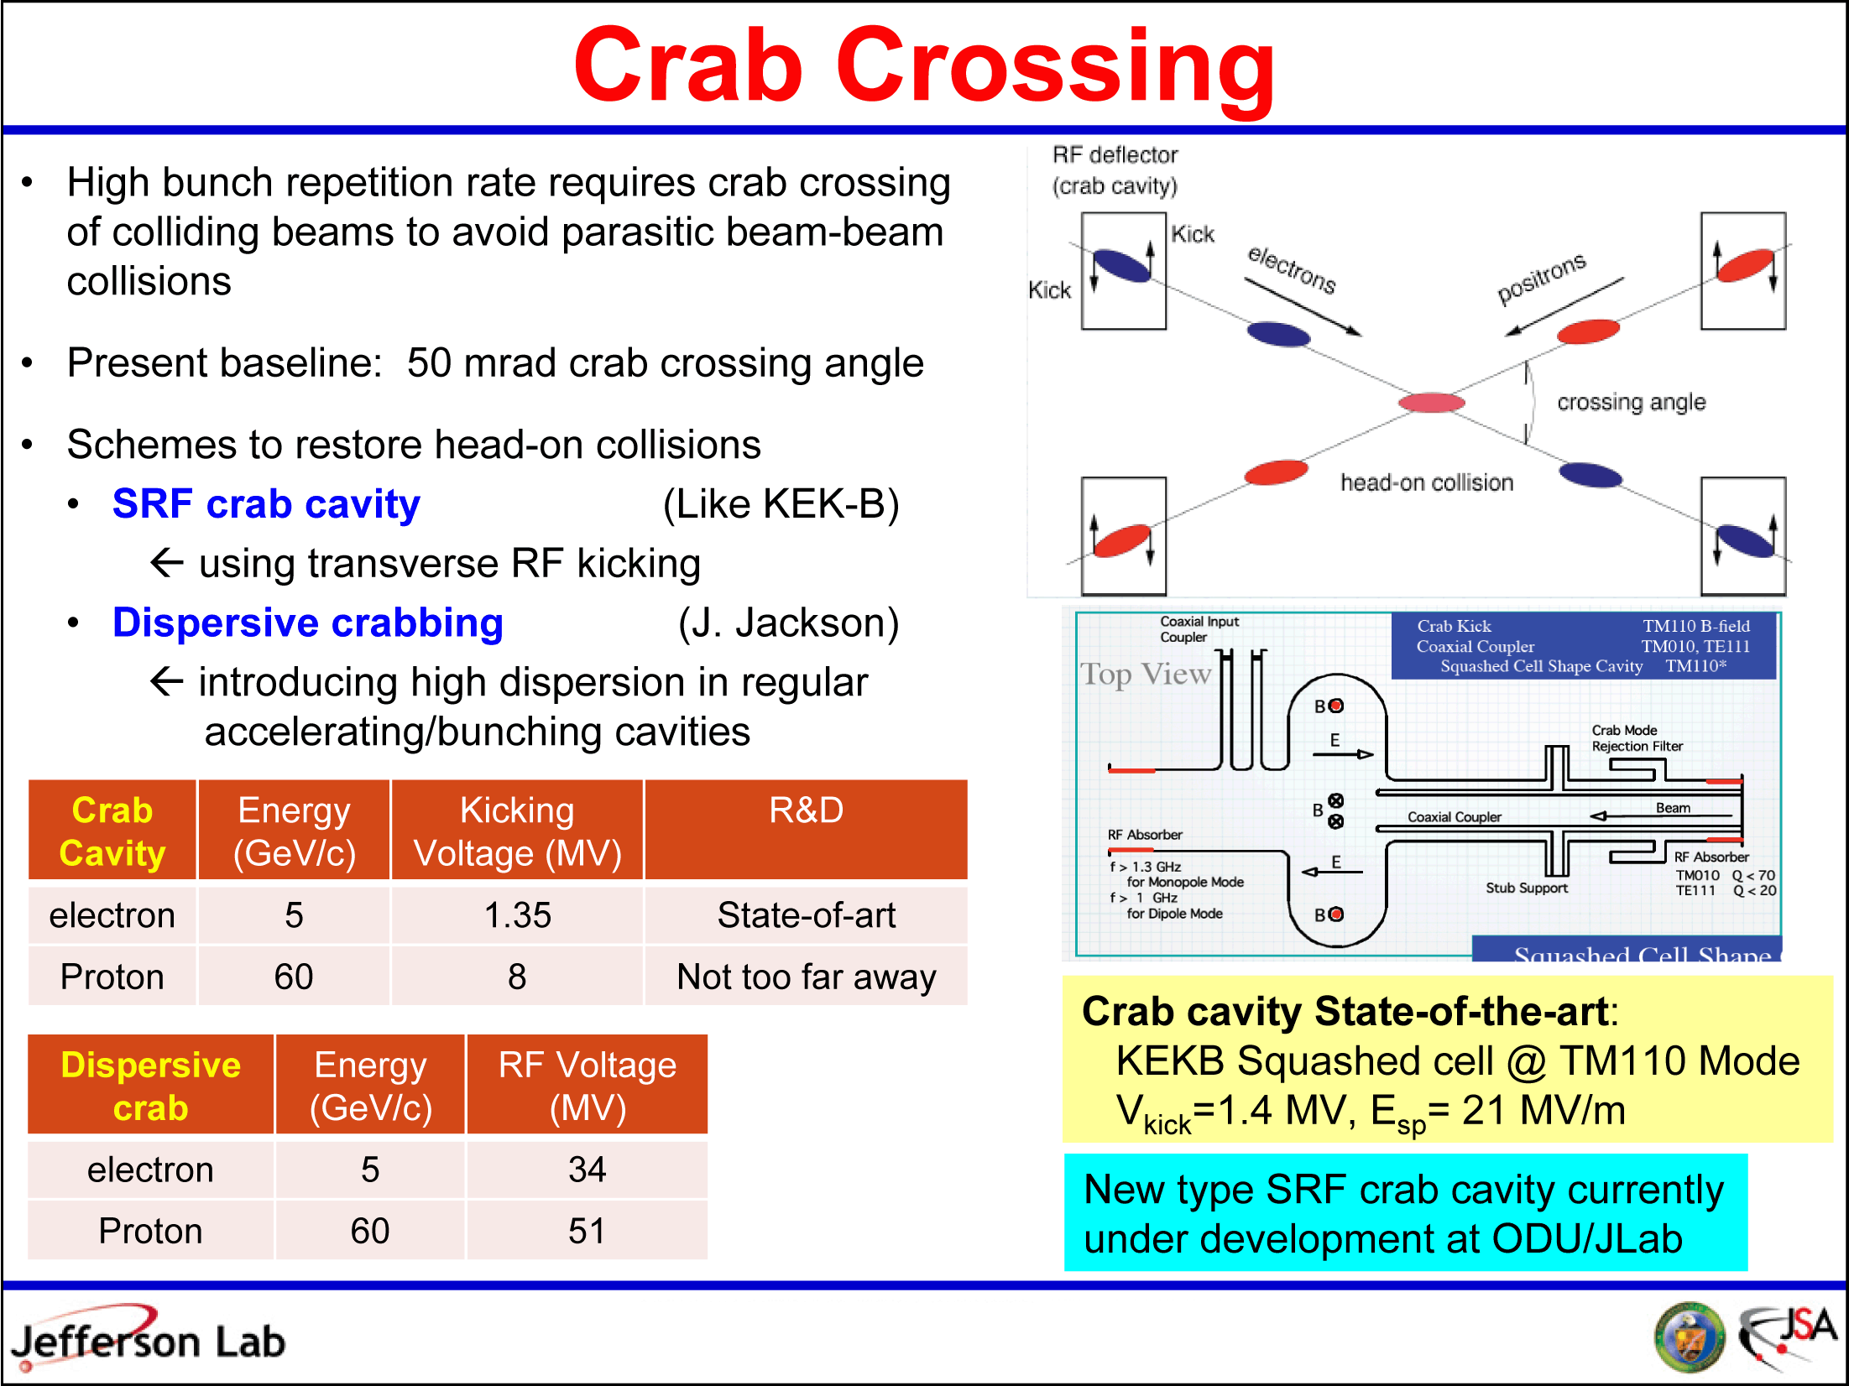
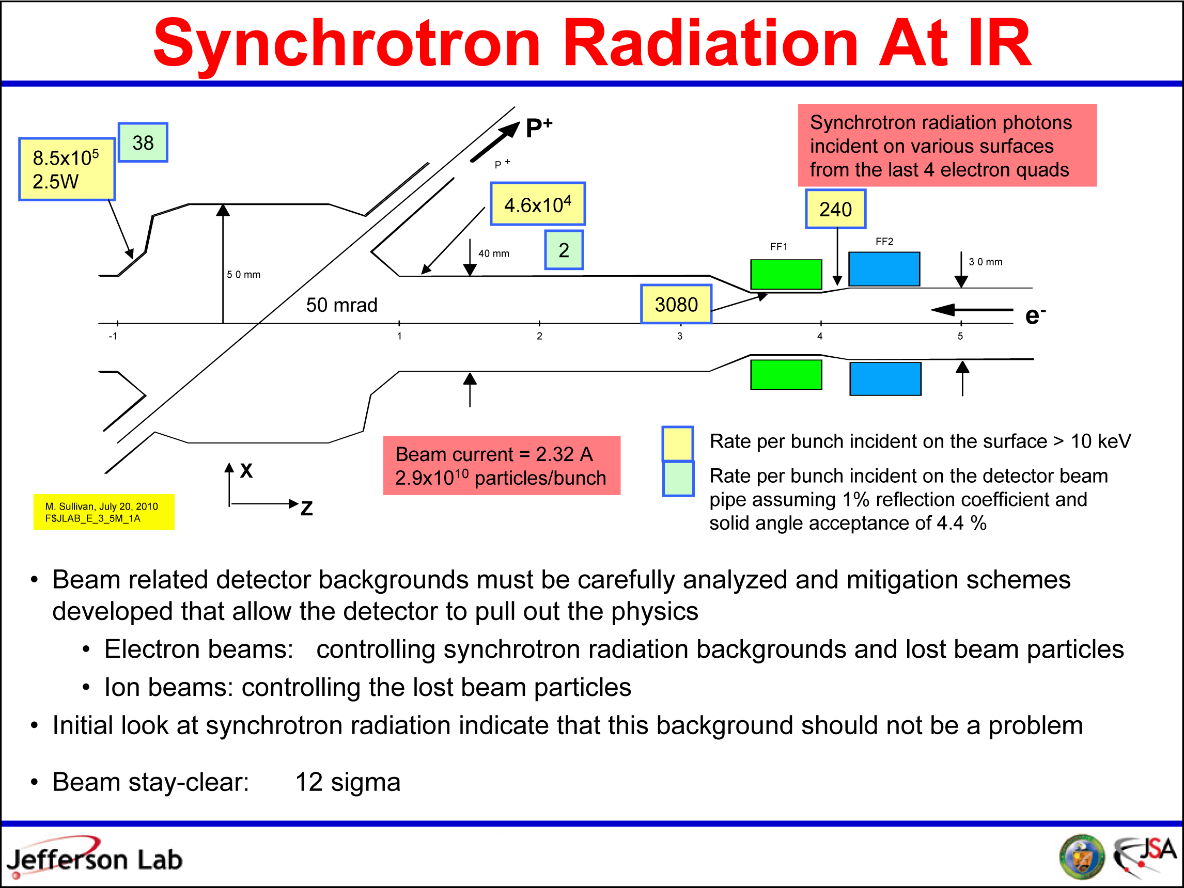
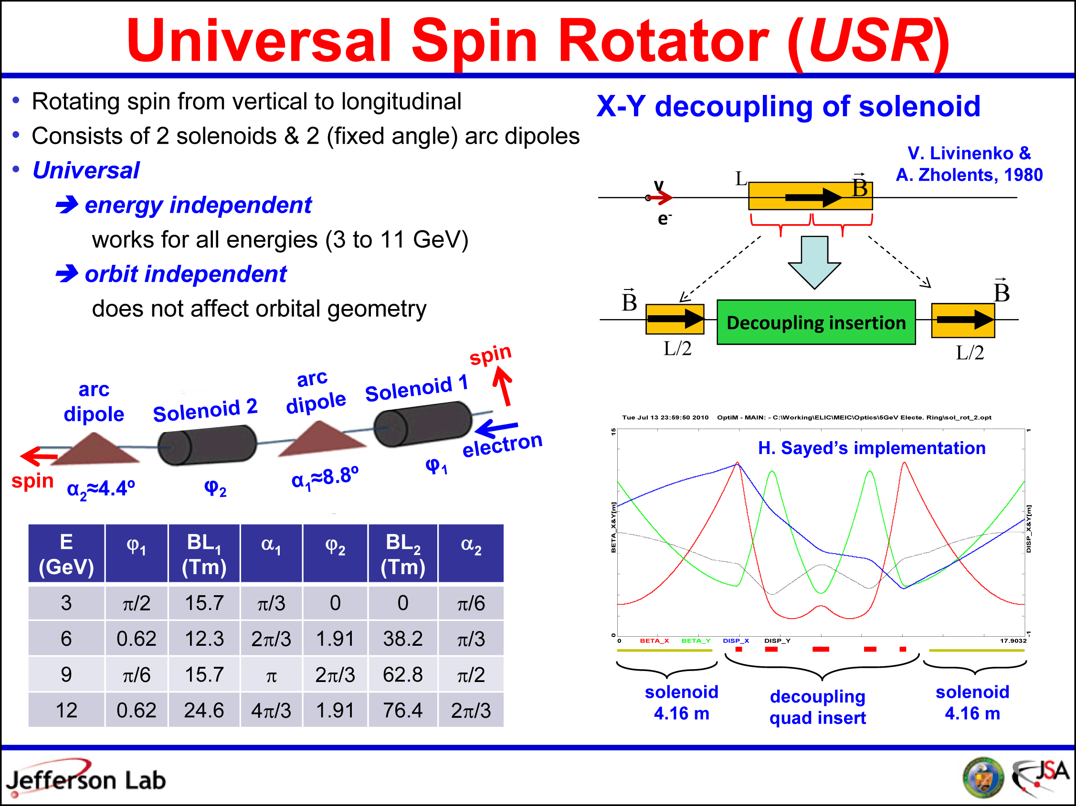
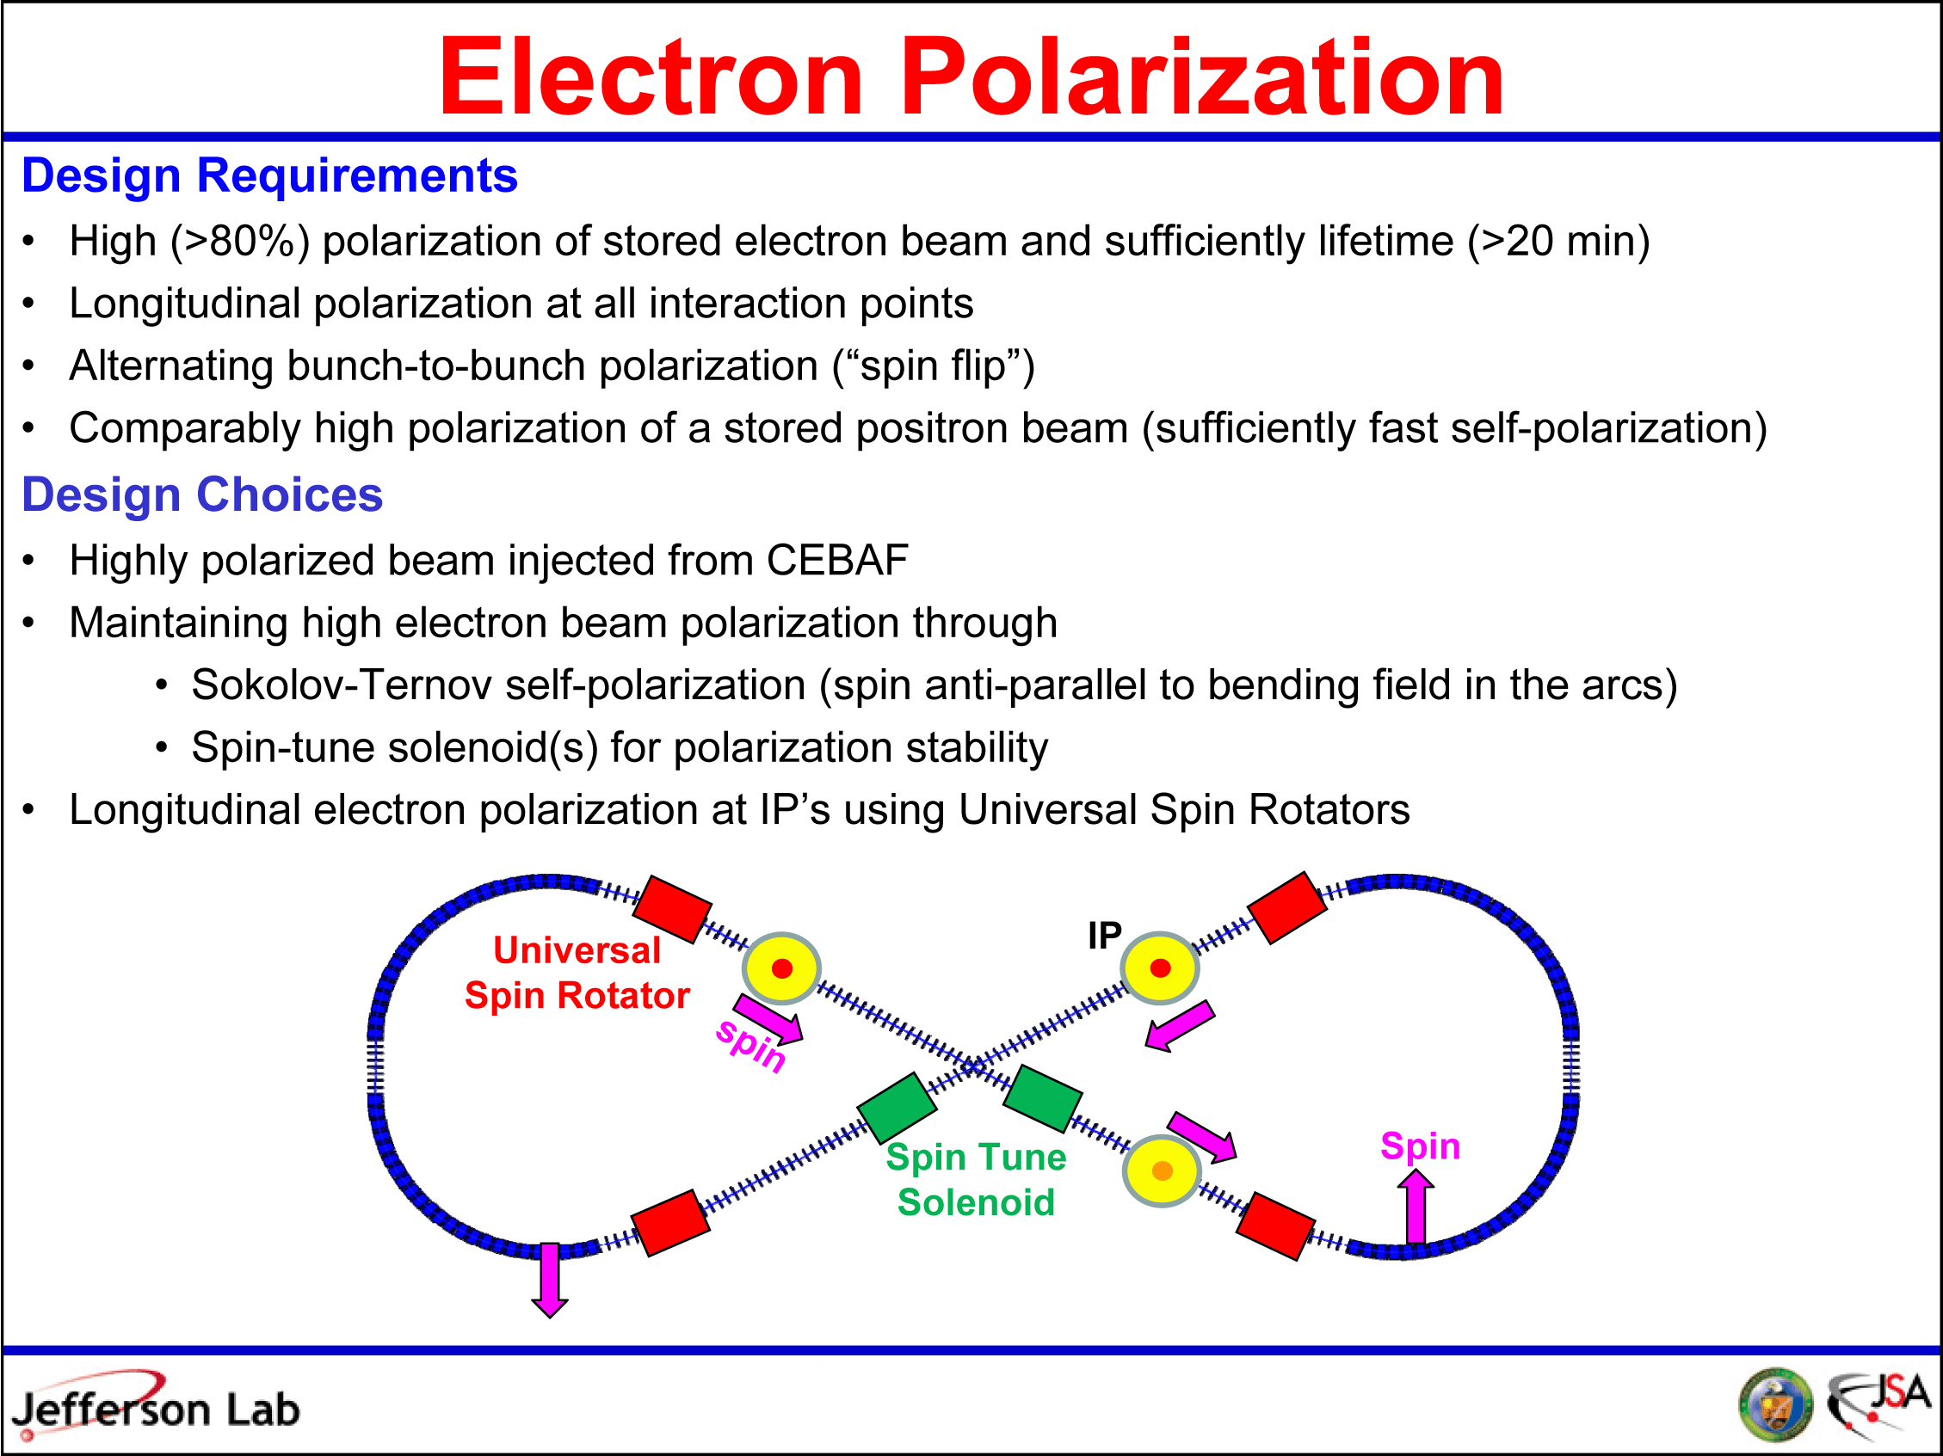
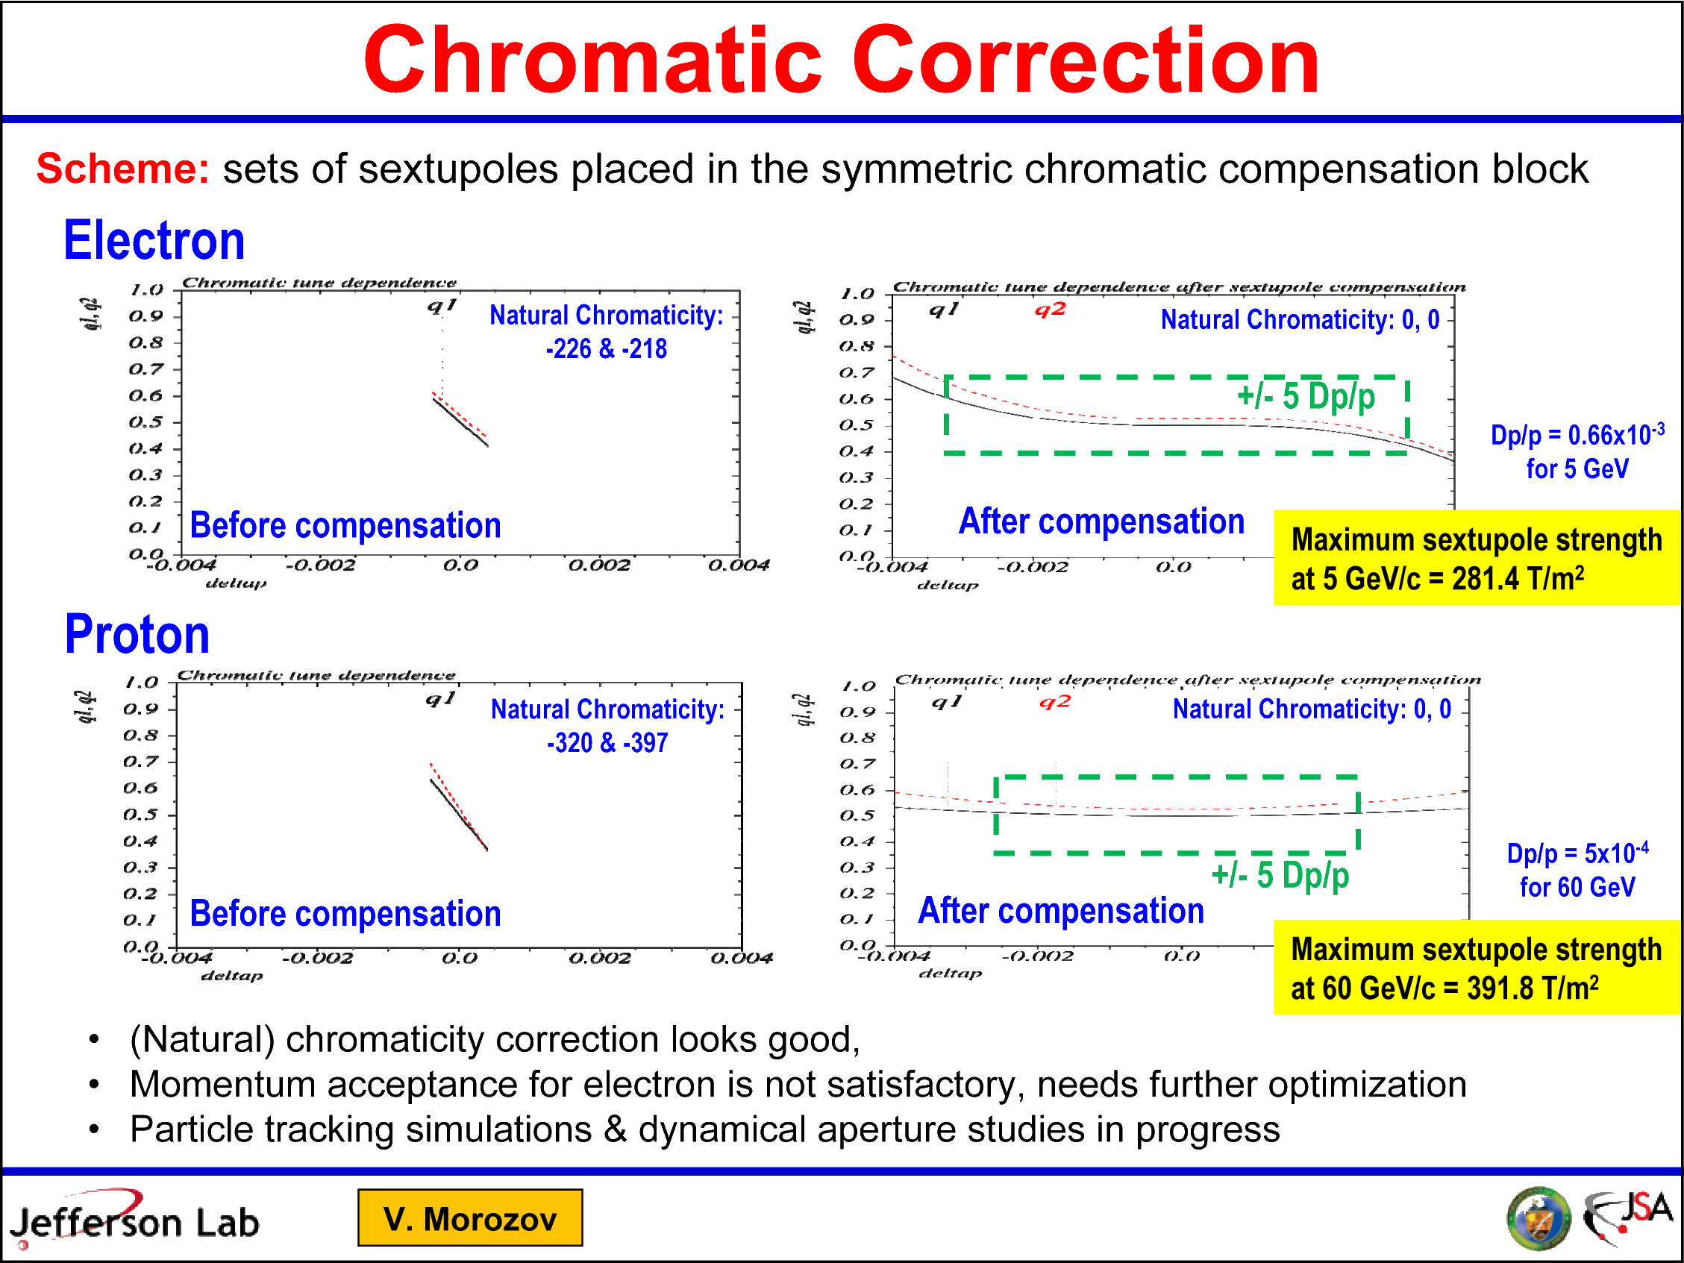
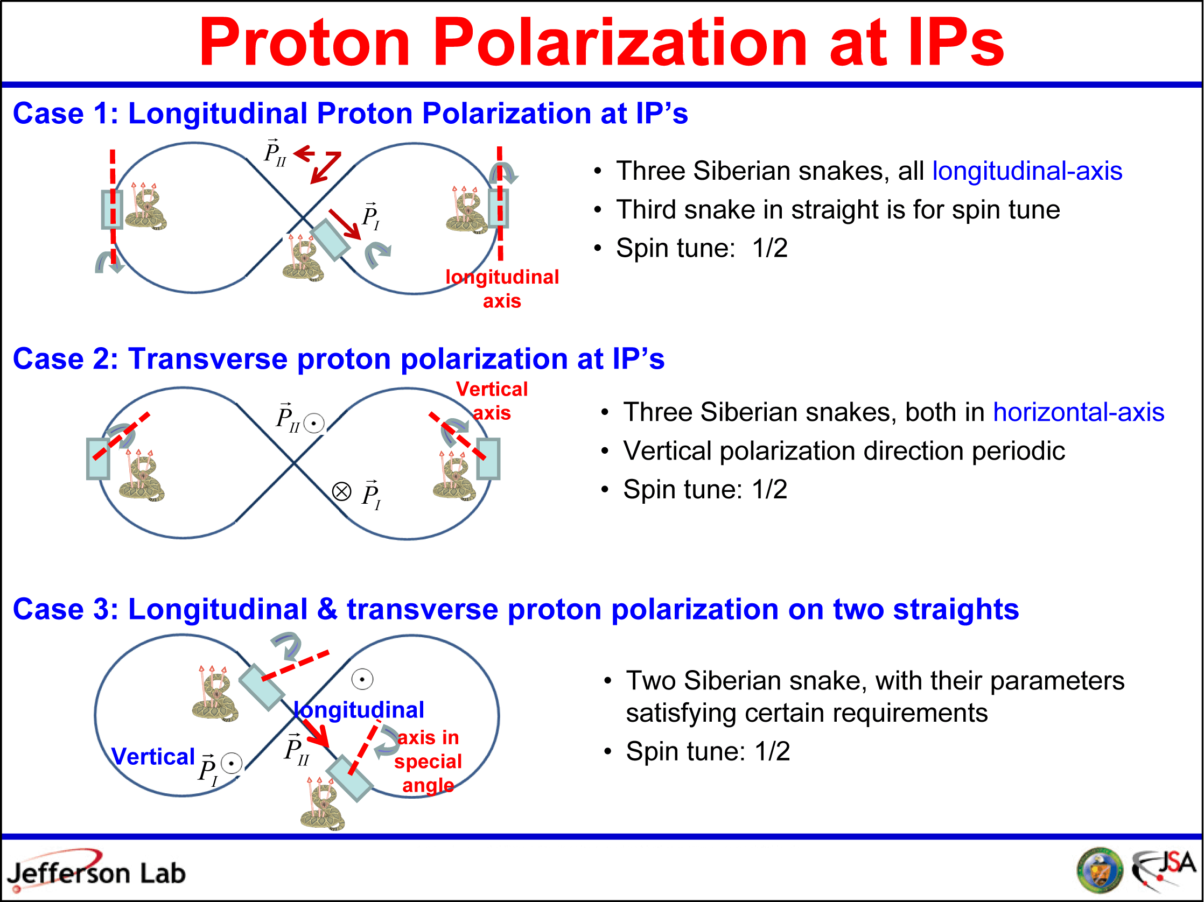
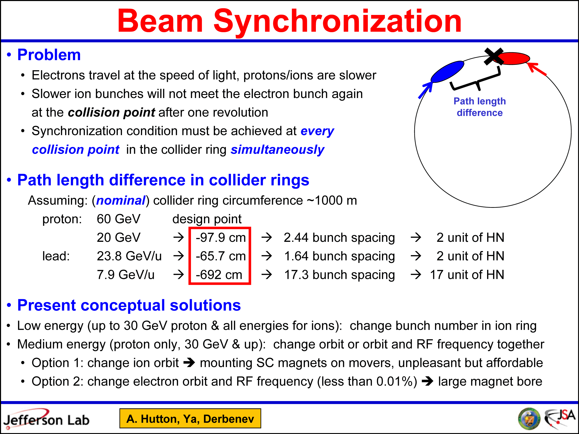
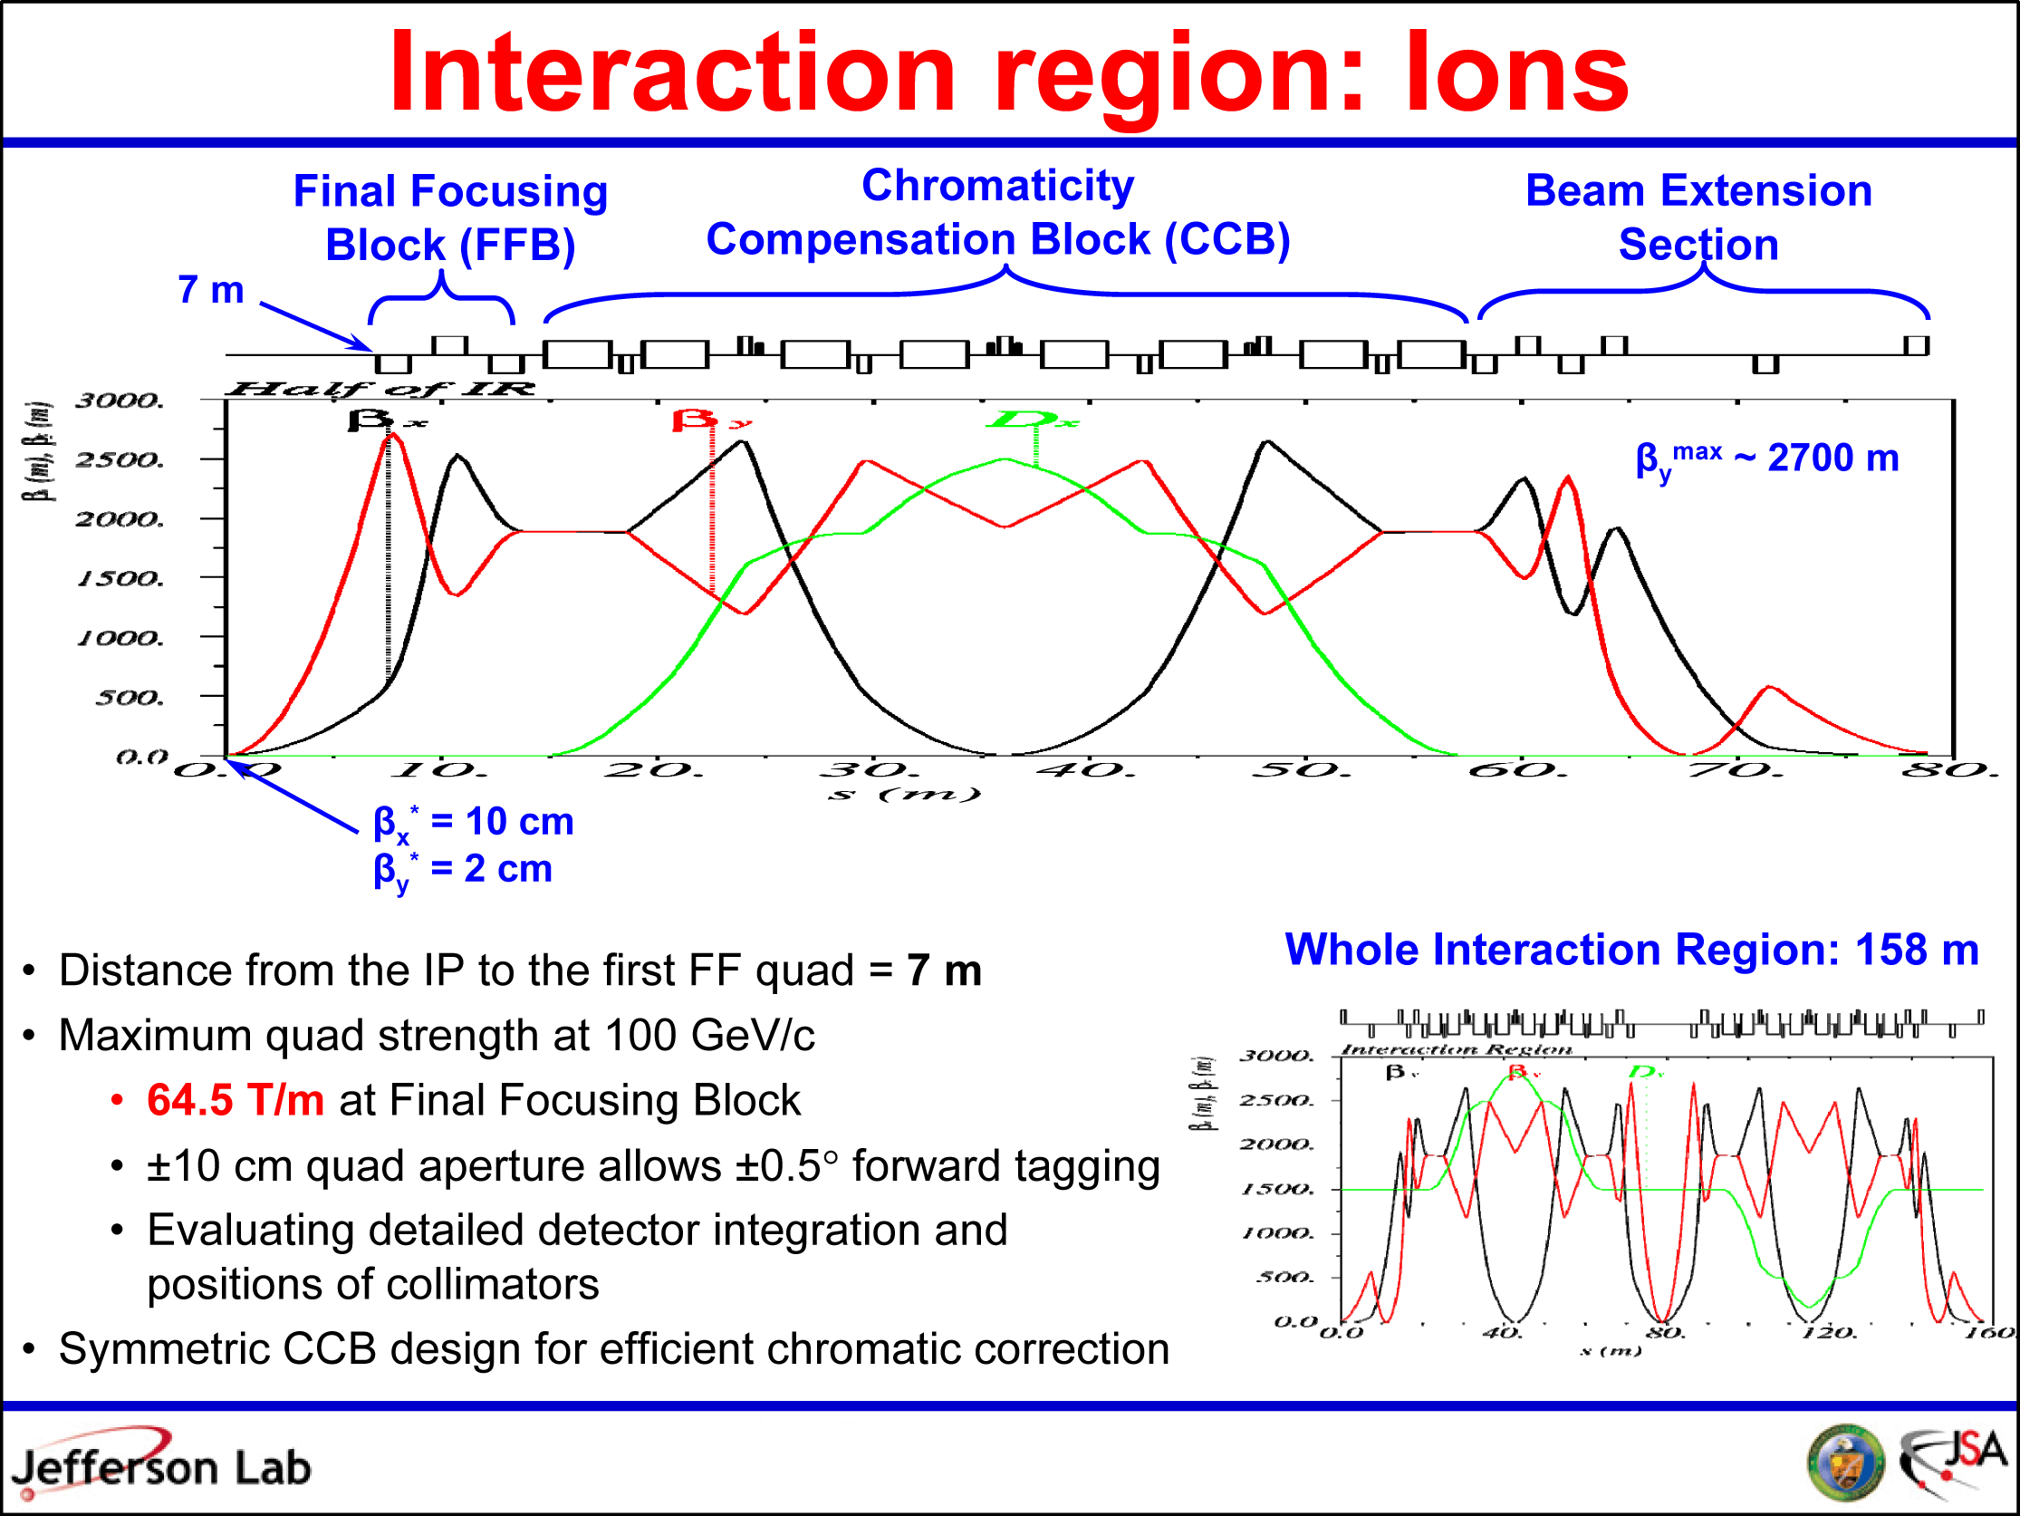
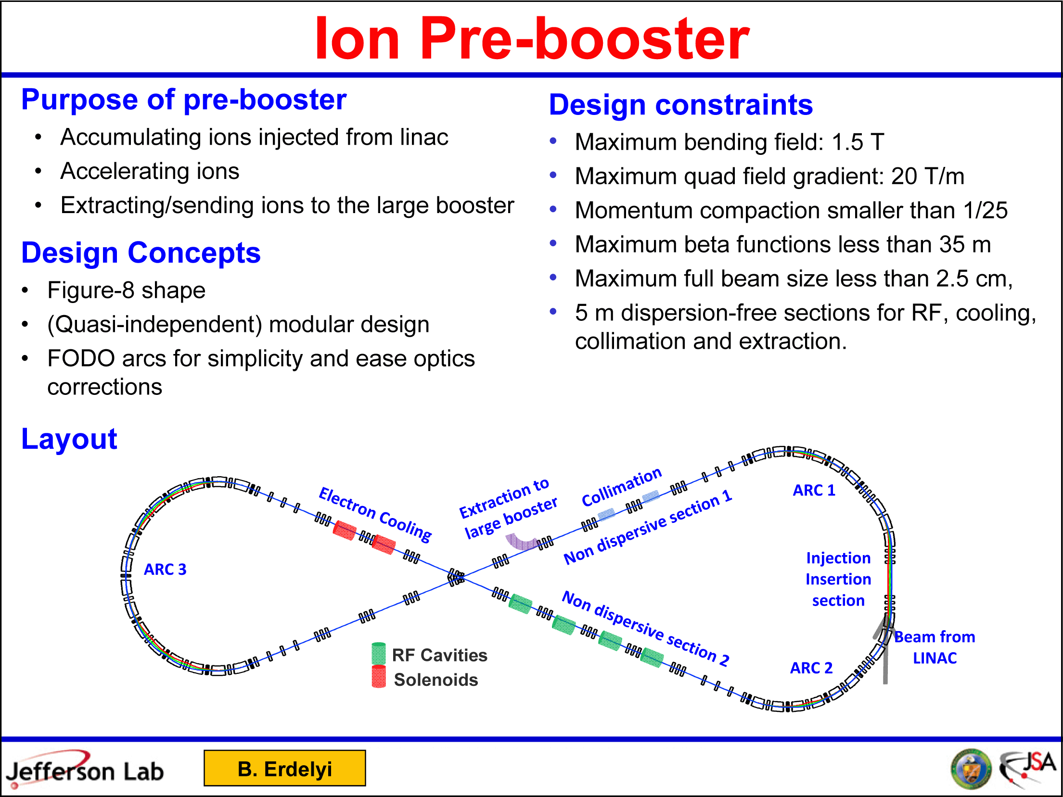
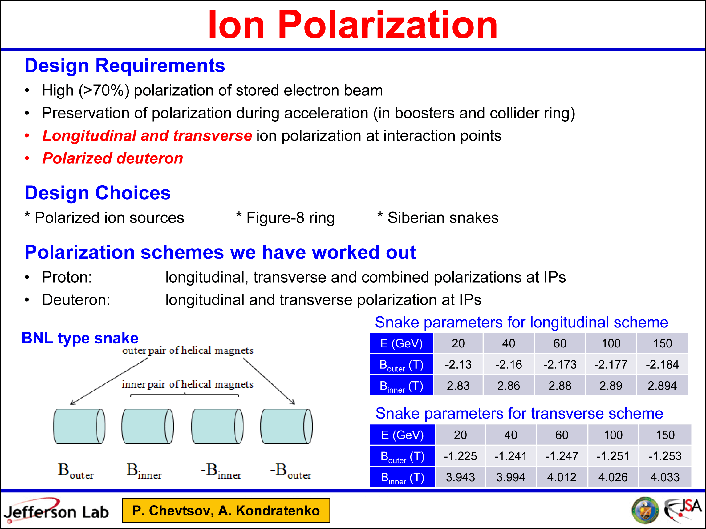
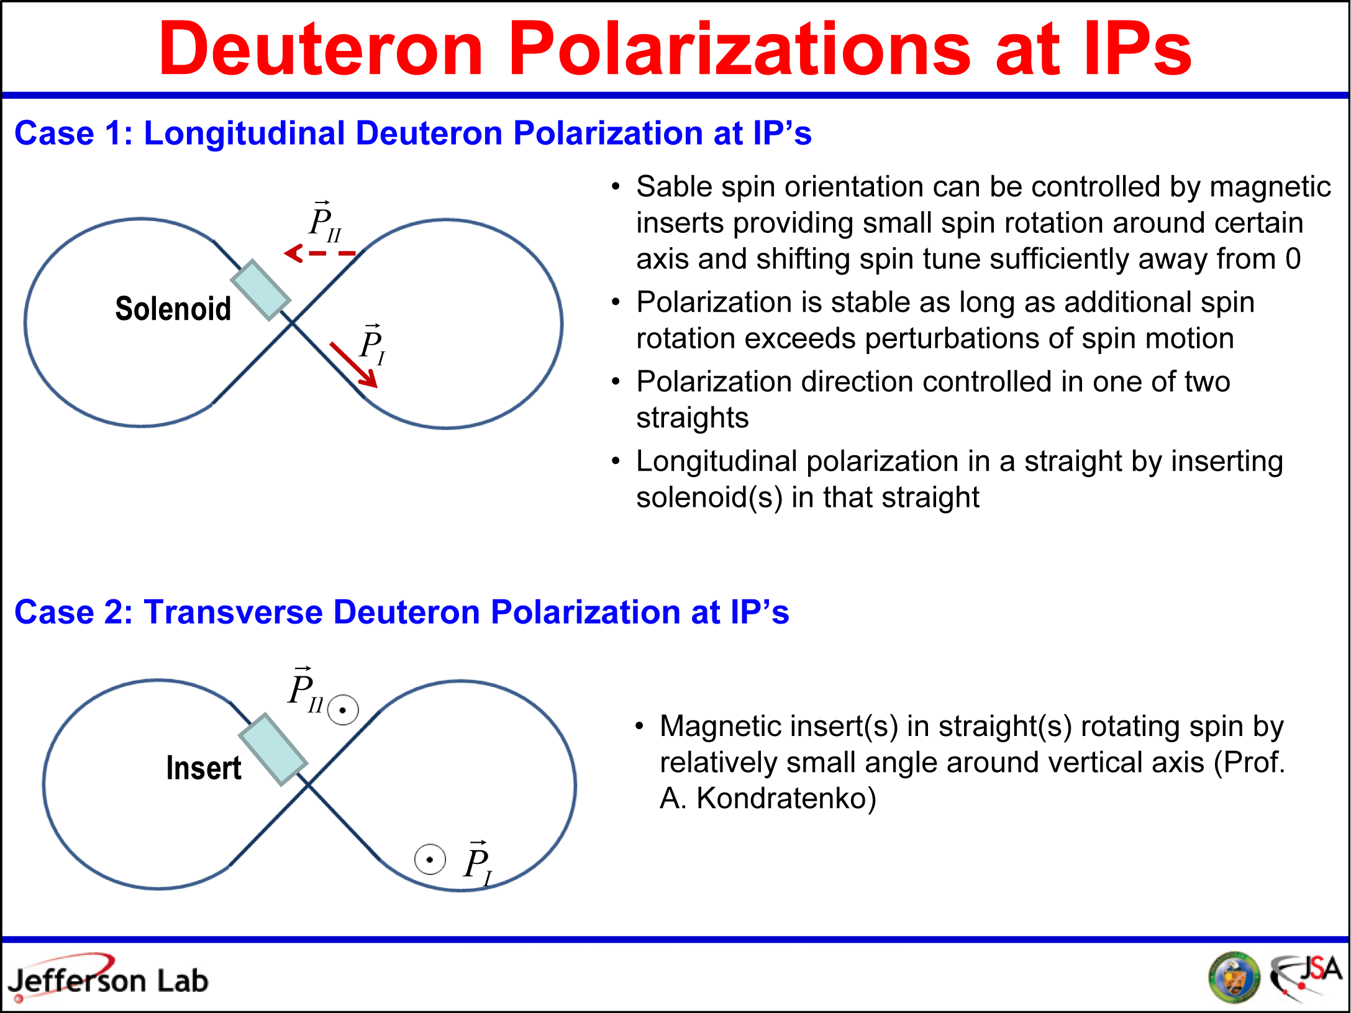
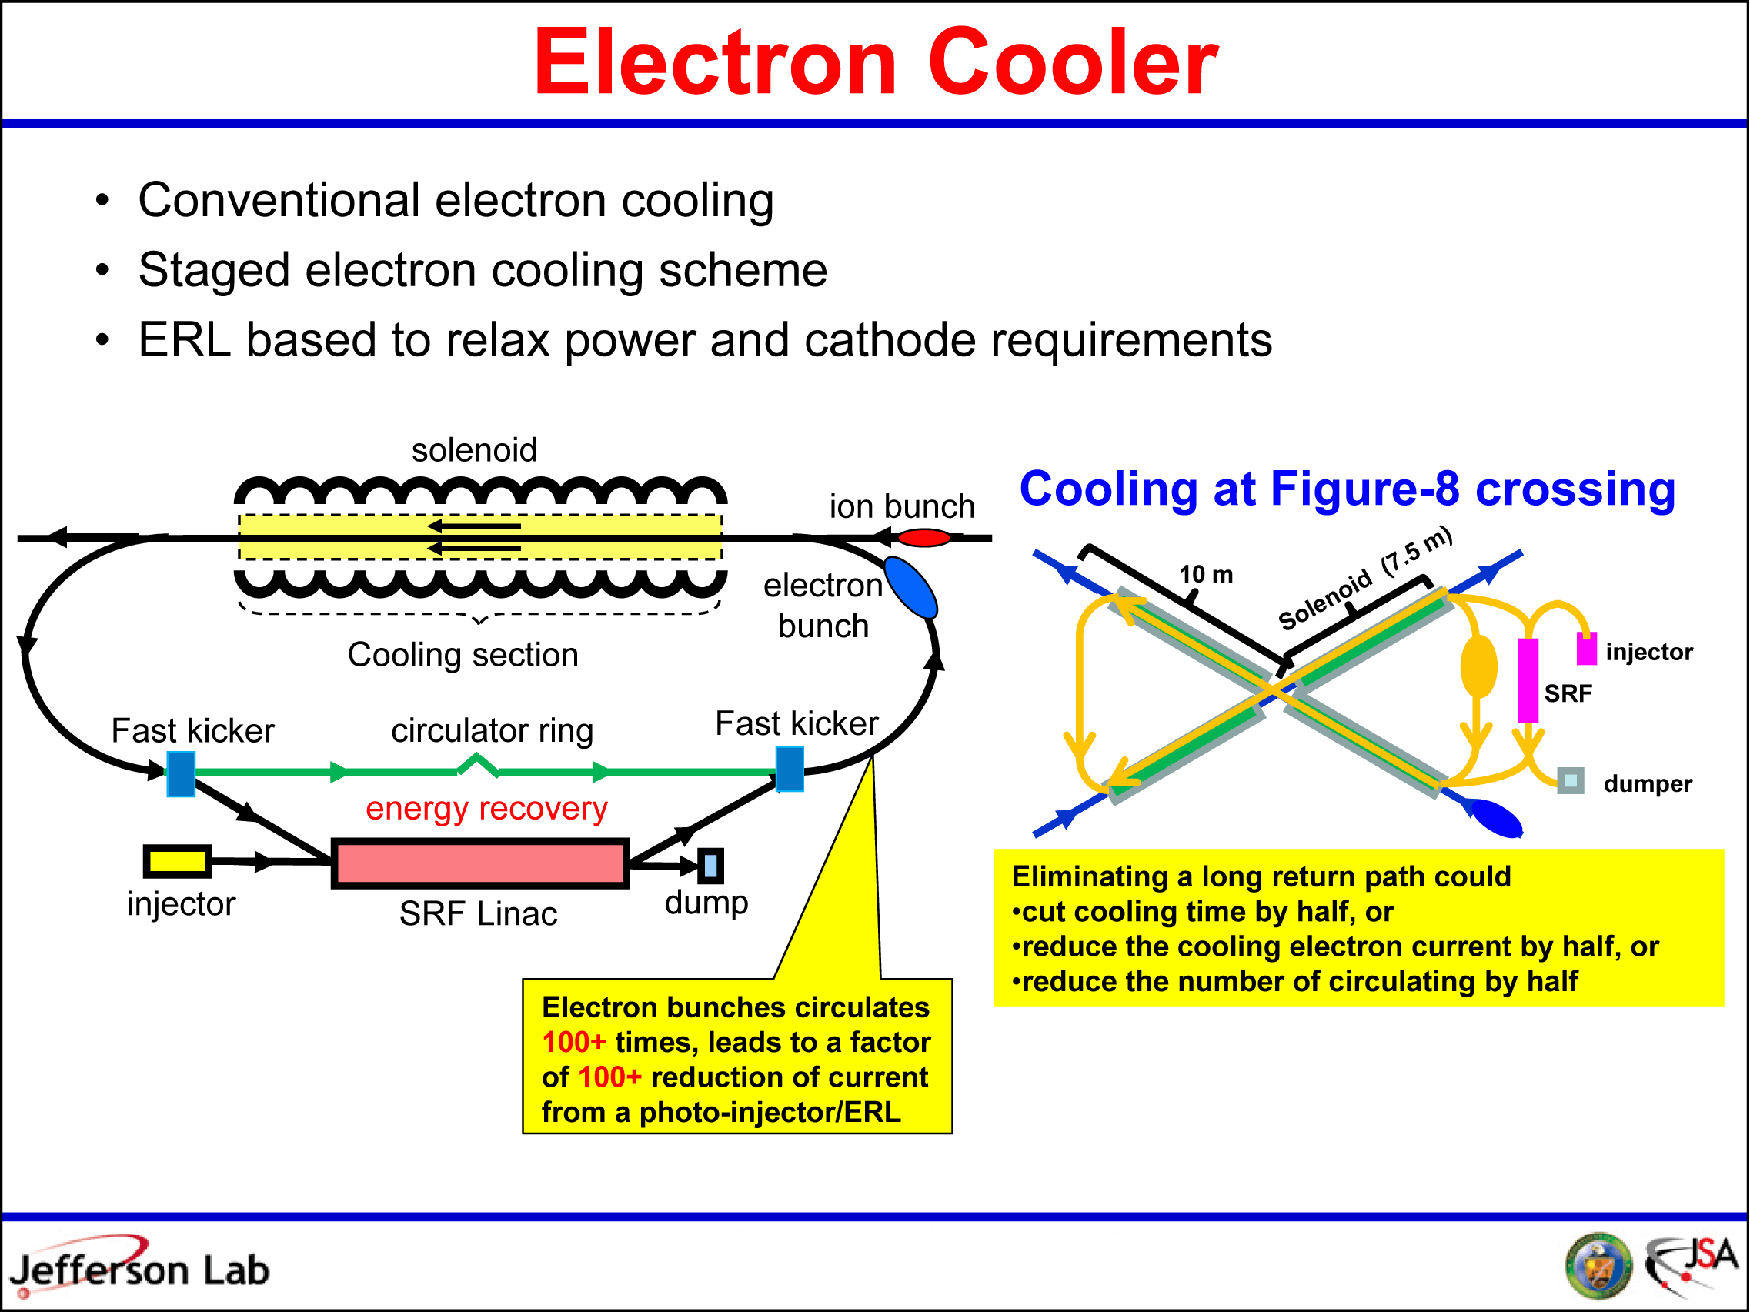
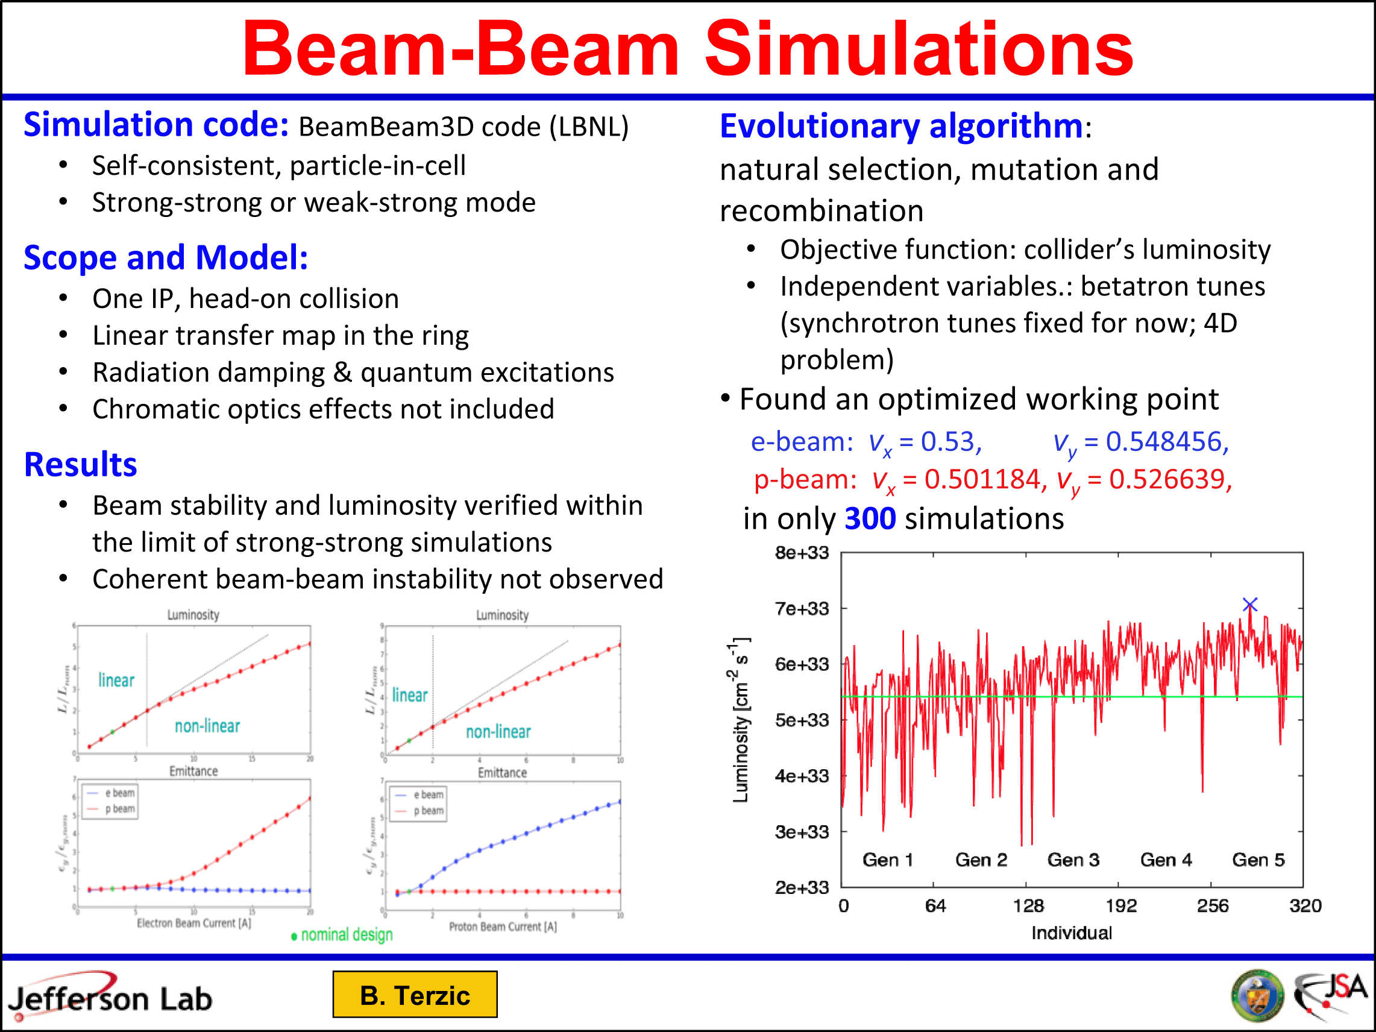
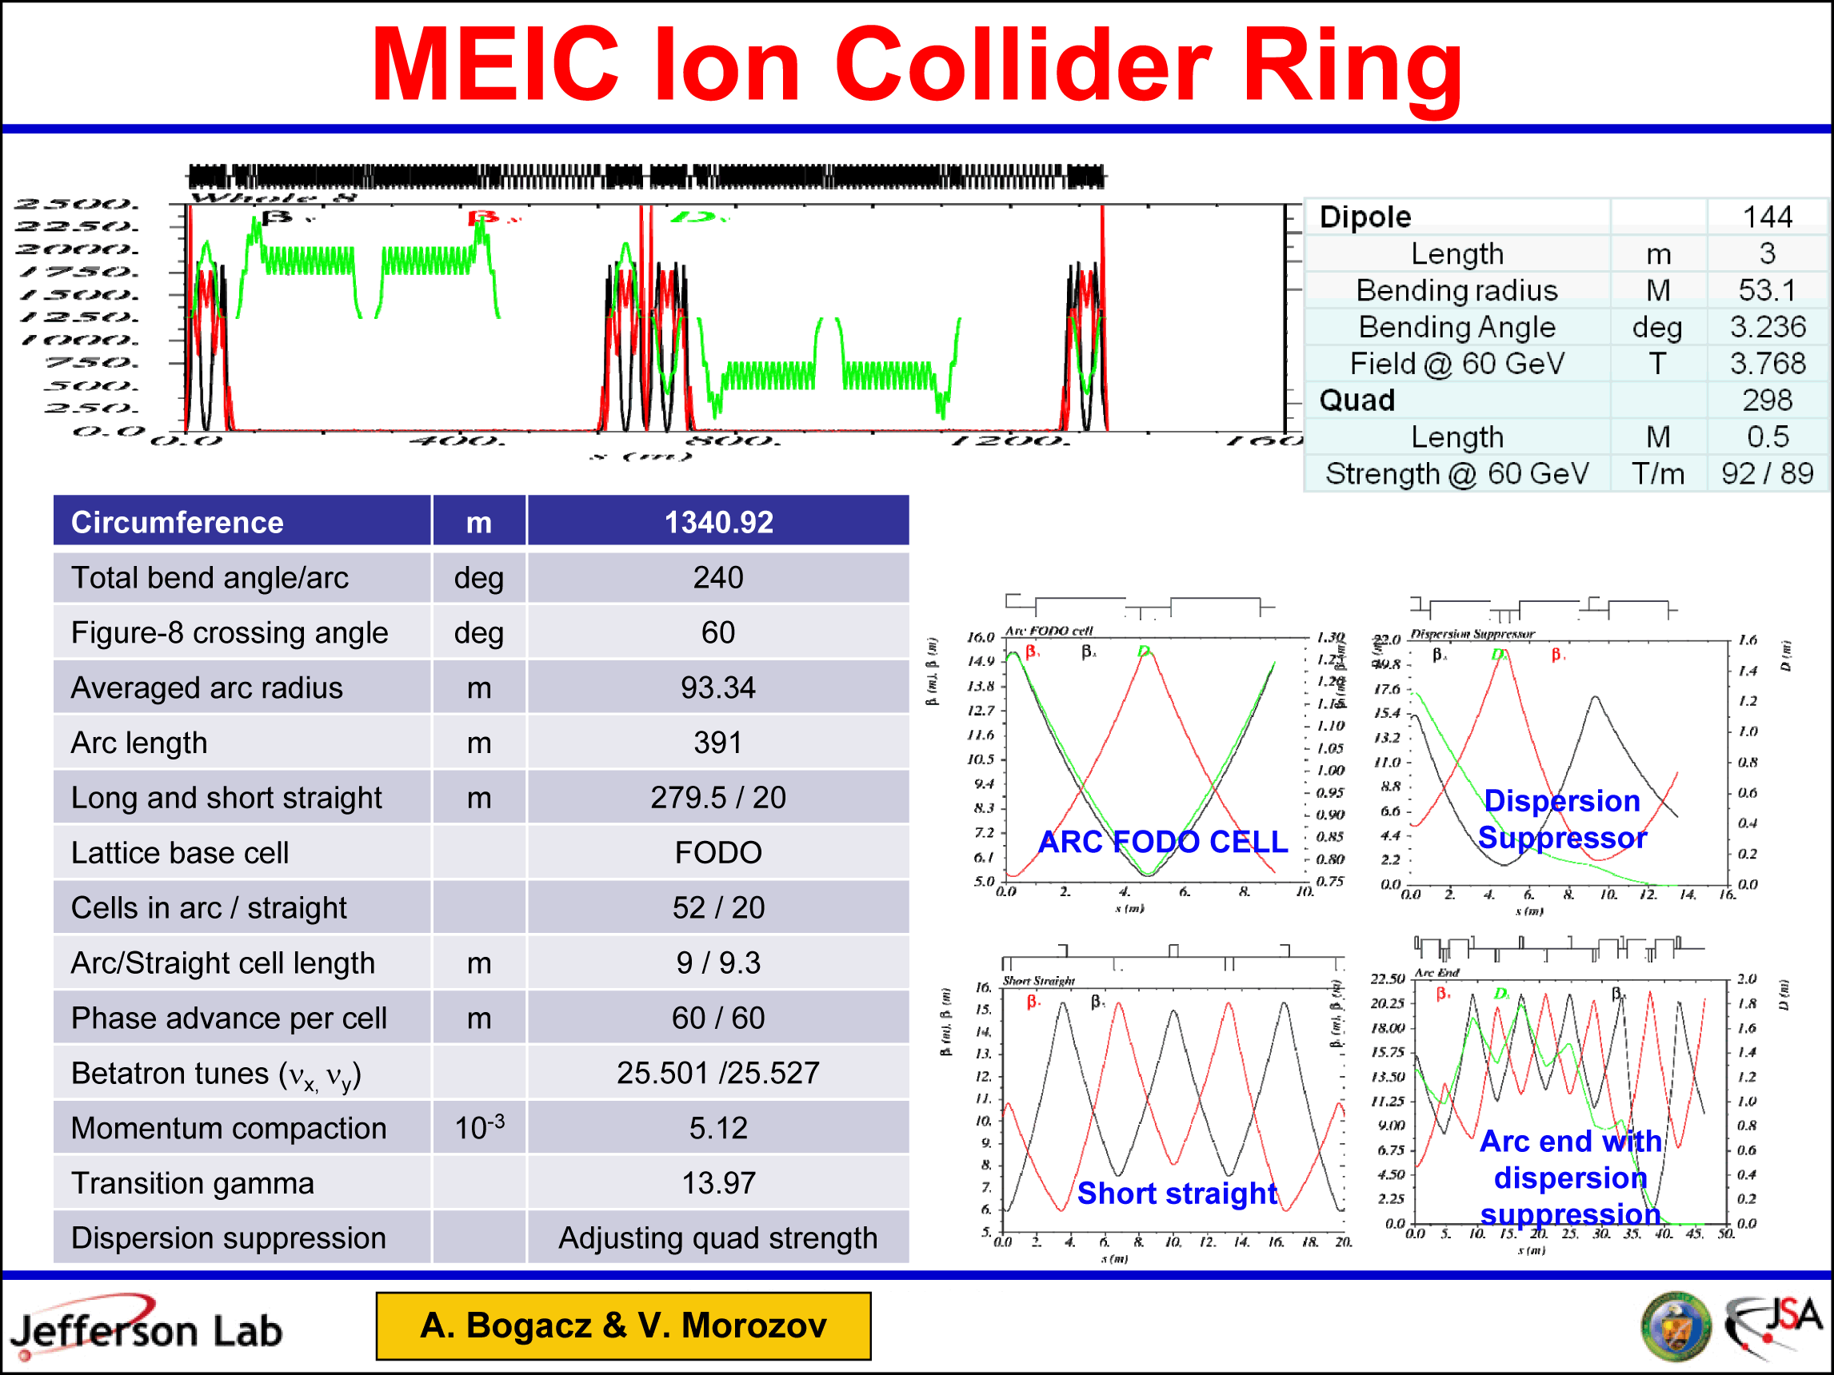
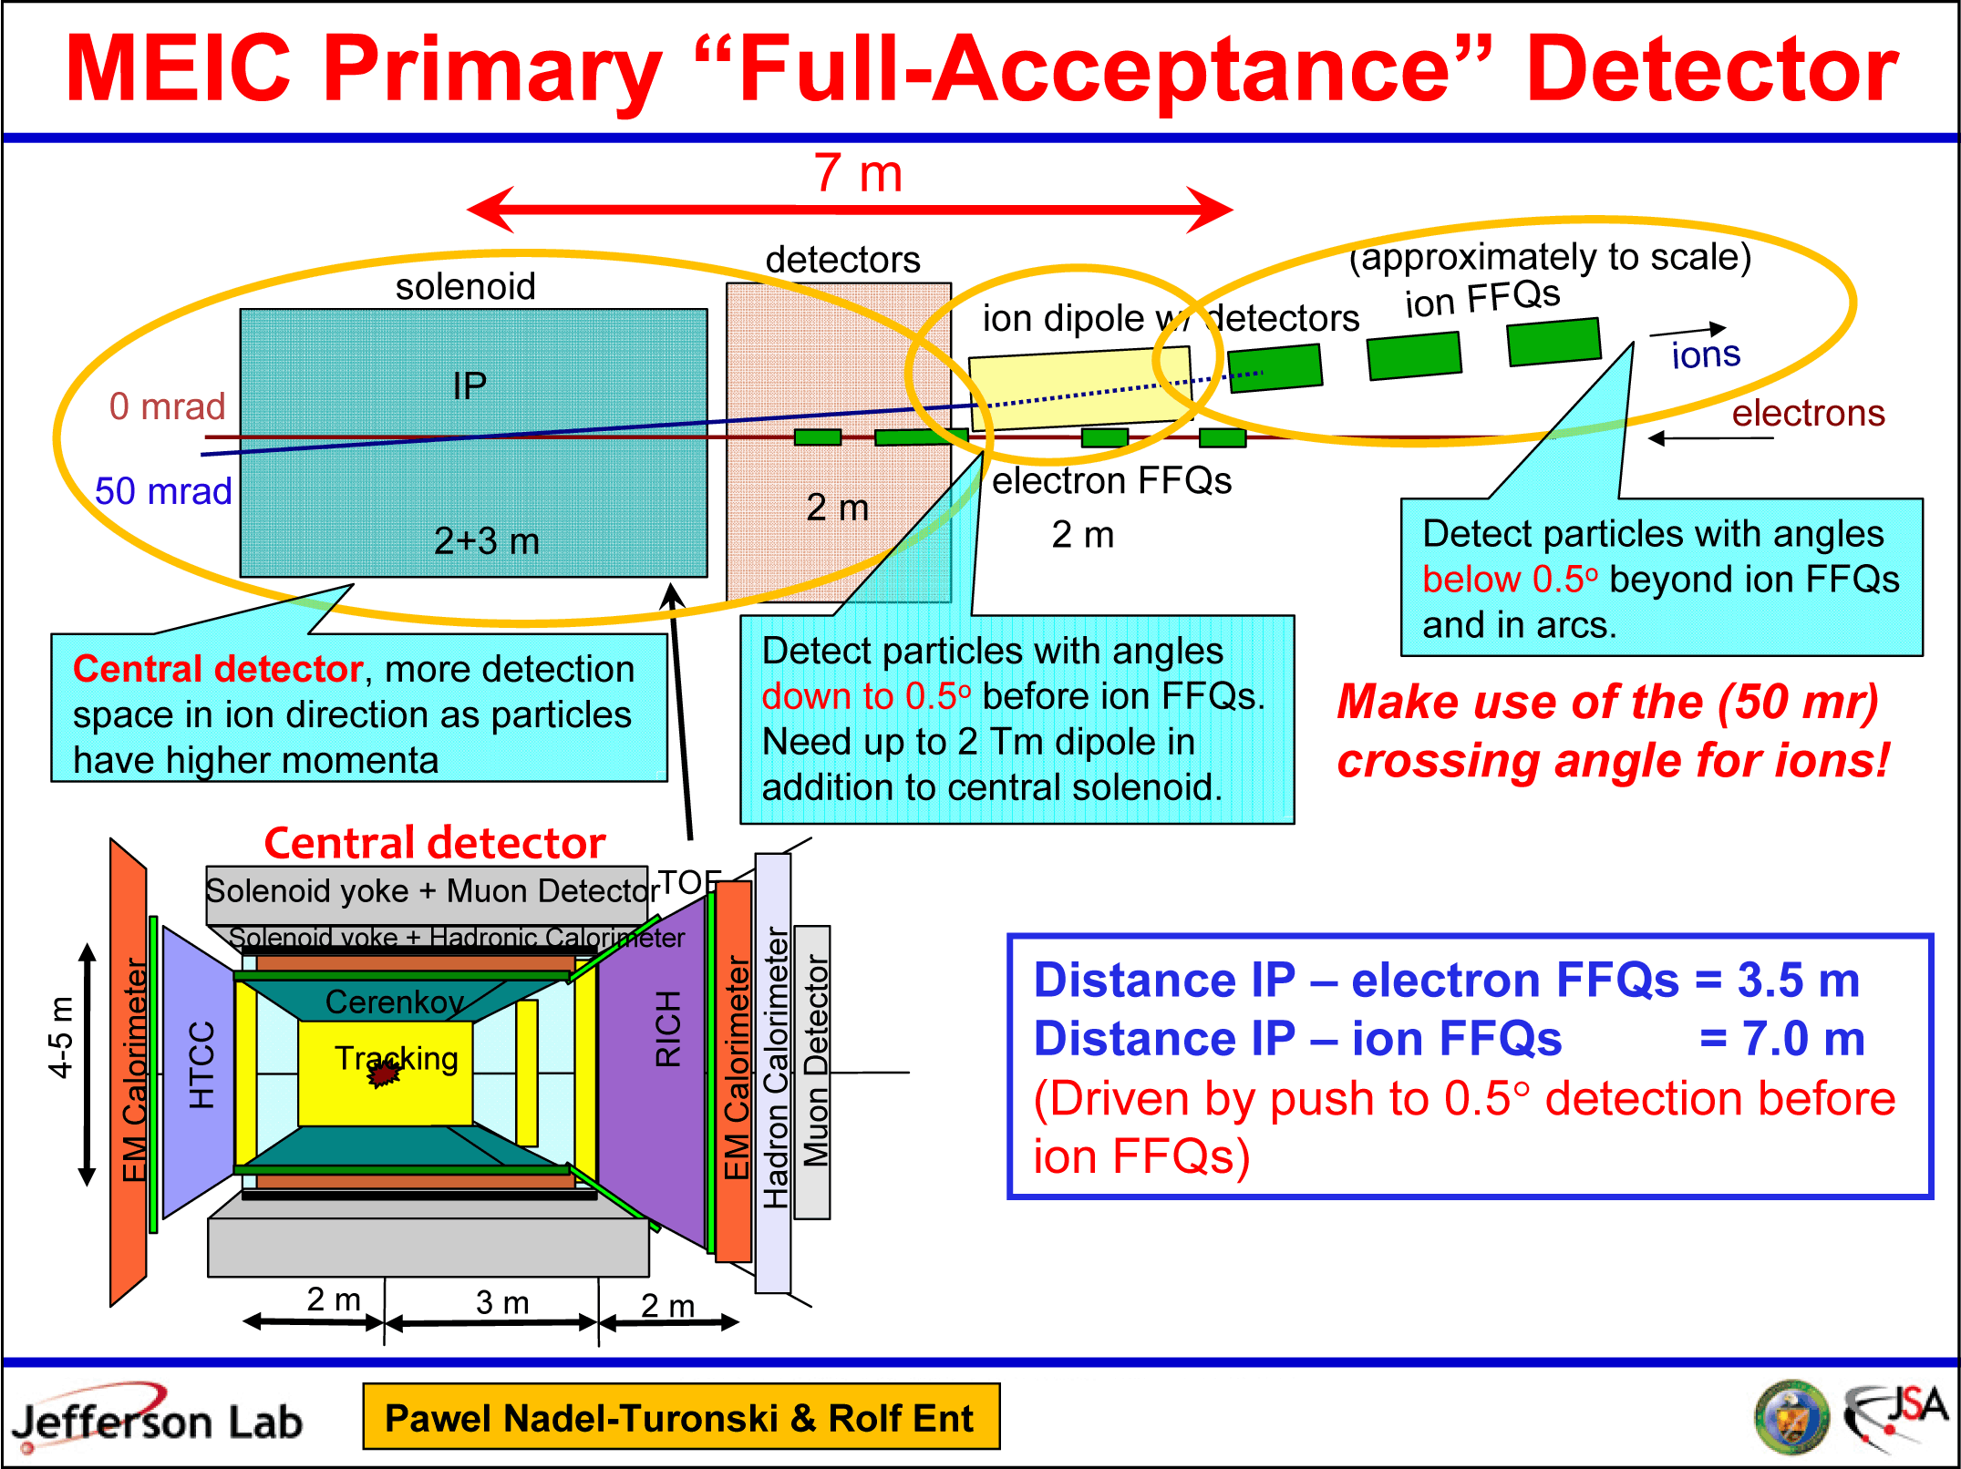
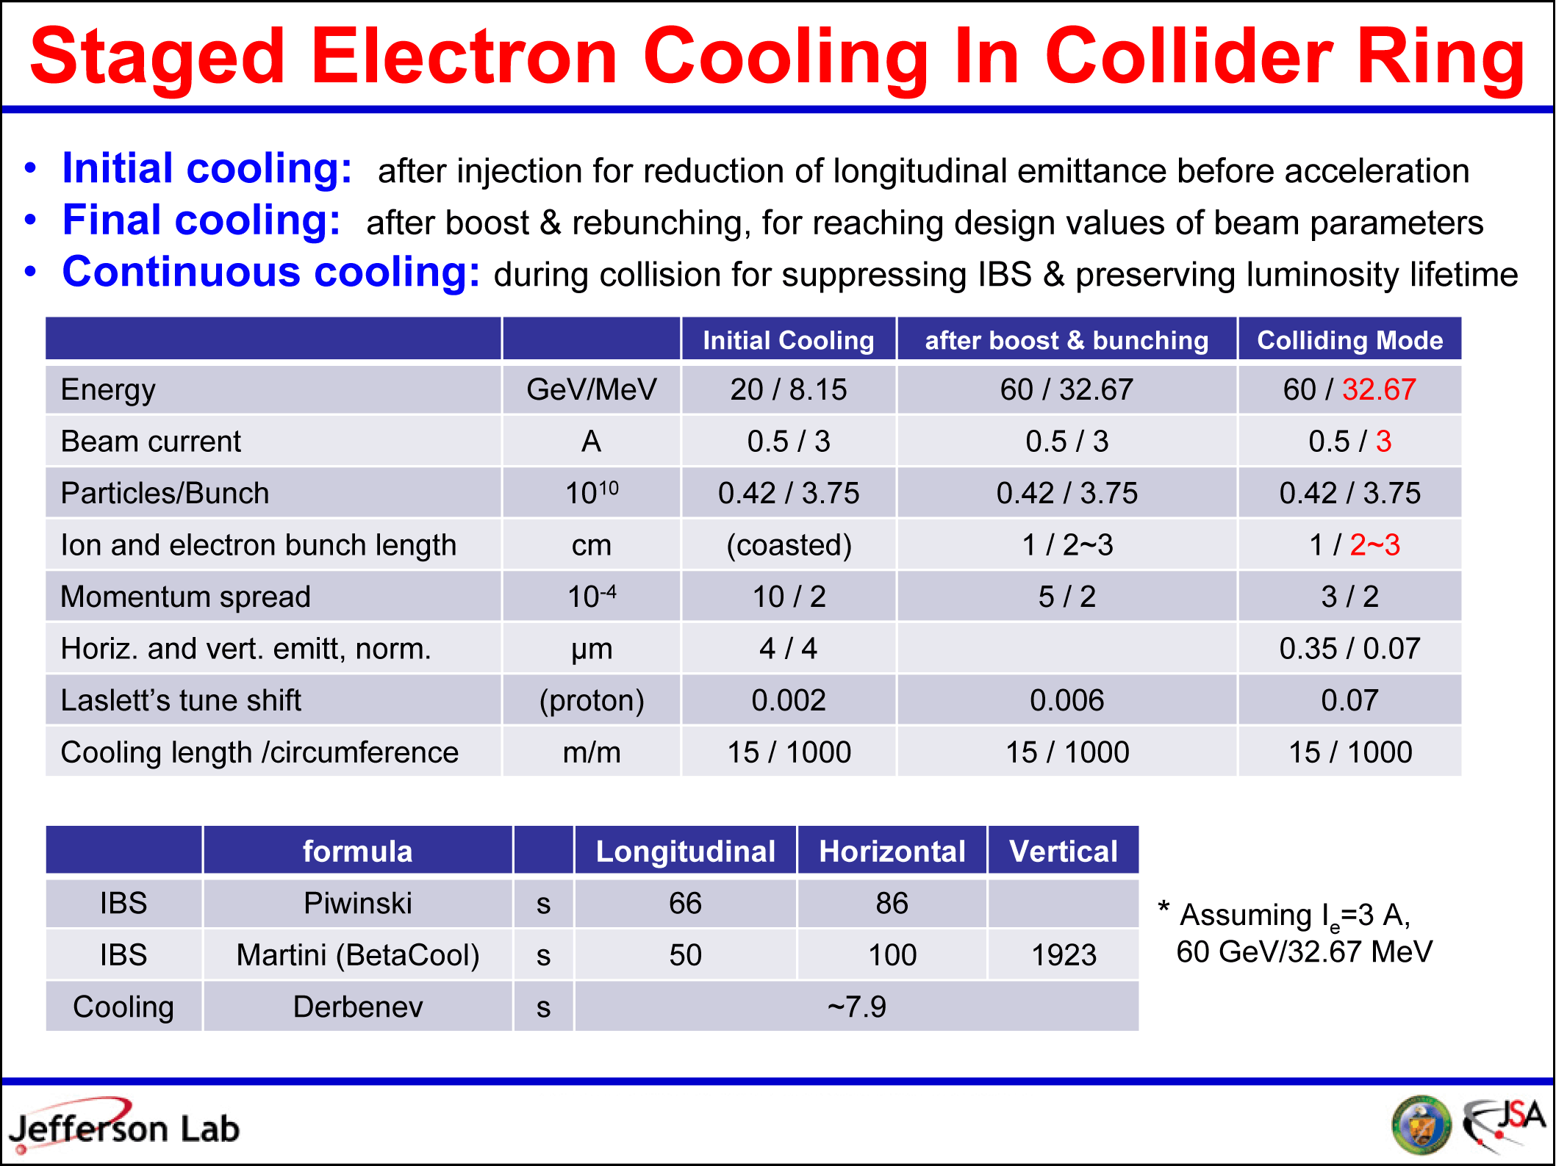
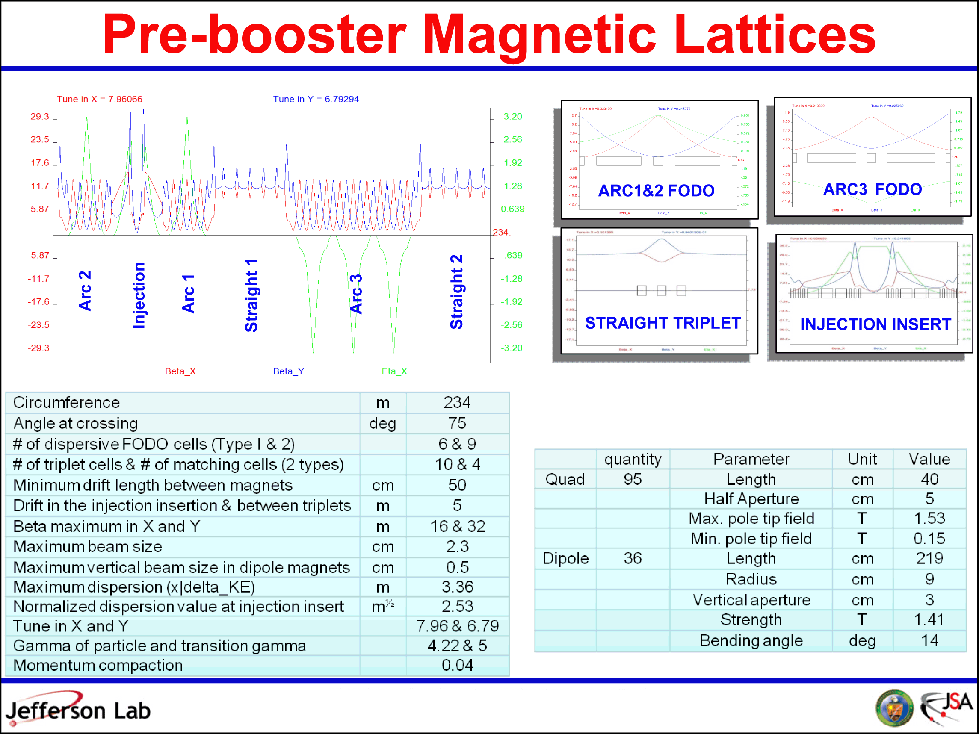
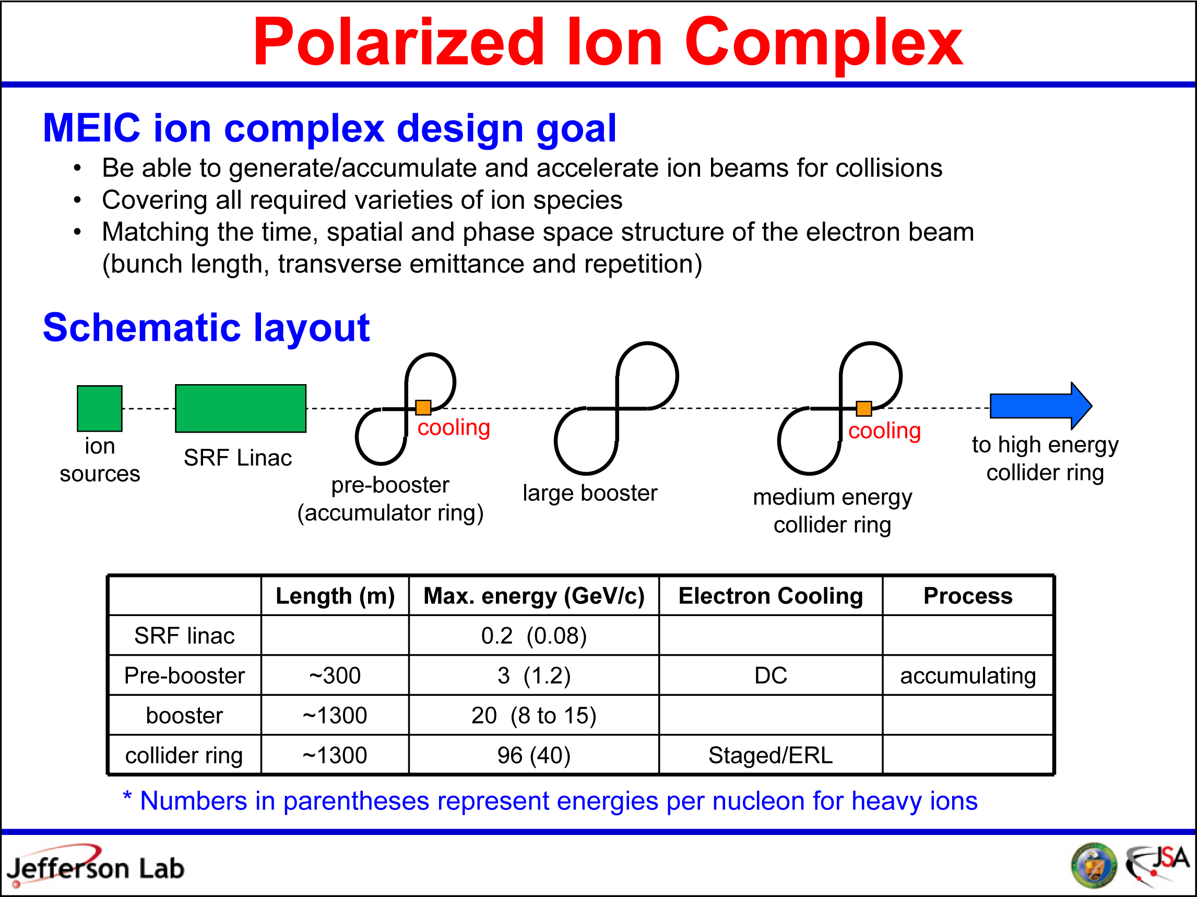
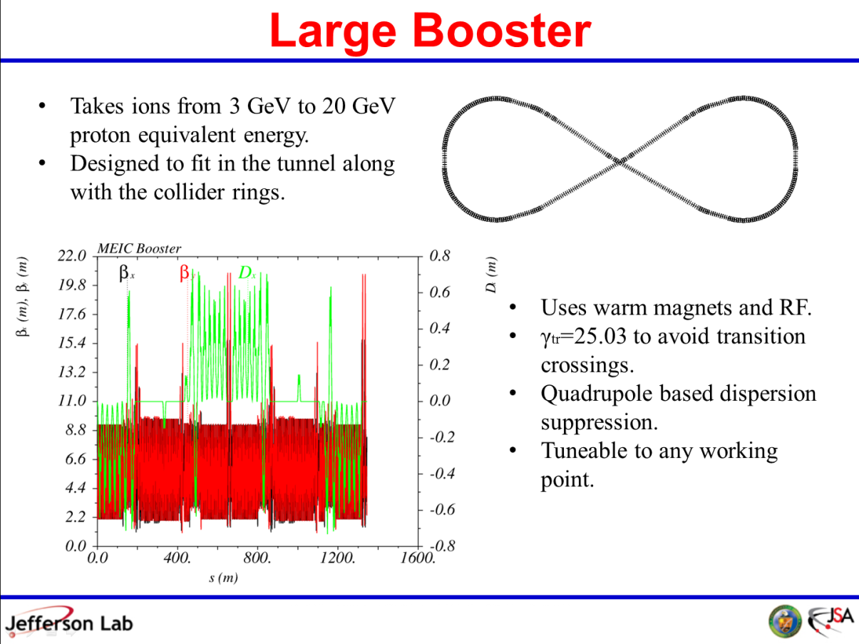
MEIC Design Details
  Our present design is mature, having addressed -- in various degrees of detail -- the following important aspects of MEIC:
  Forming the high-intensity ion beam: SRF linac, pre and large booster
  Electron and ion ring optics
  Detector design
  IR design and optics
  Chromaticity compensation
  Crab crossing
  Synchrotron rad. background
  Ion polarization
  Electron polarization
  Electron cooling
  Beam synchronization
  Beam-beam simulations
  Forming the high-intensity ion beam: SRF linac, pre and large booster
Notes:
11
11

Slide 12
A New Ion Complex
MEIC ion complex design goal
  Be able to generate/accumulate and accelerate ion beams for collisions
  Covering all required varieties of ion species
  Matching the time, spatial and phase space structure of the electron beam
  (bunch length, transverse emittance and repetition
cooling
cooling
to high energy collider ring
ion sources
SRF Linac
pre-booster
(accumulator ring)
barge booster
medium energy collider ring
 | Length (m) | Max. energy (GeV/c) | e-Cooling | Process
SRF linac |  | 0.2 (0.08)
Pre-booster | ~300 | 3 (1.2) | DC | accumulating
booster | ~1350 | 20 (8 to 15)
collider ring | ~1350 | 96 (40) | Staged/ERL
* Numbers in parentheses represent energies per nucleon for heavy ions

Slide 13
MEIC “Full-Acceptance” Detector
7 m
detectors
(approximately to scale)
solenoid
ion FFQs
ion dipole w/ detectors
ions
0 mrad
IP
electrons
50 mrad
2 m
electron FFQs
2+3 m
2 m
Detect particles with angles below 0.5º beyond ion FFQs and in arcs.
Central detector, more detection space in ion direction as particles have higher momenta
Detect particles with angles down to 0.5º before ion FFQs.
Need up to 2 Tm dipole in addition to central solenoid.
Make use of the (50 mr) crossing angle for ions!
Central detector
Solenoid yoke + Muon Detector
TOF
Solenoid yoke + Hadronic Calorimeter
Cerenkov
Distance IP – electron FFQs = 3.5 m Distance IP – ion FFQs = 7.0 m (Driven by push to 0.5° detection before ion FFQs)
RICH
4-5 m
Muon Detector
HTCC
Tracking
EM Calorimeter
EM Calorimeter
Hadron Calorimeter
2 m
3 m
2 m
Pawel Nadel-Turonski & Rolf Ent

Slide 14
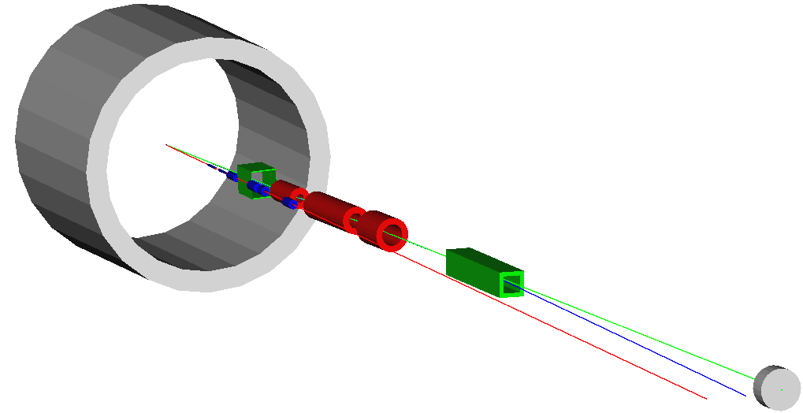
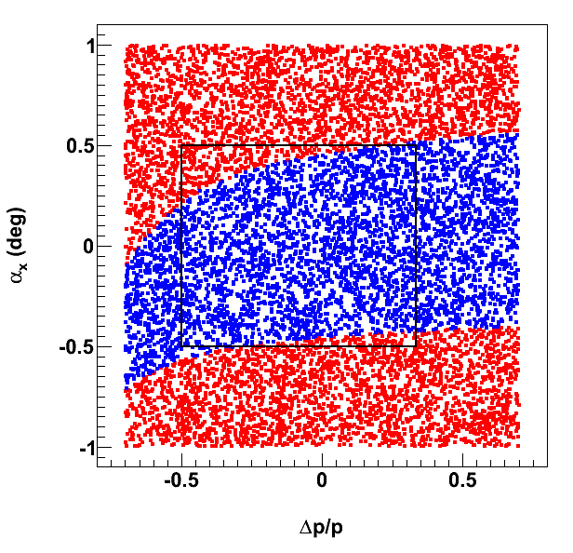
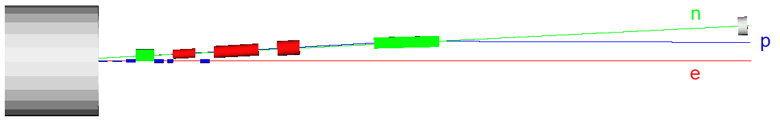
Detector Integration
Large 50 mrad crossing angle: improved detection, fast beam separation
Forward small-angle hadrons pass through large-aperture final focusing quads before detection
Final Focusing Block/spectrometer dipole combo optimized for acceptance and detector resolution
Forward Acceptance (B < 6 T)
GEANT4 / G4beamline model
Charles Hyde, Vasiliy Morozov and Pawel Nadel-Turonski

Slide 15
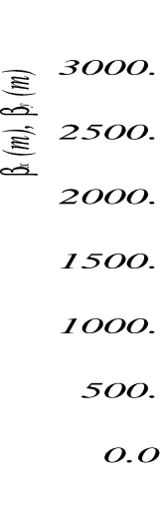
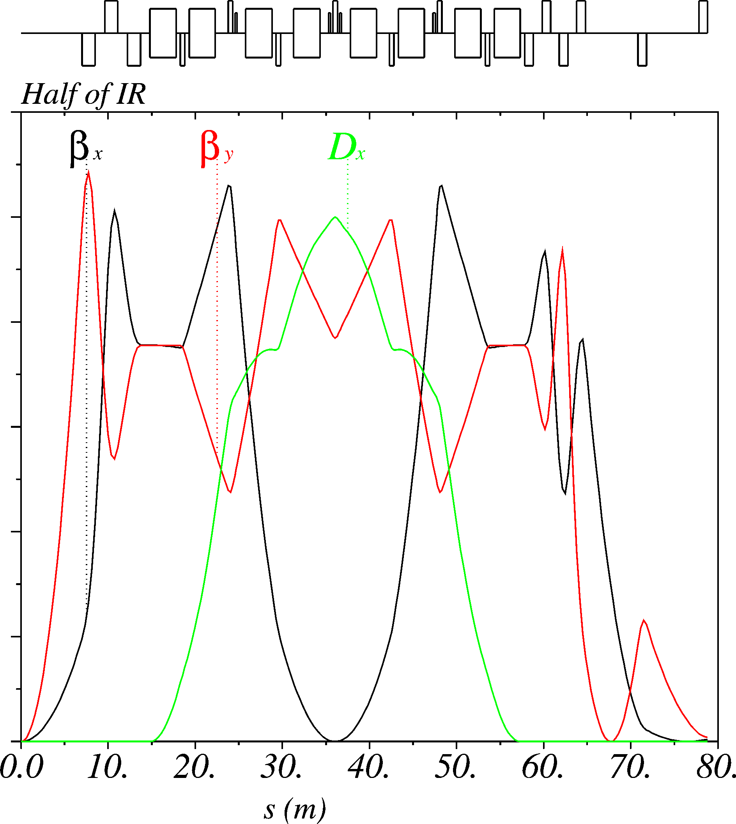
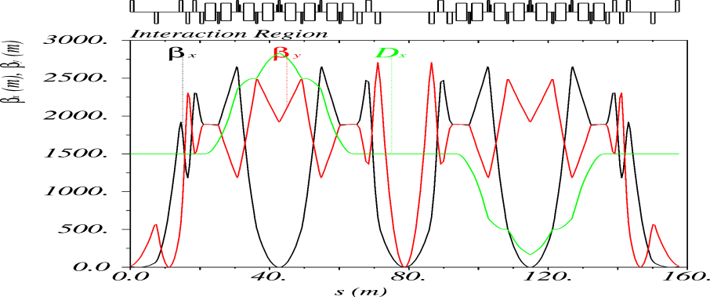
Interaction Region: Ions
Final Focusing Block (FFB)
Chromaticity Compensation Block (CCB)
Beam Extension Section
7 m
β_{y}^{max} ~ 2700 m
β_{x}* = 10 cm
β_{y}* = 2 cm
Distance from the IP to the first FF quad = 7 m
Maximum quad pole tip field at 100 GeV/c = 6T
  Allows ±0.5° forward detection
  Evaluating detailed detector integrationand positions of collimators
Symmetric CCB design for efficient chromatic correction
Whole Interaction Region: 158 m

Slide 16
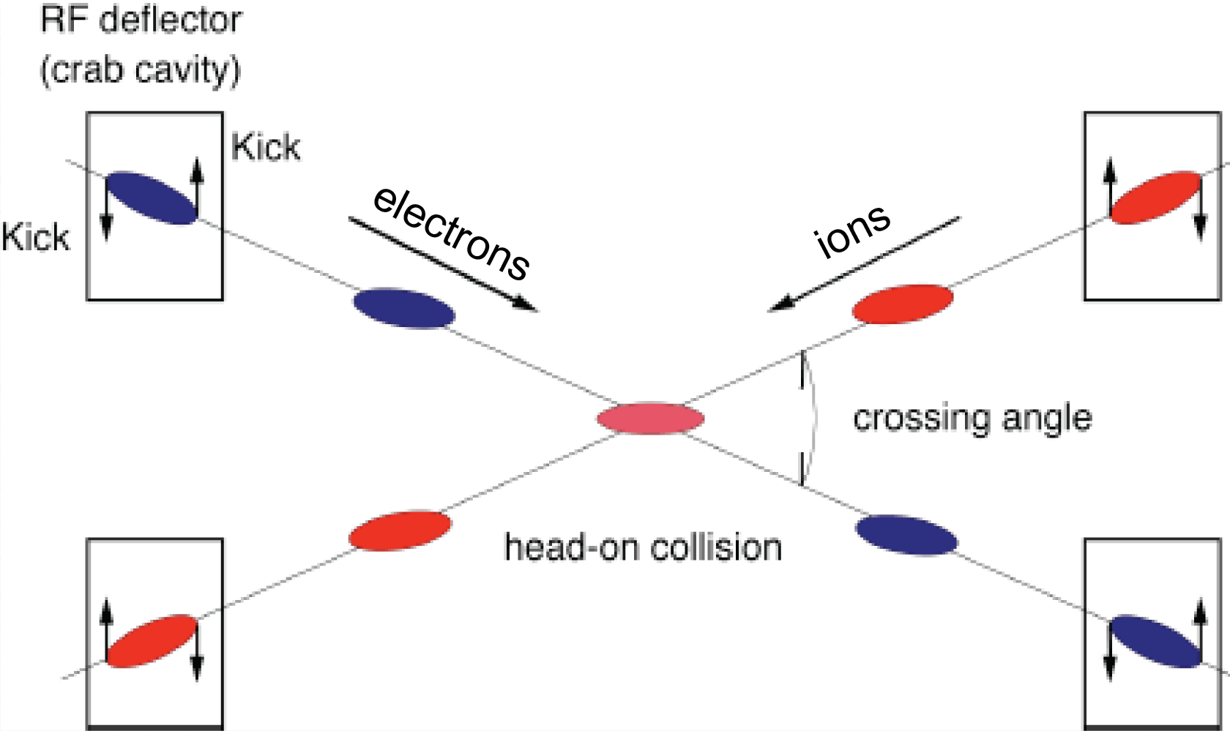
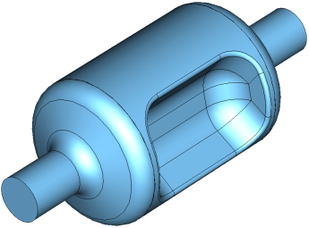
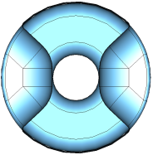
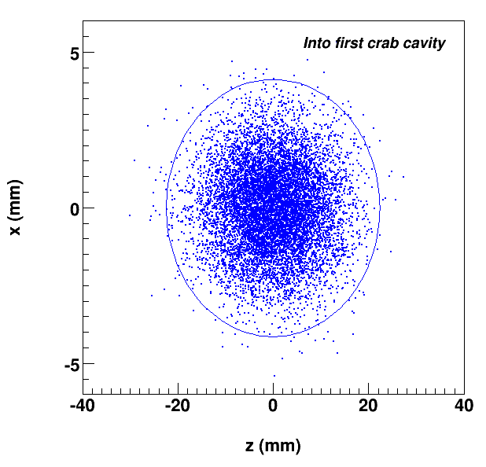
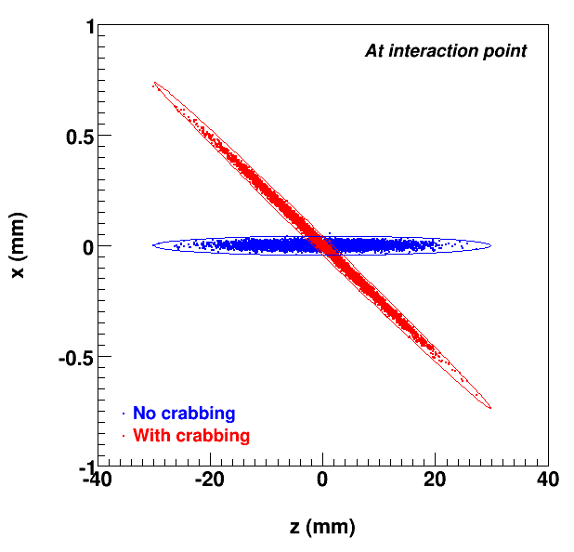
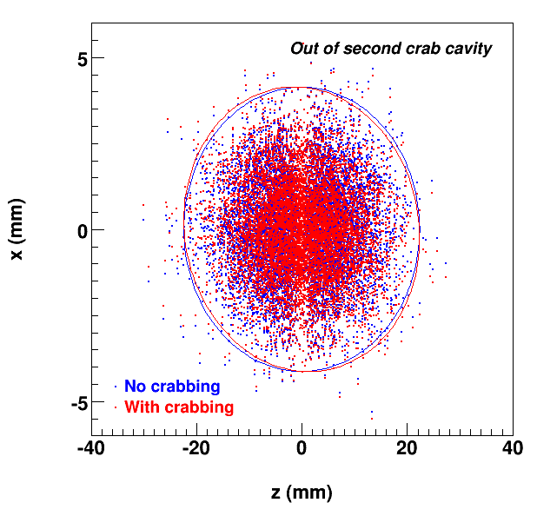
Crab Crossing
Restore effective head-on bunch collisions with 50 mrad crossing angle ⇒ Preserve luminosity
Dispersive crabbing (regular accelerating / bunching cavities in dispersive region) vs.
Deflection crabbing (novel TEM-type SRF cavity at ODU/JLab, very promising!)
Incoming
At IP
Outgoing
Notes:
16

Slide 17
Electron Cooler
Conventional electron cooling
Staged electron cooling scheme
ERL based to relax power and cathode requirements
solenoid
Cooling at Figure-8 crossing
ion bunch
electron bunch
20 m
Solenoid (15 m)
Cooling section
injector
Fast kicker
SRF
Fast kicker
circulator ring
energy recovery
dump
injector
dump
Eliminating a long return path could
cut cooling time by half, or
reduce the cooling electron current by half, or
reduce the number of revolutions by half
SRF Linac
Electron bunches circulates 100+ times, leads to a factor of 100+ reduction of current from a photo-injector/ERL
Notes:
17

Slide 18
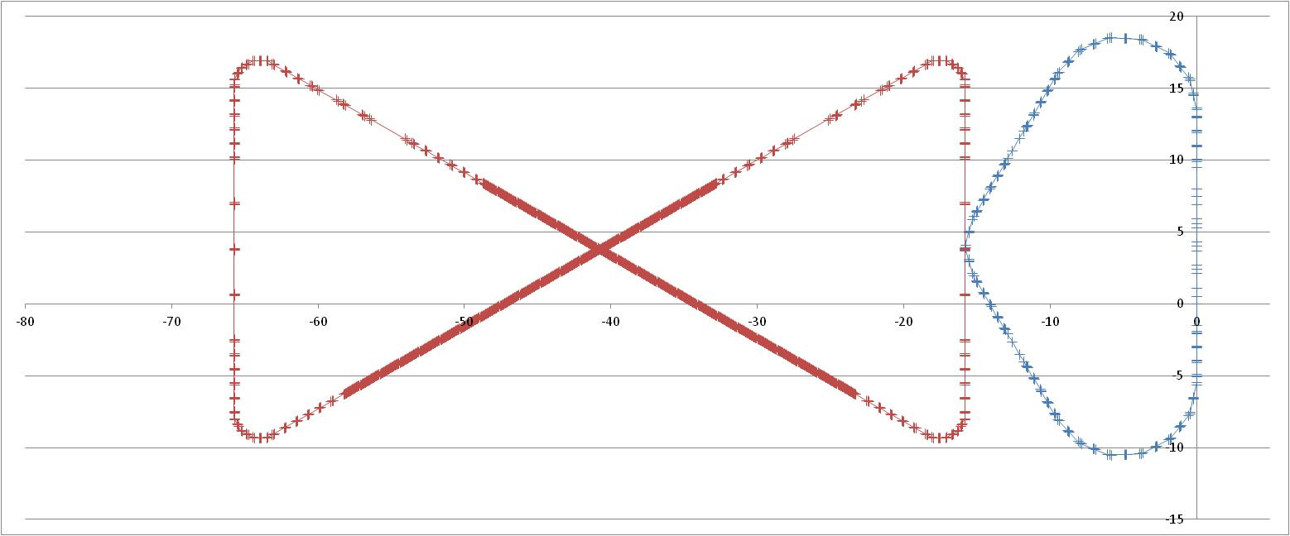
The First Design of MEIC ERL Circulator Cooler
recirculation/decompression
CCR
dechirper
dump
cooling solenoids
beam exchange system
ERL
rechirper
injector
recovery/recompression

Slide 19
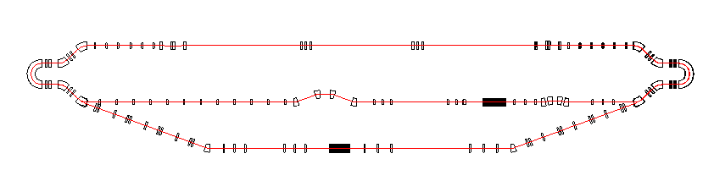
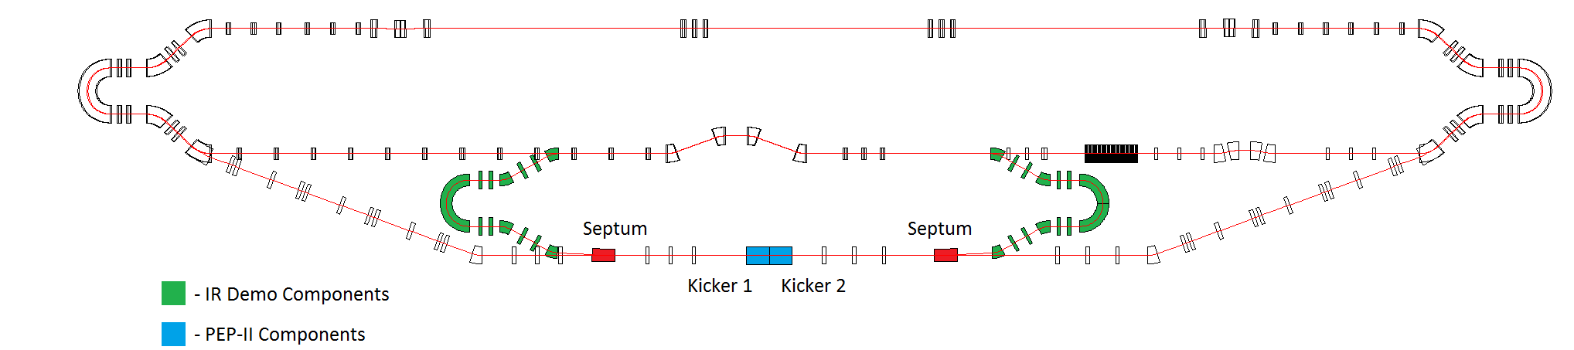
Cooling Test Facility
Jefferson Lab Free Electron Laser Facility
Test of Recovered Energy Circulation System
Determine lifetime of a bunch in the circulator ring.
Examine feasability of magnetized electron gun.
Test fast kickers, currently under development.
Beam dynamics of an ERL with recirculation.

Slide 20
Summary
Close and frequent collaboration with our nuclear physics colleagues regarding the machine, interaction region and detector requirements have taken place. This has led to agreed-upon baseline parameters:
  Energy range: 3 to 11 GeV electrons, 20 to 100 GeV protons
  Luminosity around 10³⁴ cm⁻² s⁻¹ (e-nucleon) per interaction point
  Longitudinally polarized (~80%) electrons, longitudinally or transversely polarized (>70%) protons and deuterons
Ring layouts for MEIC have been developed, which include two interaction regions, one full acceptance, one high luminosity.
Chromatic compensation for the baseline parameters has been achieved in the design. Significant progress has been made with determining and optimizing the dynamic aperture.
Designs for staged Electron cooling have been developed and will be tested using the Jefferson Lab FEL.

Slide 21
JLab EIC Study Group
A. Accardi, S. Ahmed, A. Bogacz, P. Chevtsov, Ya. Derbenev, D. Douglas, R. Ent, V. Guzey, T. Horn, A. Hutton, C. Hyde, G. Krafft, R. Li, F. Lin, F. Marhauser, R. McKeown ,V. Morozov, P. Nadel-Turonski, E. Nissen, F. Pilat, A. Prokudin, R. Rimmer, T. Satogata, M. Spata, C. Tennat, B. Terzić, H. Wang, C. Weiss, B. Yunn, Y. Zhang --- Thomas Jefferson National Accelerator Facility
J. Delayen, S. DeSilva, H. Sayed, -- Old Dominion University
M. Sullivan, -- Stanford Linear Accelerator Laboratory
S. Manikonda, P. Ostroumov, -- Argonne National Laboratory
S. Abeyratne, B. Erdelyi, -- Northern Illinois University
V. Dudnikov, R. Johnson, -- Muons, Inc
A. Kondratenko, -- STL “Zaryad”, Novosibirsk, Russian Federation
Y. Kim -- Idaho State University

Slide 22
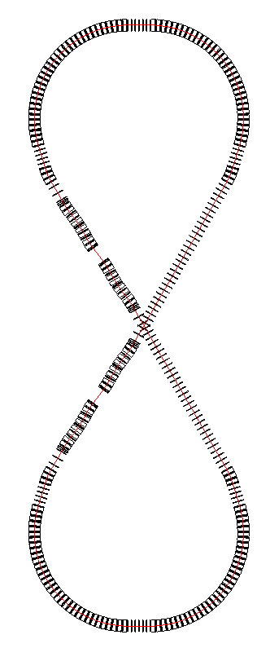
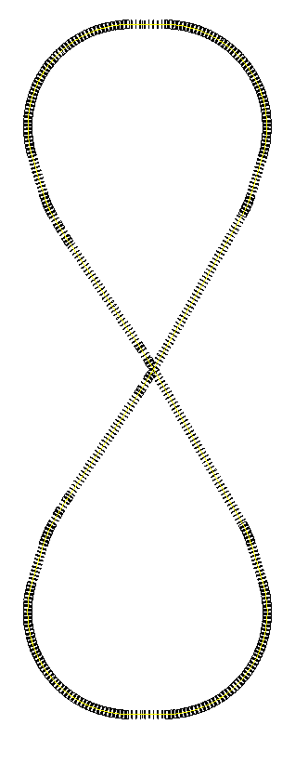
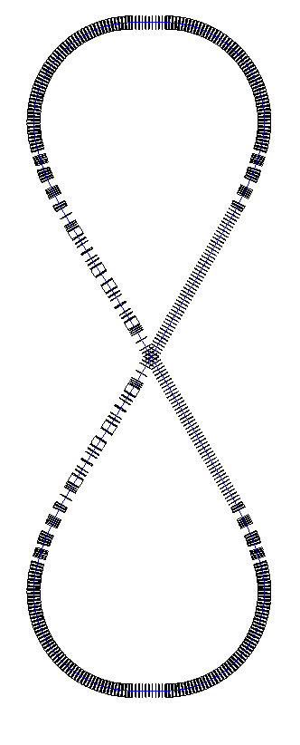
MEIC Layout
Interaction point locations:
Downstream ends of the electron straight sections to reduce synchrotron radiation background
Upstream ends of the ion straight sections to reduce residual gas scattering background
Ion path
Interaction Regions
Warm large booster
(up to 20 GeV/c)
Prebooster
Ion
source
Electron path
Ion transfer beam line
SRF linac
Cold 97 GeV/c proton collider ring
Three Figure-8
rings stacked vertically
Large Ion Booster
Electron ring
Electron Collider
Ion Collider
Medium energy IP with
horizontal crab crossing
Injector
12 GeV CEBAF
Vertical stacking for identical ring circumferences
Horizontal crab crossing at IPs
Ion beams execute vertical excursion to the plane of the electron orbit for enabling a horizontal crossing
Ring circumference: 1340 m
Maximum ring separation: 4 m
Figure-8 crossing angle: 60 deg.

Slide 23
MEIC Electron Ring Footprint
Universal
Spin Rotator
(8.8°/4.4°, 50 m)
1/4 Electron Arc (106.8°, 140 m)
IR (125 m)
IR (125 m)
Universal
Spin Rotator (8.8°/4.4°, 50 m)
Experimental Hall (radius 15 m)
RF (25 m)
Universal
Spin Rotator (8.8°/4.4°, 50 m)
Figure-8 Crossing Angle: 2x30°
Compton Polarimeter (28 m)
1/4 Electron Arc (106.8°, 140 m)
3rd IR (125 m)
Injection from CEBAF
Universal
Spin Rotator (8.8°/4.4°, 50 m)
 | m
Quarter arc | 140
Universal spin rotator | 50
IR insertion | 125
Figure-8 straight | 140 x 2
RF short straight | 25
Circumference | ~ 1300
Ring design is a balance between
  Synchrotron radiation ➔ prefers a large ring (arc) length
  Ion space charge ➔ prefers a small ring circumference
Multiple IPs require long straight sections
Straights also hold required service components (cooling, injection and ejection, etc.)

