Slide 1
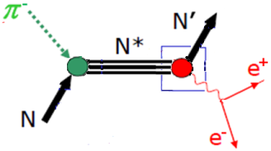
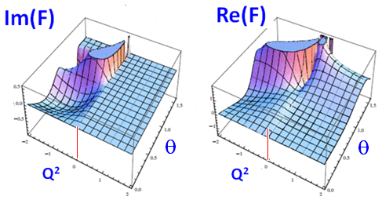
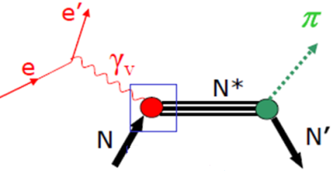
Inverse Pion Electroproduction (IPE)
• IPE is the only process which allows the determination of EM nucleon & pion
formfactors in the intervals
0 < k² < 4 M² = 3.53 GeV² 0 < k² < 4 m_{π} = 0.08 GeV²
which are kinematically unattainable from e⁺e⁻ initial states.
JLab EIC
CLAS
• IPE π⁻p→e⁺e⁻n measurements will significantly complement the current
electroproduction γ*N→πN study for the evolution of baryon properties
with increasing momentum transfer by investigation of the case for the
time-like virtual photon.
Forum for MAX-IV Ring, Lund, Nov 2011
Physics with Secondary Hadron Beams, Ashburn, VA, April 2012

