Slide 1
How we can improve nuclear fission data for applications and fundamental physics
Alexander Laptev
Los Alamos Neutron Science Center (LANSCE)
Neutron & Nuclear Science
Physics with Secondary Hadron Beams in 21st Century
The GWU Virginia Science and Technology Campus
Ashburn, Virginia, April 7, 2012

Slide 2
Why neutrons?
High demand from nuclear industry for good quality data, first of all neutron-induced reaction cross sections for actinides and sub-actinides
Development of new advanced nuclear reactors
Decreasing nuclear data uncertainties will decrease nuclear reactor construction safety margins incorporated into reactor’s design
Industry keeps developing: in Dec. 2011 NRC approved first nuclear power plant license since 1978 for the power plant expansion in Georgia
Public pressure is as high as ever

Slide 3
Why neutrons (cntd)?
Defense physics needs
Accelerator-based conversion of weapon’s grade plutonium
Transmutation of nuclear waste, especially actinides
Yucca Mountain nuclear waste repository doesn’t accept new waste effective in 2011
Basic understanding of fission process, fundamental physics, etc.

Slide 4



Why a pulsed neutron source?
The most accurate and effective method to measure neutron energy is the time-of-flight method
Cartoon idea is from the KENS web-page

Slide 5
What is the energy range of interest?
Fission Cross Section and Fluxes
Neutron flux shapes folded with cross sections determine
the region of interest (both energy and isotopes)
The magnitude of the neutron flux drives cross section uncertainty requirements

Slide 6
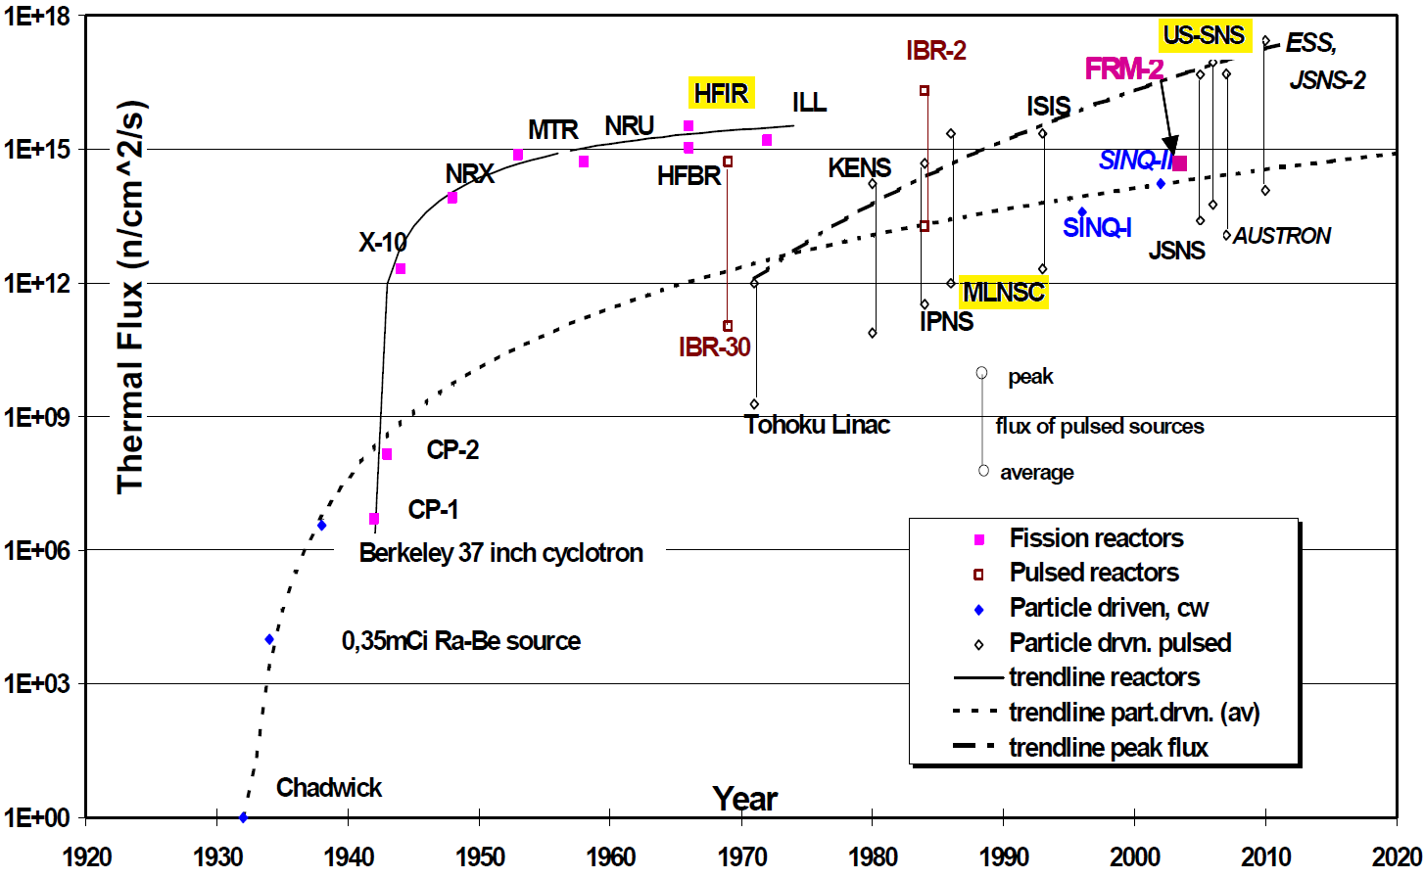
History of neutron source development
Highlighted are active facilities in the US
IAEA-TECDOC-1439, 2005

Slide 7
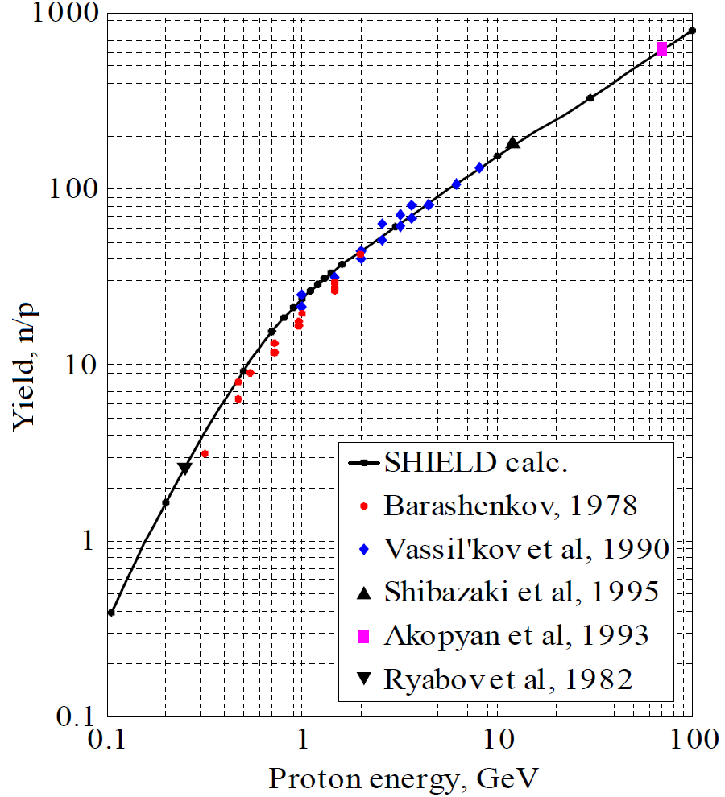
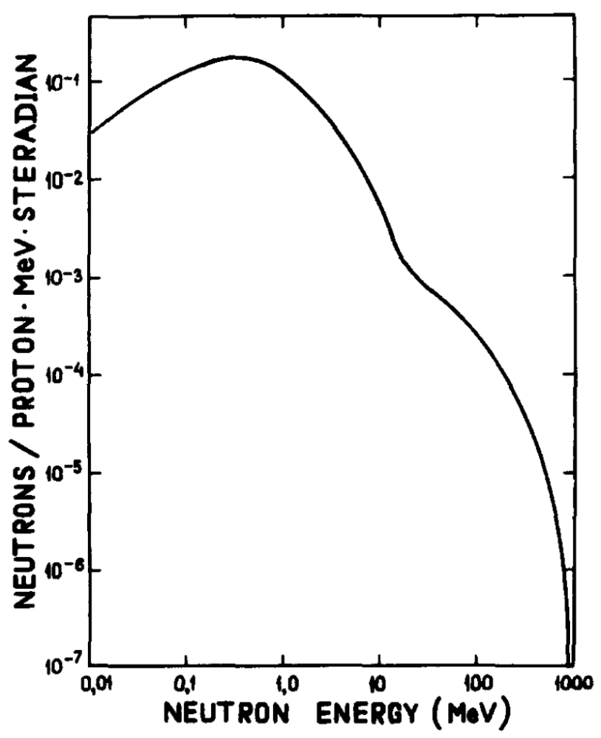
Spallation sources: n/p yield and neutron energies
(thick Pb target)
E_{p} = 800 MeV
Two components:
- The cascade component up to the energy of the incident protons
- The evaporation component which is dominant up to ~20 MeV
NIM A 374 (1996) 70
Preprint INR RAS 1280, 2011
Report LA-4789, 1972
NIM A 242 (1985) 121

Slide 8
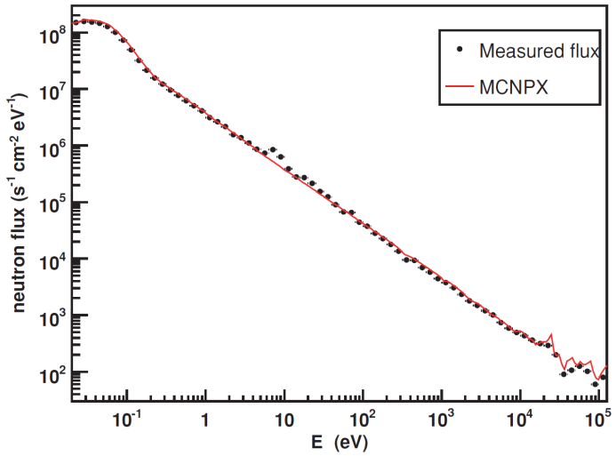
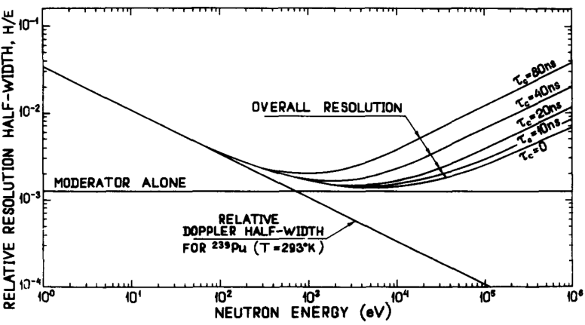
Moderated neutron sources
Enrich neutron flux with epithermal neutrons
Neutron flux of moderated source, LANSCE
High content hydrogen material is used for effective neutron moderation, e.g. polyethylene, water, etc.
Varying of moderator thickness one can change the ratio of faster/slower neutrons
PR C 79, 014613 (2009)
Time resolution of moderated source, GNEIS
Very specific moderator – liquid hydrogen – provides cold and ultra cold neutrons. This is a very unique field of neutron physics
Details about this field are in the following report of S.Dewey
NIM A 242 (1985) 121

Slide 9
What facilities are available for fast neutrons?
Handbook of Nuclear Engineering, Springer, 2010
NIM A 242(1985)121

Slide 10
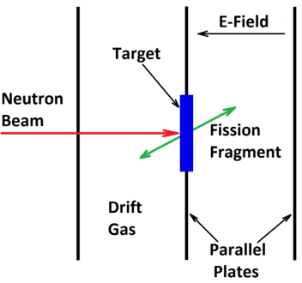
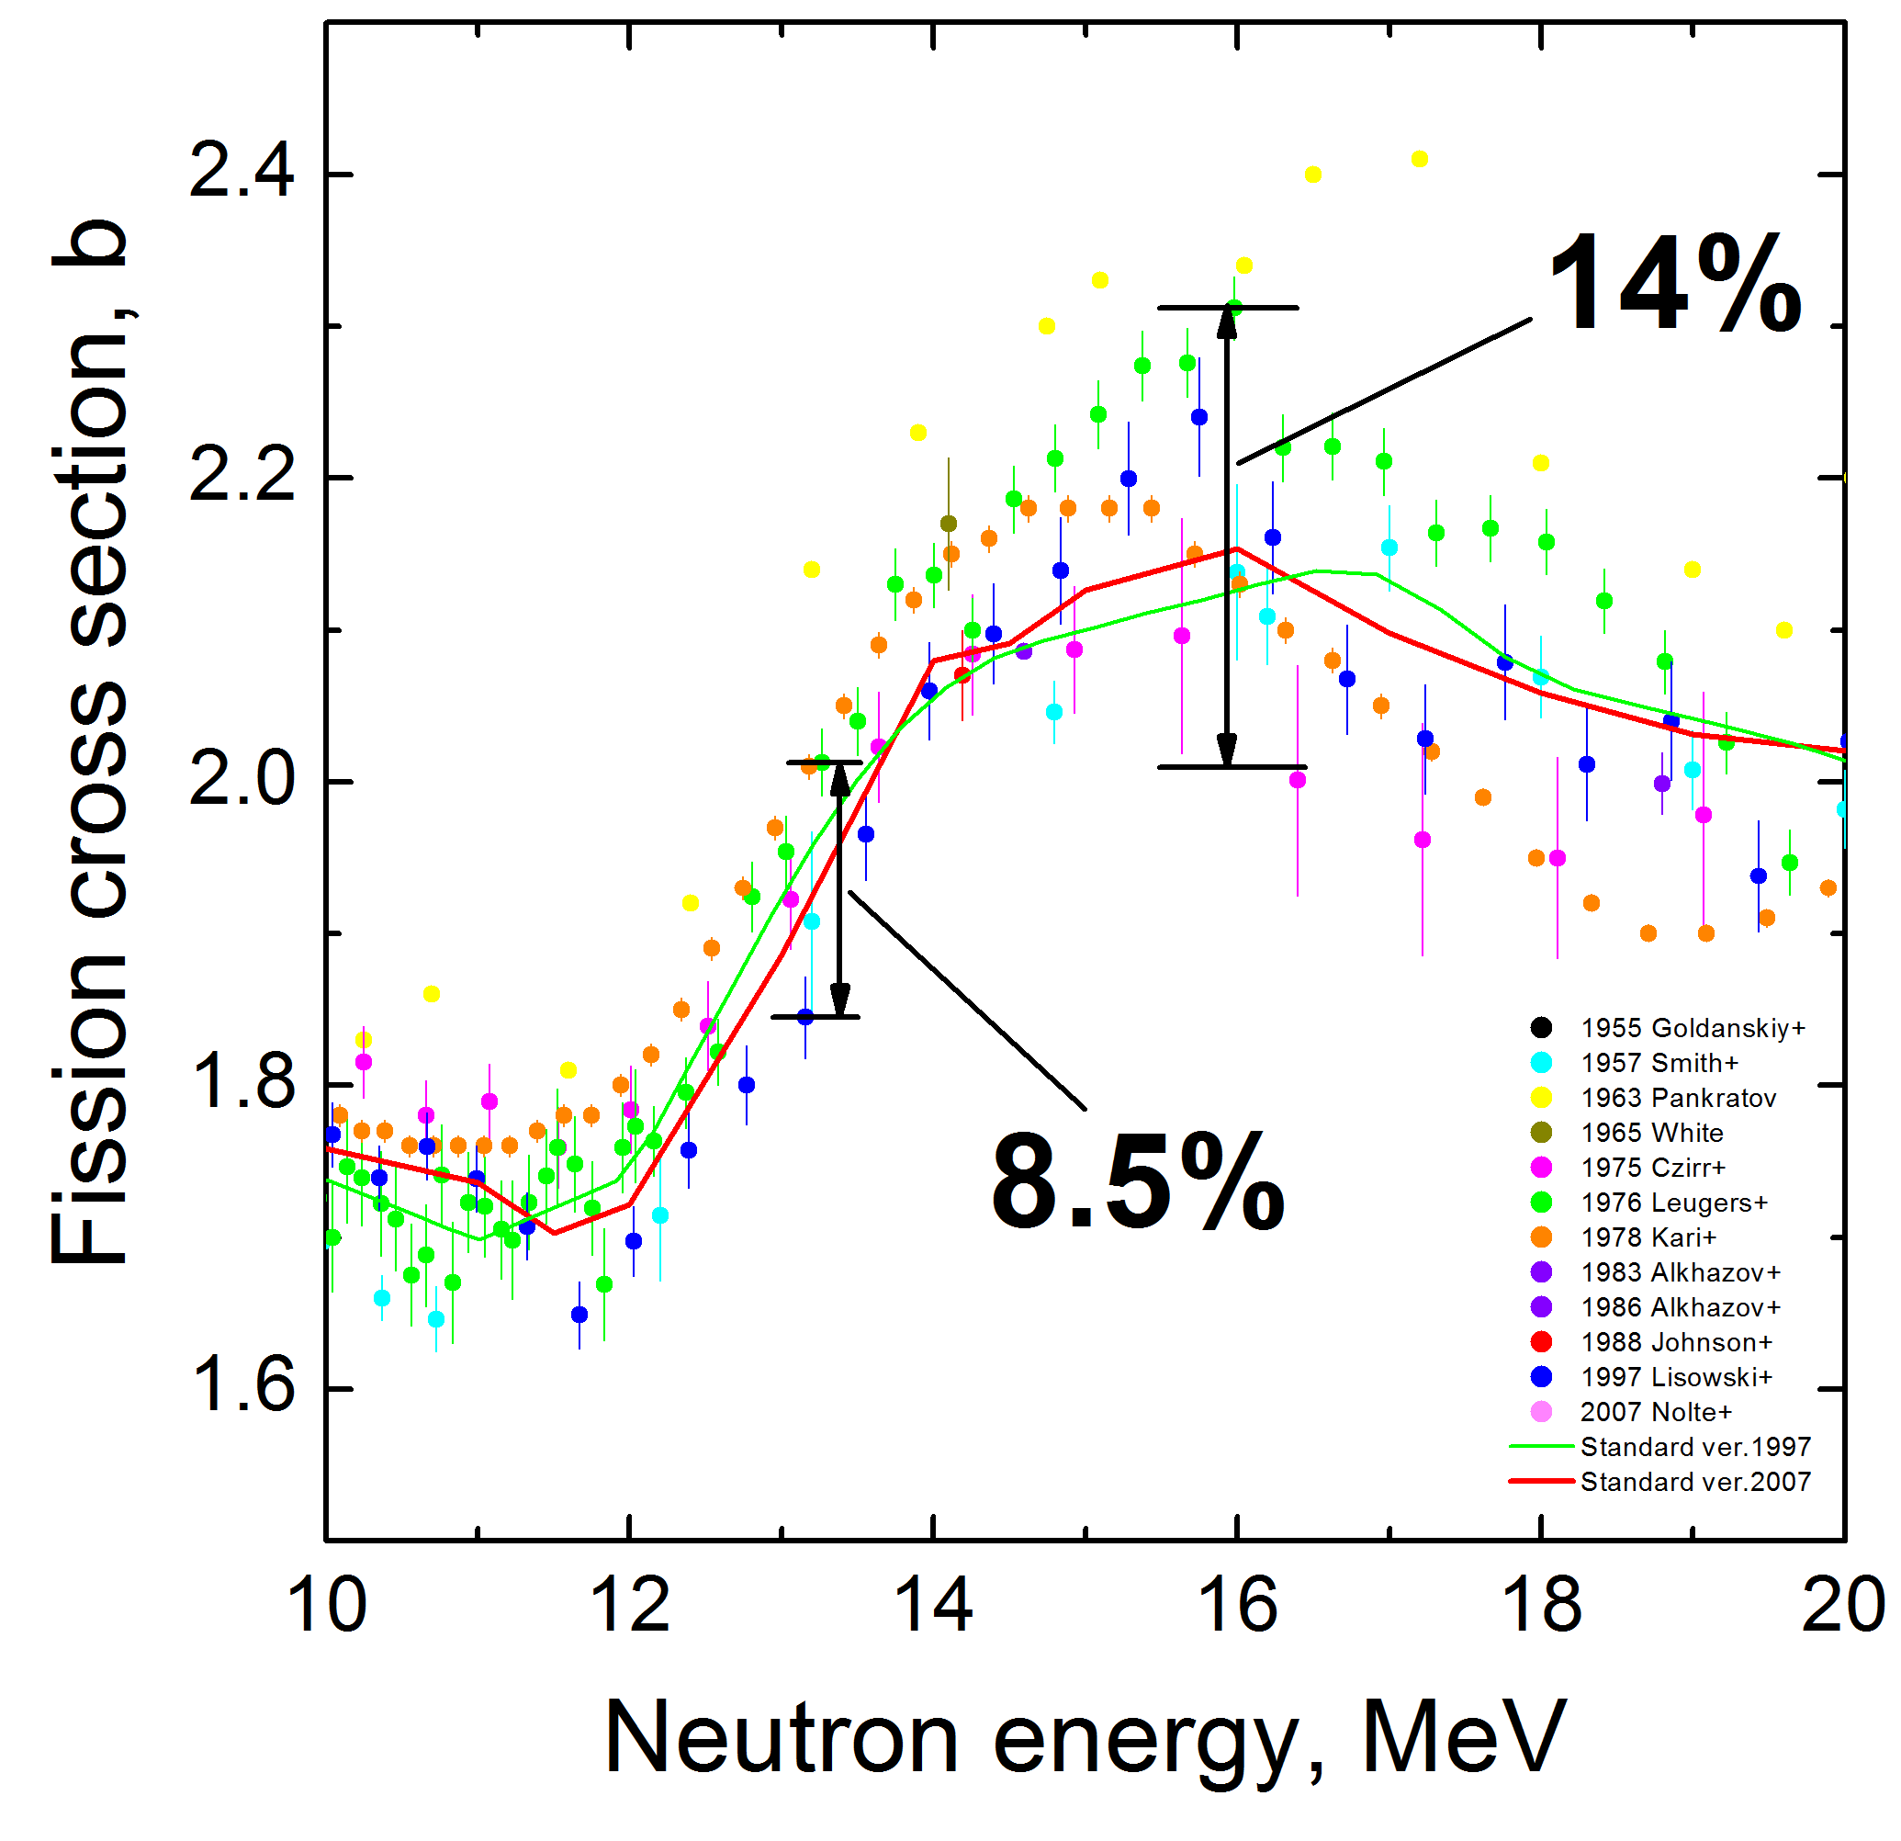
Existing ²³⁵U(n,f) XS data for fast neutrons
The most popular detector is a parallel-plate fission ionization chamber (FIC)

Slide 11
Existing ²³⁹Pu(n,f) XS data for fast neutrons
Ref.:
LANL(88): Lisowski et al., ND-1988(1988)97
LANL(98): Staples et al., Nucl.Sci.Eng. 129(1998)149
PNPI(02): Shcherbakov et al., J.Nucl.Sci.Tech. S2(2002)230
LANL(10): Tovesson et al., Nucl.Sci.Eng. 165(2010)224

Slide 12
Existing ²³⁸U(n,f) XS data for fast neutrons
Data were taken using FIC as a ration to ²³⁵U (LANL and PNPI)
Data of Nolte were obtained relative to
np-scattering
Ref.:
Lisowski: Lisowski et al., ND-1991(1992)732
Shcherbakov: Shcherbakov et al., J.Nucl.Sci.Tech. S2(2002)230
Nolte: Nolte et al., Nucl.Sci.Eng. 156(2007)197

Slide 13
Existing data for fast neutron-induced fission of some minor actinides
From the NEA Nuclear Data High Priority Request List for fission cross section of minor actinides
Requested accuracy is defined by the Accelerator-Driven Minor Actinides Burner (ADMAB)

Slide 14
Systematic errors associated with conventional FICs
Separation of fission and background events in pulse-height spectra:
Spallation and fragmentation inputs
Radioactivity of used targets
Electronic noise
Anisotropy of emitted fission fragments
Neutron flux normalization: mostly data were obtained from ²³⁵U ratio, very few were normalized to (n,p)-scattering
Beam profile and sample uniformity
Charged particle contamination of neutron beam
…

Slide 15
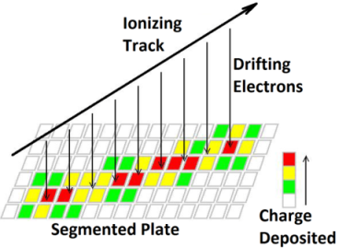
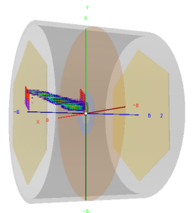
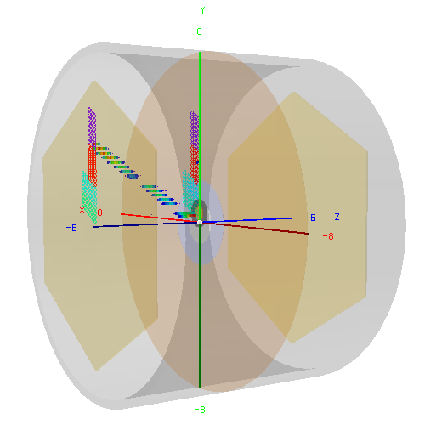
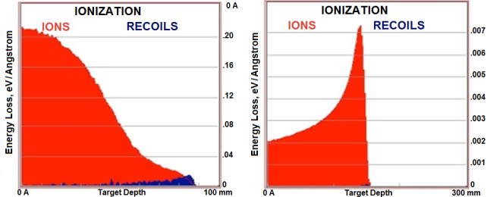
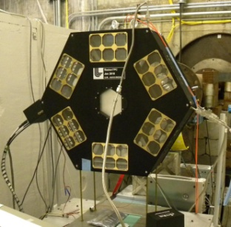
TPC can address most of the systematic uncertainties associated with conventional FICs
Time Projection Chamber (TPC) technology based on highly pixelated readout anodes
Full 3D event reconstruction gives a “snapshot” of ionization tracks in
a fill gas
Particle identification based on specific ionization loss
The TPC experiment, involving a collaboration of 4 national labs and 6 universities, is currently running at the fast neutron beam facility WNR at LANL
Fission fragment track
Alpha particle track
Fission fragment
Alpha particle
There are more details in following report of F.Tovesson
Ref.: Heffner, AIP Conf.Proc. 1005(2008)182

Slide 16
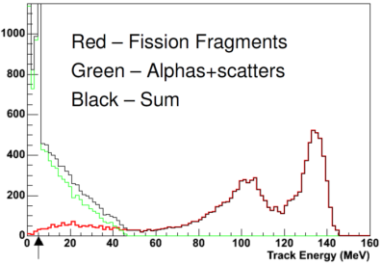
Other ways to avoid systematic uncertainties associated with conventional FICs
An ionization fission chamber with gaseous actinide target doesn’t lose fission fragments emitted at steep angles
Uranium hexafluoride UF₆ can be a suitable compound for investigating U isotopes as it has a boiling point at 56.5ºC
There is no “edge-effect” due to two fragment emission
It is expected much better resolution between fission fragments and small PH signals in a pulse height spectrum
Separate active volume outside the main one should be used for the background neutron input estimation
Neutron
beam
Ref.: Laptev, Strakovsky, Briscoe, Afanasev,
Proposal NSF-ARI-MA (DNDO) Grant ECCS-1139985, 2011
For the Pu isotopes, plutonium hexacarbonyl Pu(CO)₆ can be considered.
Ref.: Thanks to W.Loveland, Oregon State University,
for pointing out this opportunity

Slide 17
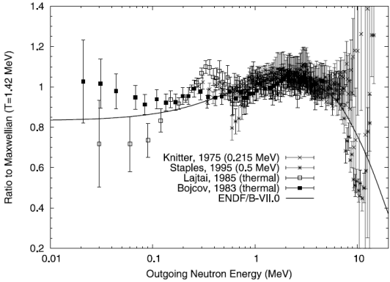
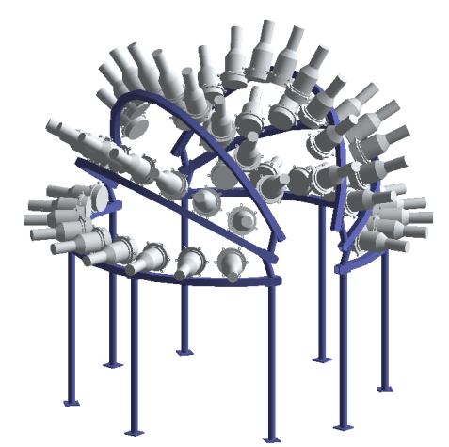
Prompt Fission Neutron Study
Existing data establish the prompt fission neutron spectrum quite well in the energy
range from 1 to about 5 MeV
The Chi-Nu experiment to study the prompt fission neutron spectrum will also run at the WNR
Parallel plate avalanche counter as a fission trigger
20 ⁶Li-glass detectors to measure neutron output below 1 MeV
50 liquid scintillator detectors to measure neutron output from 0.5 to 12 MeV
~35 % less
than 1 MeV
Important
region for rad-chem: (n,2n) etc.
Chi-Nu goals are
Below 1 MeV, to reduce the neutron output uncertainties from ~10% to ~5%
Above 6 MeV, to reduce uncertainties from 20-50% to
10-20%
Ref.: Noda, Haight et al., Phys.Rev.C 83, 034604 (2011)

Slide 18
Angular distribution of PFN relative to FF
Recent measurement for thermal neutrons
Fission neutrons from the ²³⁵U(n_{th},f) reaction were detected at several angles
Angular resolution is 18º
Model calculation was done on the basis of the assumption that neutrons are emitted only from fully accelerated fragments
Obtained an estimate of upper limit for “scission” neutrons less than 5% of the total neutron output
From all existing works: the contribution of scission neutrons to the total yield of PFN ranges from 1% to 20%, so even existence of “scission” neutrons can hardly be considered proven
Ref.: A.Vorobyev et al., NIM A 598 (2009) 795
Slide 18

Slide 19
Fission fragment yield distribution
The fission fragment yield distribution changes drastically with neutron energy above ~10 MeV, from asymmetric to symmetric
There are no data above neutron energy of about 20 MeV except for ²³⁸U and ²³²Th. No data for the most important nuclei ²³⁵U and ²³⁹Pu !
These data are vitally important for both fission theory and many applications including fast reactors, ADS systems, and special nuclear devices
This gives strong motivation for the new LANL experiment SPIDER, designed to obtain fission fragment yields with mass resolution up to 1 amu following fast neutron-induced fission

Slide 20
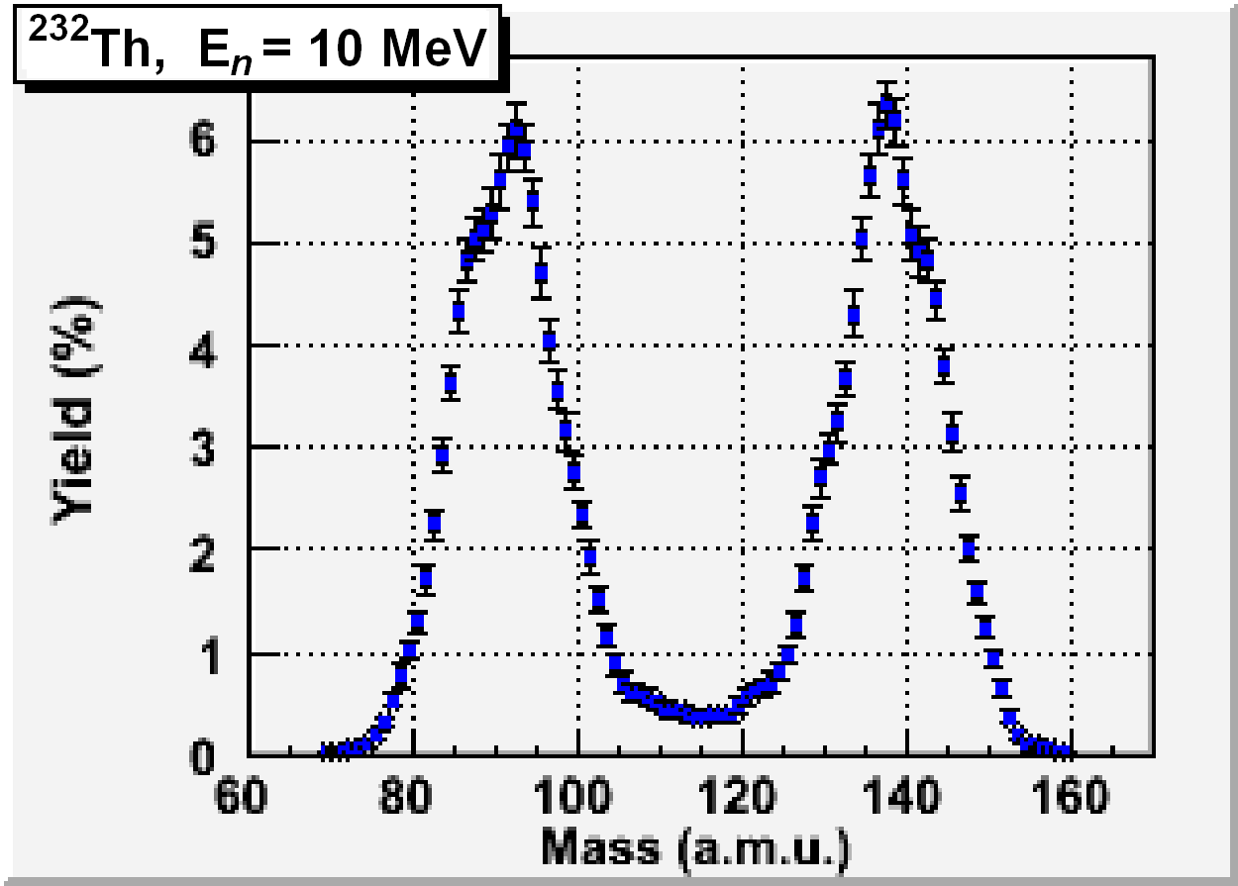
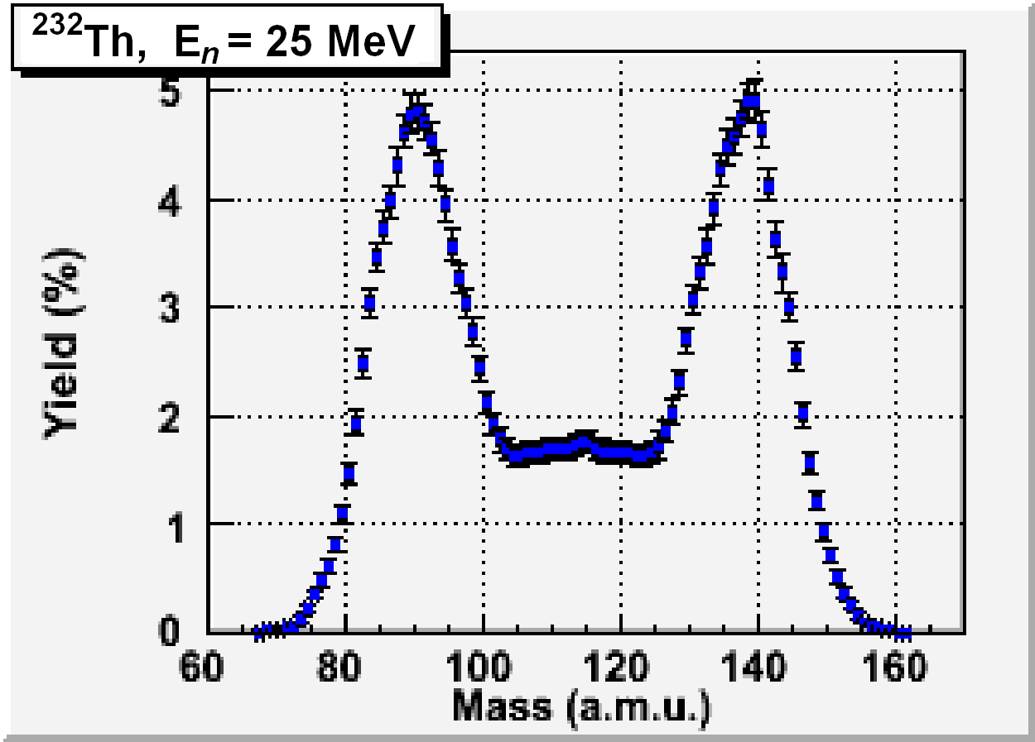
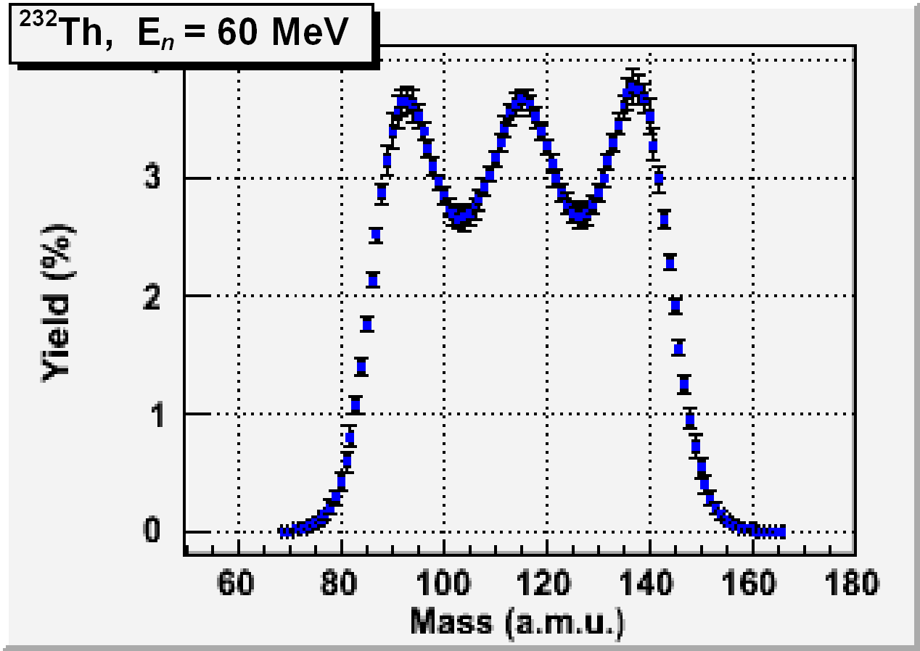
Existing data for fission fragment yield distribution as a function of neutron energy for ²³²Th
FF mass resolution is ~ 8 amu
The fission fragment yield distribution experiences drastic change in the energy range from 10 to 60 MeV
Ref.: Simutkin et al., AIP Conf.Proc. 1175(2009)393

Slide 21
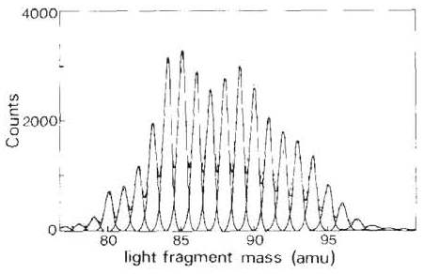
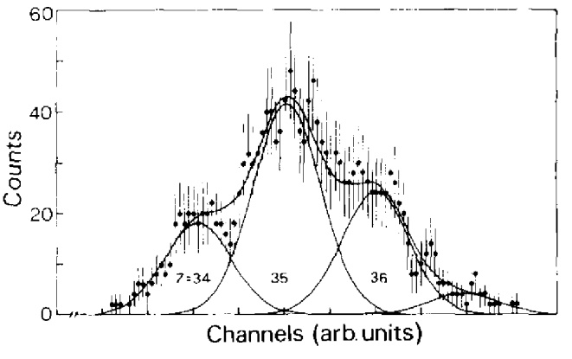
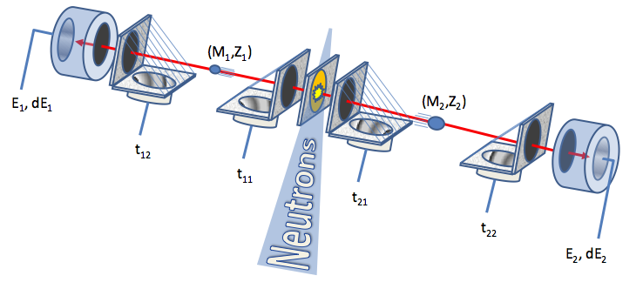
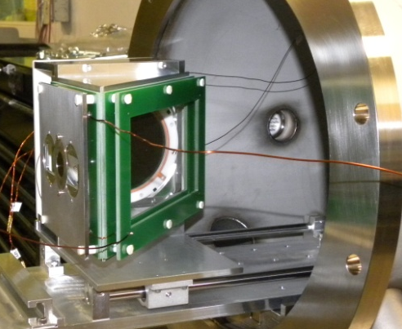
High resolution fission fragment yield measurements
Measured at ILL, France for thermal neutron
²²⁹Th(n_{th},f) with COSI-FAN-TUTTE spectrometer
FF yield
Nuclear charge
distribution for
A=87
FF mass resolution is ~ 0.64 amu
Ref.: Boucheneb et al., Nuc.Phys.A 502(1989)261c
SPIDER experiment to measure energy-dependent neutron-induced FF yields with high resolution in progress at LANL
Ref.: White, Tovesson et al.,
Report LA-UR-11-01125
FF mass resolution is expected ~1 amu
There are more details about SPIDER in following report of F.Tovesson

Slide 22
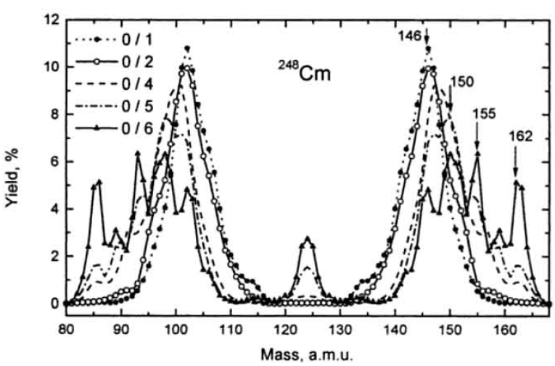
Correlation between PFN multiplicity & FF properties
Search for correlation between PFN multiplicity & FF properties in SF of ²⁵²Cf, ²⁴⁴Cm, and ²⁴⁸Cm was done using a 4π neutron detector and twin Frisch gridded FIC
Fission fragment mass distribution for fixed numbers of emitted neutrons ν_{L} / ν_{H} for spontaneous fission of ²⁴⁸Cm
There are no such data for fast neutron-induced fission. The very first attempt of such measurement was done for thermal and 0.3 eV neutron induced fission of ²³⁵U and ²³⁹Pu [Batenkov et al., AIP Conf. Proc. 769 (2005)1003]
Fission theories are most sensitive for correlated data, source: LANL-LLNL fission workshop, Feb 3-6, 2009
Ref.: V.Kalinin et al., Fission: Pont d’Oye V (2003)73
FF mass resolution is ~ 1.5 amu (for ²⁵²Cf)
Slide 22

Slide 23
Average fission neutron multiplicity
Average fission neutron multiplicity as a function of incident neutron energy is known quite well for nuclei ²³⁵U, ²³⁸U, and ²³⁷Np, up to 200 MeV
Ref. (²³⁵U):
R.Howe,
Nucl.Sci.Eng. 86(1984)157
T.Ethvignot et al.,
PRL 94(2005)052701
Ref. (²³⁸U):
J.Frehaut ,
EXFOR data 21685.003
J.Taieb et al.,
ND-2007 (2007)429
For other nuclei important to the nuclear cycle the data are limited:
for ²³²Th < 50 MeV, ²³⁹Pu < 30 MeV, ²³³U < 15 MeV, ^{243,241}Am < 11 MeV, etc.
Slide 23

Slide 24
Total kinetic energy of fission fragments as a function of neutron energy
Data on total kinetic energy of fission fragment are required for both theory and applications to calculate total energy release in fission (along with that for
prompt and delay fission neutron, prompt and delay fission gamma-ray energy, etc.)
Ref.:
Data: C.Zöller, PhD Theses (1991)
Fit: D.Madland, NP A 772(2006)113
The quadratic fit doesn’t describe structure near different chance fission thresholds because the corresponding experimental data for ²³⁵U and ²³⁹Pu are much lower in quality and the energy range is limited (no data above
15 MeV)
Slide 24

Slide 25
Angular anisotropy of fission fragments
It is used in fission cross section measurements to calculate a correction for FF absorption in a target
Provide information about the projection of the total angular momentum J of the fissioning nucleus along the nuclear symmetry axis at saddle point deformation
Ref.:
Ouichaoui et al., Acta Phys.Hung. 64(1988)209
Shpak, Yadernaya Fizika 50(1989)922

Slide 26
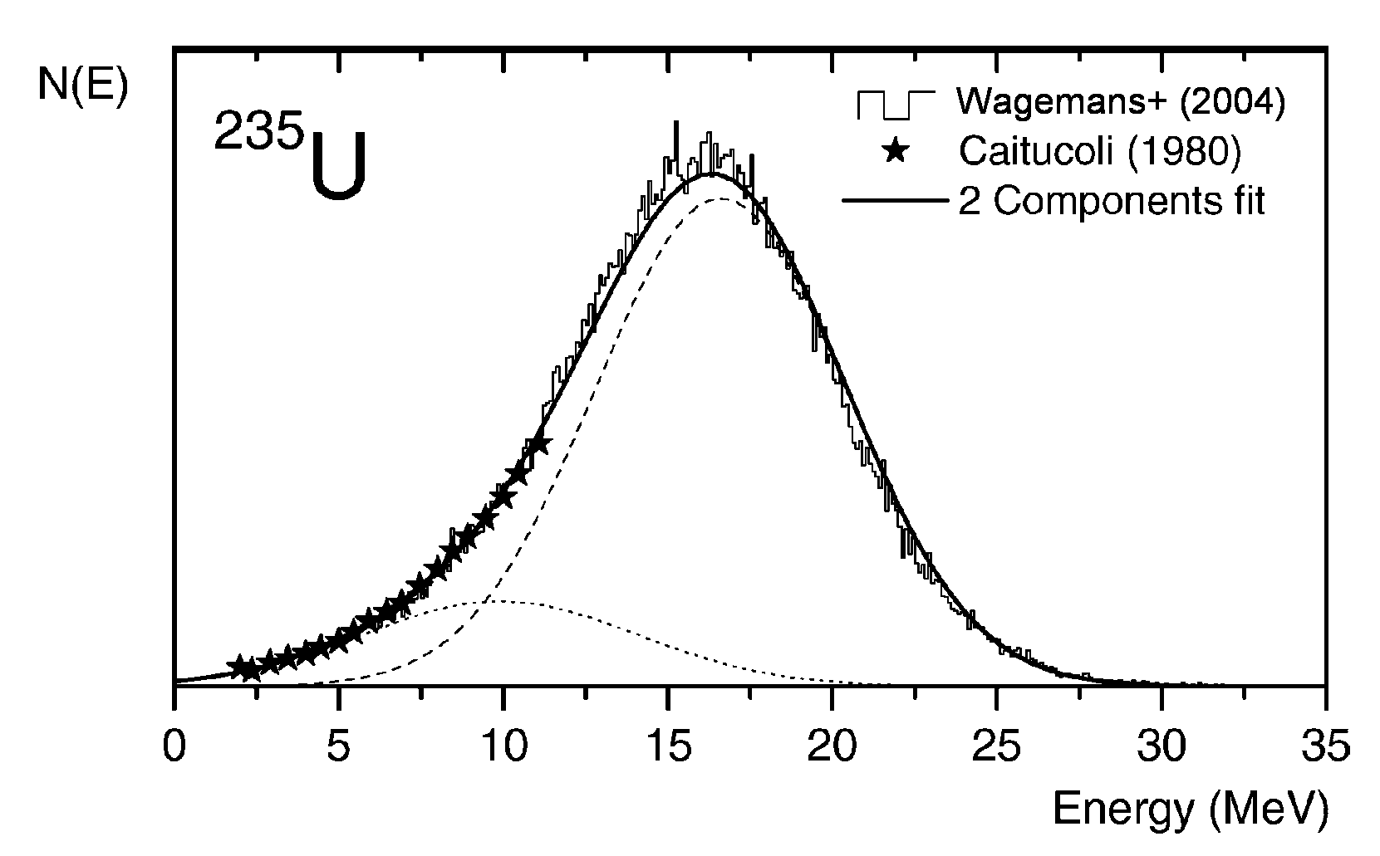
Ternary fission yields
Important for both fission theory and applications (gas emission characteristics)
Studied quite well at thermal energy:
E-distribution for the ²³⁵U(n_{th},f) ternary α’s
²³⁵U ratio binary/ternary fission was measured quite well: 536±10
[C.Wagemans et al., PR C 33(1986)943];
energy distribution of ternary α’s measured
[C.Wagemans et al., NP A 742(2004)291];
etc.
Confident separation of all ternary particles in SF ²⁵²Cf [M.Mutterer et al., PR C 78(2008)064616]

Slide 27
Prospective investigations of ternary fission
Very little data for fast neutron-induced fission. Better understanding needed of:
Variation of ternary-to-binary fission ratios in the resonance energy region. E.g., a correlation of ternary fission yields and the relative contribution of standards I and II fission modes was found in ²³⁵U(n,f) resonances at energy from thermal to 2500 eV
[S.Pomme et al., NP A 587(1995)1]
Angular anisotropy in ternary nuclear fission and its dependence on neutron energy. Most fission theories predict ternary particles to be formed at scission. A way to confirm this assumption is to analyze the angular distribution of fission fragments
[S.Dilger, PhD Theses(2004)]
“Quaternary” fission with an apparently independent emission of two charged particles?
[M.Mutterer, Pont d'Oye V (2003)135]

Slide 28
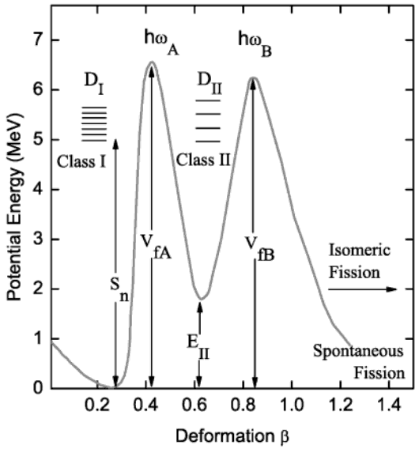
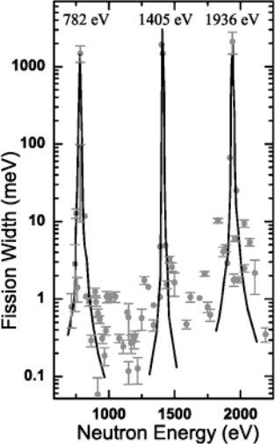
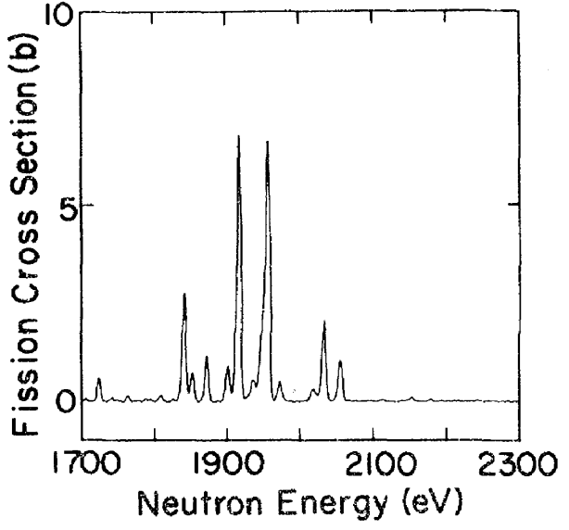
Subthreshold fission as a search for class-II states
Gives unique information about fission barriers
Direct demonstration of double-humped structure of potential energy of heavy nuclei and existence of class-II states
First systematic study of class-II clusters with high energy resolution was done at the ORELA facility, ORNL for ²⁴⁰Pu
The double-humped
fission barrier
Clustering of
fission strengths
1936 eV cluster in subthreshold fission of ²⁴⁰Pu
Ref.: Mughabghab, Atlas of Neutron Resonances, 2006
Clustering of subthreshold fission strengths observed in ²⁴⁰Pu was explained in terms of the double-humped fission theory
Average level spacing of class-II states estimated of
D_{II} = 450±50 eV. Based on that and known D_{I}, a value of
E_{II} = 1.52±.08 MeV was derived
Ref.: Auchampaugh, Weston,
PRC 12, 1850 (1975)
Slide 28

Slide 29
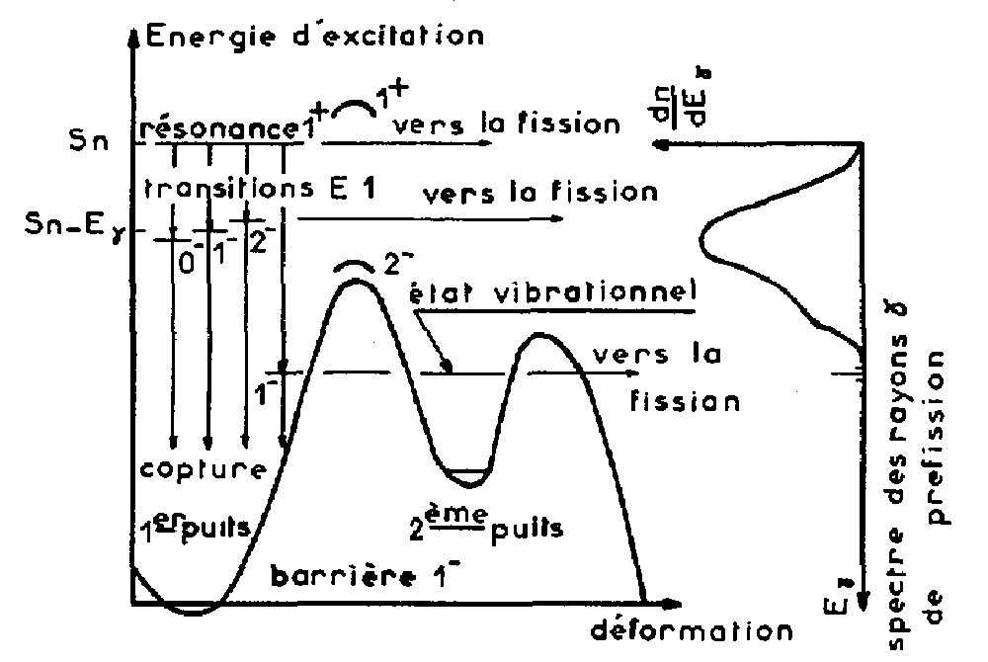
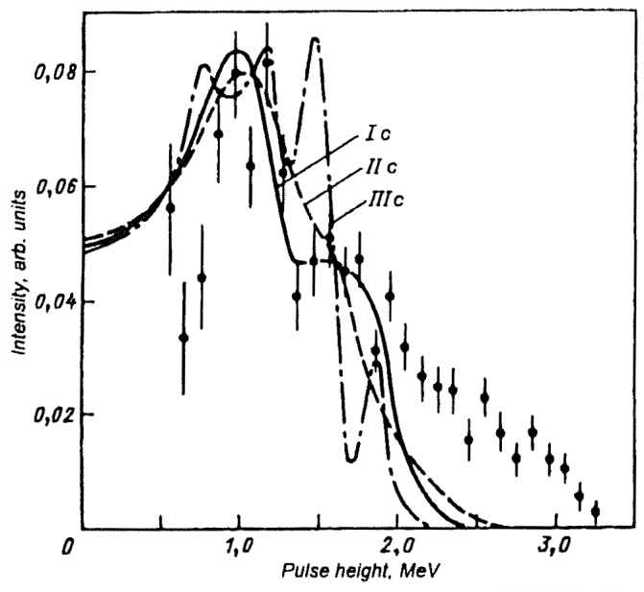
Search for γ-transitions to class-II states
Differences in pulse-height γ-ray spectra for weak (Γ_{f} < 10 meV) and strong (Γ_{f} > 10 meV) fission 1⁺‑resonances of ²³⁹Pu in epithermal neutron energies
Few possible structures could be interpreted as a γ-transitions between class-II states
Confident discovery of class-II γ-transitions will give unique information about the structure of the fission barrier
Descriptive schematic of the
(n, γf) reaction mechanism
Ref.: J.Trochon, Physics & Chemistry of Fission, 1979, Vol. I, p.87
Ref.: O.Shcherbakov et al., ASAP Proc. (2002) 123
Slide 29

Slide 30
Proton-induced fission of ²³⁵U
This energy range is important for future ADC systems, e.g., for transmutation of nuclear waste
Existing data are very scarce and are in contradictory
The ALICE code calculation for the JENDL-HE data file shows a peak near 300 MeV, which comes from a broad reaction cross section shape from the optical model [Private communication from T.Kawano, 2009]. New experimental data are needed to confirm that result
Relevant proton energy range should be available for the JLab EIC booster

Slide 31
Single-event effects (SEEs) in electronics investigations
Increasing complexity and density of an electronic chips increases their susceptibility to cosmic radiation. Most SEEs in avionic electronics at aircraft cruising altitudes are caused by neutrons
Electronics industry is very interested in checking the stability of their electronics against neutron irradiation
Spallation neutron sources can imitate cosmic neutron flux but with intensities millions of times higher
Many facilities all around the world built irradiation facilities, which are in high demand

Slide 32
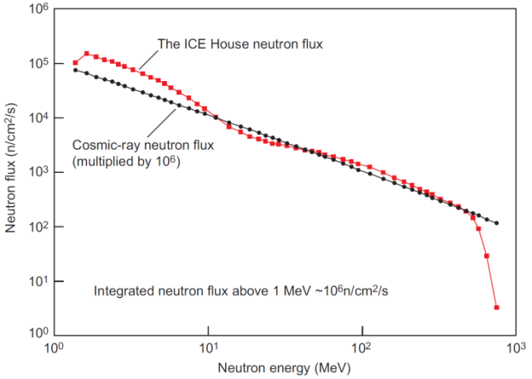
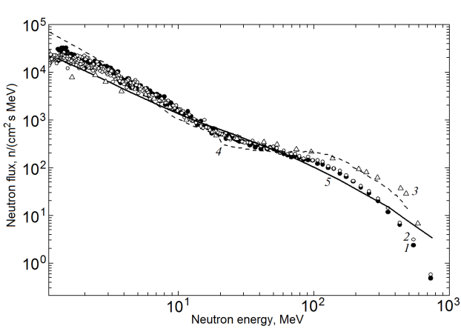
Active facilities in SEEs studies
Neutron flux of the ICE House
irradiation facility at LANL
Neutron flux of the irradiation facility at GNEIS
With the EIC booster proton energy of 3,000 MeV it may be possible to obtain better imitation of cosmic-ray neutron spectrum to higher energies

Slide 33
Summary
In many years of fission research, a large volume of experimental data was accumulated
There is still a significant lack of fission data for fast neutrons. Improving the quality of existing data will make a crucial impact on important applications and nuclear theory
The proposed EIC complex at JLab promises to be a facility for acquiring high-quality experimental fission data and to carry out applied research

