Slide 1
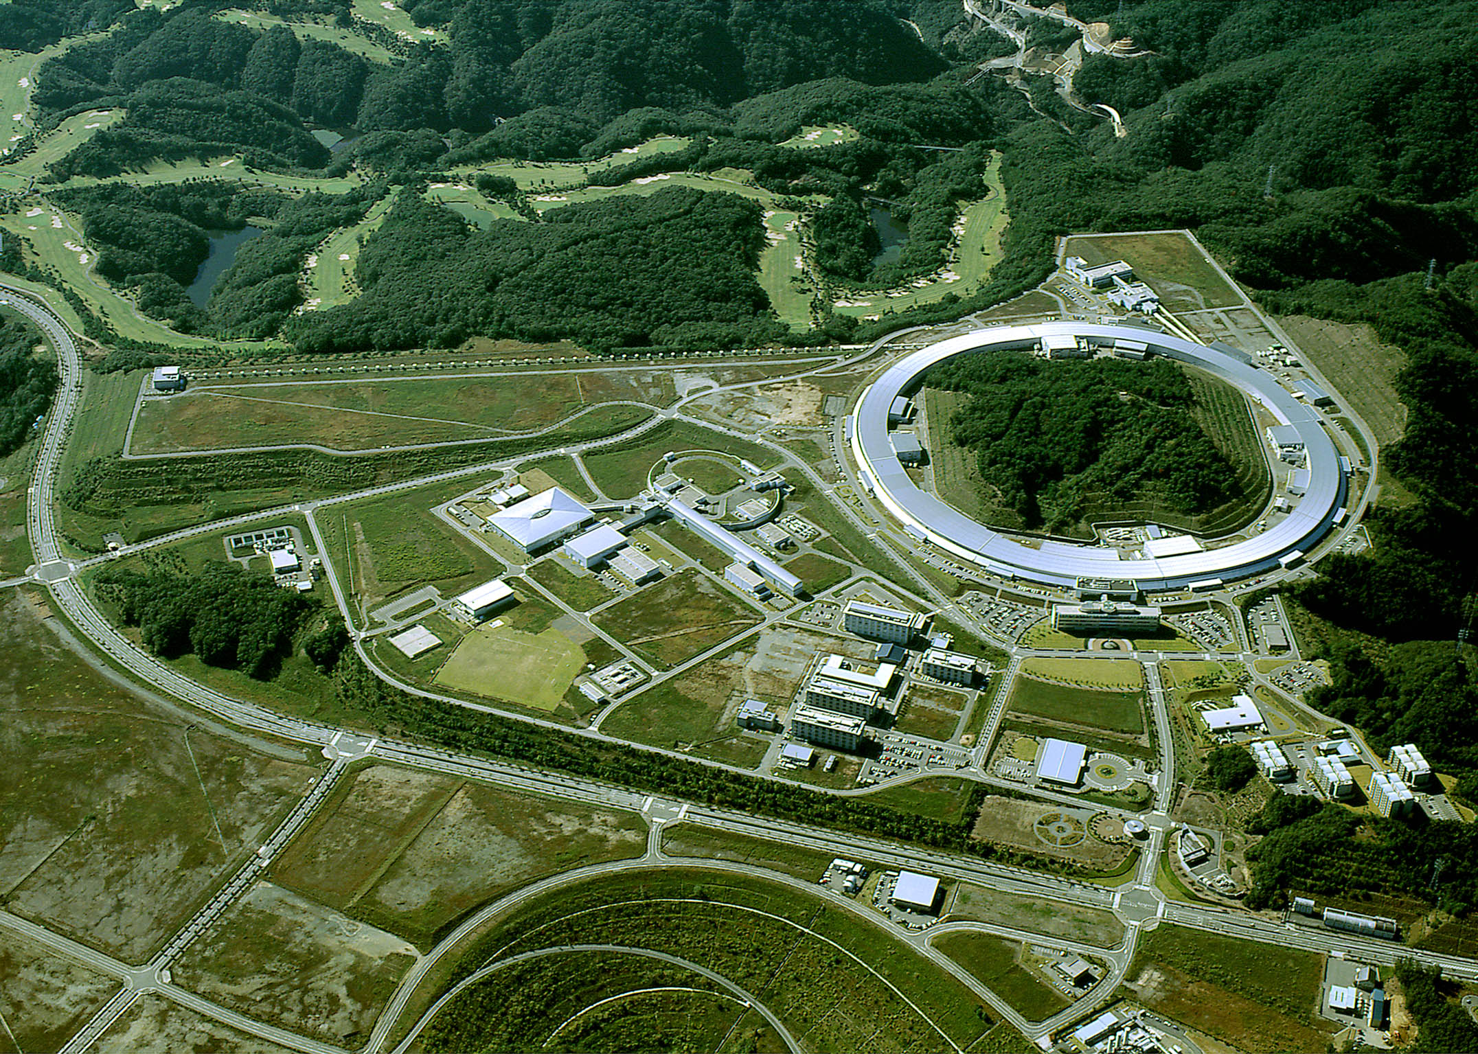
N* study at Japanese facilities
-LEPS and LEPS2
LEPS/LEPS2
LEPS facility
Experimental results
New project, LEPS2
Mizuki Sumihama
For LEPS collaboration
Gifu university

Slide 2
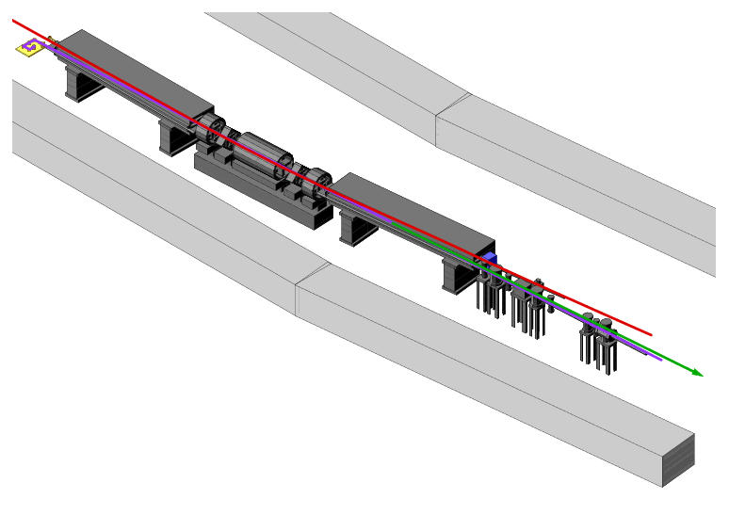
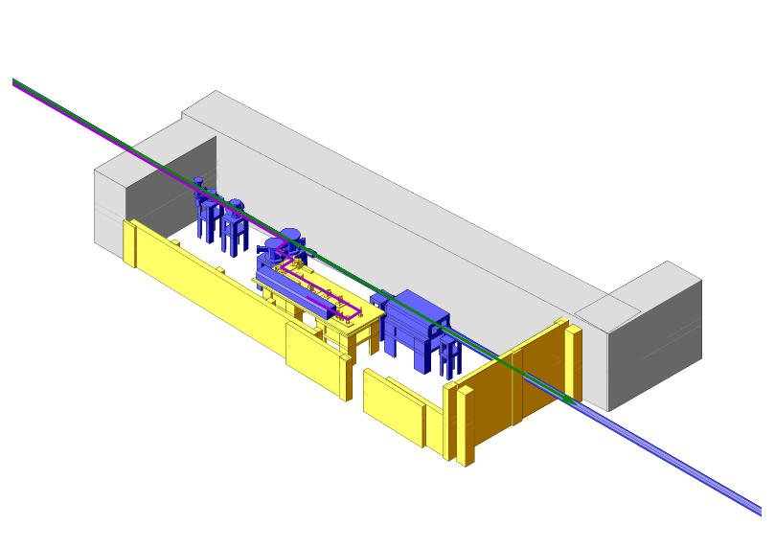
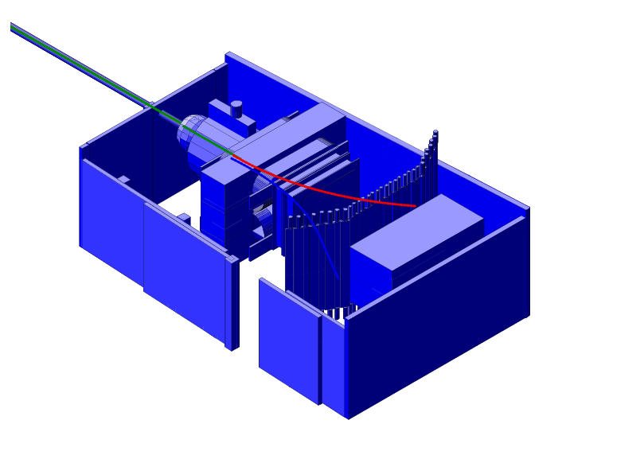
Laser Electron Photon beam
8 GeV electron
Collision
Recoil electron
Tagging counter
36m
a) SPring-8
SR ring
Laser light
70m
Inverse Compton γ-ray
b) Laser hutch
Backward-Compton
scattering
c) Experimental hutch

Slide 3
Linearly polarized photons
Cross section(Energy spectrum) Linear Polarization
351 nm
257 nm
351 nm
257 nm
tagged
tagged
Energy range Eγ=1.5 ~ 2.4 GeV → 3 GeV.
Energy resolution ΔEγ ~10 MeV
Highly polarized photons, known event by event

Slide 4
LEPS spectrometer
– forward acceptance
± 10º in y
± 20º in x
Aerogel
Cherenkov
(n=1.03)
Dipole Magnet (0.7 T)
TOF wall
M
B
Start counter
Liquid Hydrogen
Target (15 cm thick)
γ
Silicon Vertex
Detector
MWDC 3
MWDC 1
1m
MWDC 2
4

Slide 5
Particle identification
Time resolution ~120ps
Momentum resolution ~5(14) MeV for 1(2) GeV/c Kaon

Slide 6
Forward spectrometer + TPC
Time-projection chamber (TPC)
p / K / π
γ beam
target
Forward spectrometer
Λ(1405)
Σ π
cosΘ_{cm} = ~0.6 – 1.0
p → K⁺Λ*
p → p ω/ρ/φ
p → K⁺x
p → p x
Missing mass

Slide 7
  Advantage of photon beam
  γ + N ◊ ∗
  Polarization observables –linearly polarized photon,
  parity filter
  polarized target under construction
  πN, ρN, ηN, η’N, ωN, φN, KY, KY* …, simultaneously
  Isospin filter :
η, η’, ω / Λ I=0, → N* only
π, ρ / Σ I=1, → N* and Δ*
  Strangeness channel (ss-bar)
  KΛ, KΣ, KΛ*, KΣ*, φN, ηN, K⁻Θ⁺
  LEPS energy range
  Eγ=1.5 –3.0 GeV / W=1.9-2.5GeV
Multi-channel analysis

Slide 8
π⁰ and η photoproductions at backward angles
−1 < cosΘ_{cm} < −0.6
s-channel
u-channel
γ
M
γ p
p, N*, Δ*
p p
p, N*, Δ*
p
M
g_{NNM}
g_{NN*M}
….
Resonances
Nucleon exchange

Slide 9
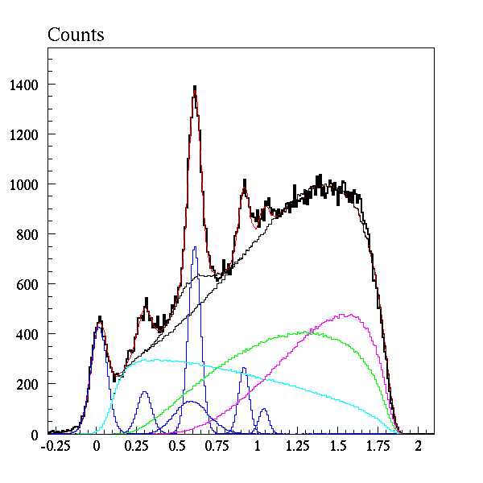
Backward meson photoproduction
p → p x
ω
Eγ = 2.3 - 2.4 GeV
cosΘ_{cm} = −1 ∼ −0.9
Data
Fitting result
η’
φ
ρ⁰
η
π⁰
4π
3π
2π
Look at π⁰p, ηp, η’p, and ωp, simultaneously
Missing Mass² (GeV²/c⁴)

Slide 10
π⁰
Differential cross sections
dσ/dΩ vs. √s
New data
Preliminary
Orsay(PR 164, 1623(1967))
cosΘ_{cm} =−1
DESY(PRL 20, 230(1968))
LEPS
cosΘ_{cm} =−0.975
−0.875
−0.775
−0.675
?

Slide 11
+ p → π⁺ + n ….N*?
+ p → πº + p ….Δ*?
Previous data
PRD vol.6, 1 (1972)
N(1720)
3/2+
Δ(1920)
3/2+
cosΘ_{cm} = −1
N(2190)
7/2⁻
Δ(1232)
Δ(2420)
11/2+

Slide 12
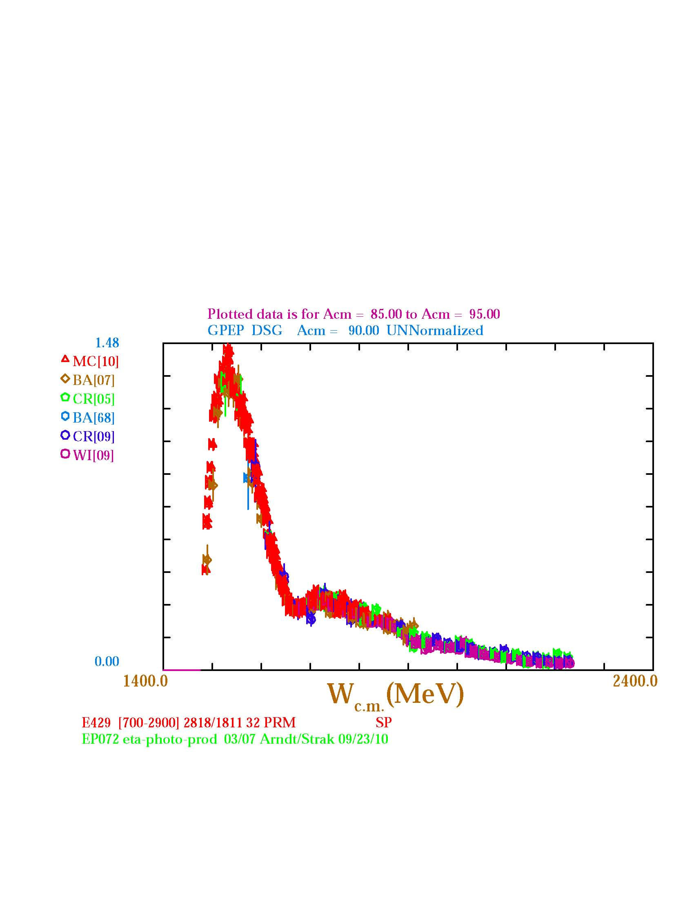
η
η photoproduction
Resonances strongly coupled to ηΝ.
S(1535) --- contain ss-bar
P(1710/1720)?
?
S₁₁(1535)
P(1720/1710)?
Higher mass resonance?

Slide 13
Differential cross sections dσ/dΩ vs. W
η
LEPS data
Jlab/CLAS data
Bonn/ELSA data
SAID -partial-wave analysis
Wide structure is seen above W=2.0 GeV

Slide 14
π⁰η
η’ ω
Comparison of π⁰, η, η’ and ω
photoproductions
cosΘ_{cm} = −0.8 ~ −0.7
η η’
ω π⁰
ss-bar component
Different!

Slide 15
φ photoproduction at forward angles

Slide 16

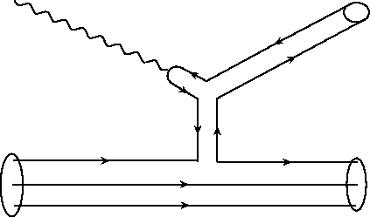
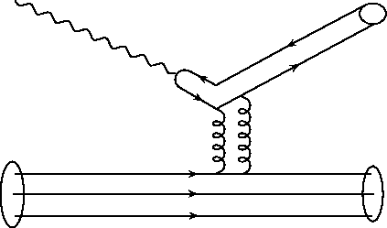
Diffractive Photoproduction of vector meson
Vector Meson Dominance
Meson Exchange
Pomeron Exchange
q
_
qq = ρ, ω, φ ...
_
q
Dominant
at low energies
γ
ρ, ω
N
Slowly increasing
with energy
γ
ρ, ω
φ (~ss)
N
uud

Slide 17
Polarization observables with linearly polarized photon
φ meson rest frame
ε_{γ}
K⁺
Σ=-1
Decay Plane // γ
natural parity exchange (-1)^{J}
(Pomeron, Scalar Glueball,
Scalar mesons)
Polarization
vector of γ
K⁻
ε_{γ}
Σ=+1
Decay Plane γ
unnatural parity exchange -(-1)^{J}
(Pseudoscalar mesons π,η)
K⁺
Decay angular distribution of φ meson
Relative contributions from natural, unnatural parity exchanges

Slide 18
γN→φN
T. Mibe et al., Phys. Rev. Lett. 95, 182001 (2005)
From decay asymmetry, the relative strength of natural-party processes to unnatural-parity ones is the same in the peak and off-peak regions.
The bump structure is not due to unnatural-parity processes ONLY.
Possible presence of additional natural parity exchange
→ signature of 0+ glueball trajectory??

Slide 19
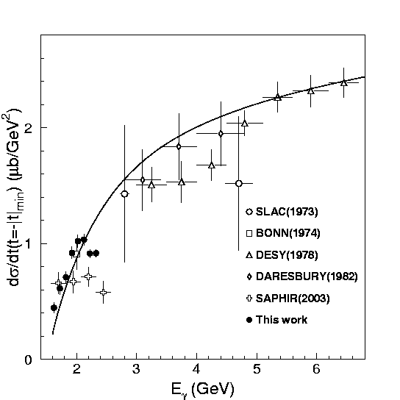
Bump structures around 2 GeV in some reactions
PRL95,182001 (2005)
PRL104,172001 (2010)

Slide 20
Λ(1405)/Σ(1385)

Slide 21

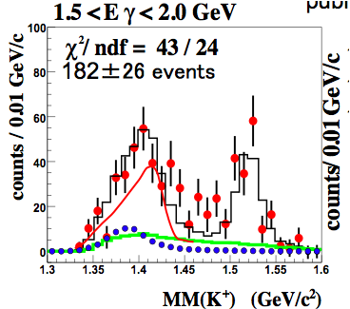
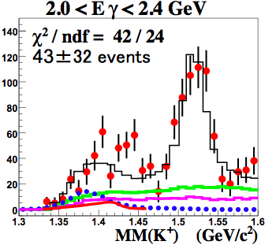
Measurement of γp → K⁺Λ(1405) and K⁺Σ⁰(1385)
M. Niiyama et al, Phys.Rev.C78:035202,2008
Decay particles are detected by time-projection chamber
target : H₂ (CH₂ – C)
dσ/dΩ
1.5-2.0GeV 2.0-2.4GeV
Λ(1405) 0.43±0.088 0.072±0.061
Σ⁰(1385) 0.80±0.092 0.87 ±0.064
Remarkable decreasing
different production mechanism
or/and internal structure?

Slide 22
Study of Θ⁺ (γd→K⁻K⁺np)
γn → K⁻Θ⁺ → K⁻K⁺n
Θ⁺
Higher statistics (3 times)
in data taken in 2006-7.
Blind analysis
Still under analysis.
Check and conform the statistics and quality of the data by using single track, φ events, LH2 data masking K⁻n .
PRC 79, T.Nakano et al., 025210 (2009)

Slide 23
K* production
Proposed by K. Hicks (Ohio U.) and J.K. Ahn (PNU)

Slide 24
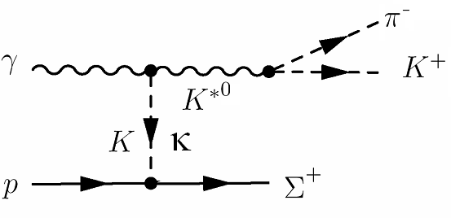
The κ meson with a resonance pole at ~800 MeV is seen in many phenomenological analyses and also in the analysis of the D → Kππ decay, yet its existence is still controversial.
See photon asymmetry for K*Σ⁺ photoproduction
K : Pseudoscalar meson → unnatural exchange
κ: Scalar meson → natural exchange
K*Σ⁺ photoproduction form threshold to 3GeV

Slide 25
Missing Mass for (γ,K+π-) vs Invariant Mass of K+π-
K*Σ⁺ photoproduction form threshold to 3GeV

Slide 26
K⁺π⁻ Invariant Mass
Horizontal Polarization
K*⁰
Vertical Polarization
K*Σ⁺ photoproduction form threshold to 3GeV

Slide 27
LEPS2

Slide 28
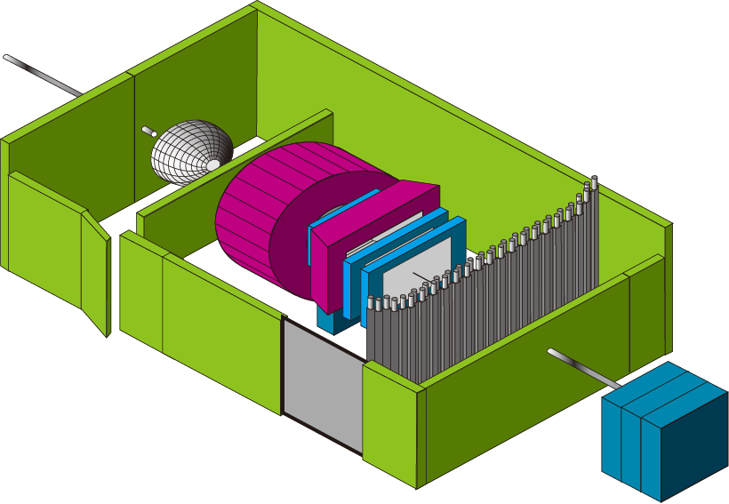
Schematic view of the LEPS2 facility
Backward Compton Scattering
10 times high intensity：
Multi laser injection &
Laser beam shaping
(future possibility:
Re-injection of
X-ray from undulator)
8 GeV electron
SR ring
Recoil electron
(Tagging)
30m long line
Laser
LEP
(GeV γ -ray)
Laser room
Inside SR bldg
Best emittance
(parallel) beam
photon beam
does not spread
Outside SR bldg
Large 4p spectrometer based on BNL-E949 detector system.
Better resolutions are expected.
New DAQ system will be adopted
Experimental bldg
Beam dump

Slide 29
LEPS new beam line (LEPS2)
Beam upgrade:
Intensity --- High power laser, Multi laser(x4)
--- Laser elliptic focus
~10⁶ → ~10⁷ /sec for 1.5 GeV~2.4 GeV
~10⁵ → ~10⁶ /sec for 1.5 GeV~2.9 GeV
Detector upgrade: (reaction process & decay process)
Scale &--- General-purpose large 4π detector
→ large experimental hutch
Flexibility Coincidence measurement of charged particles and
neutral particles (photons) ← BNL/E949 detector
DAQ --- High speed for the minimum bias trigger
Target upgrade: Polarized HD target

Slide 30
ss-bar knockout process
・ We have developed the polarized HD target for these 6 years.
・Measurement of double polarization asymmetry of φ photoproduction, which is sensitive to the ss-bar content in nucleon through the ss-bar knockout process.
(A.I.Titov et al. PRC58(1998)2429)
・When we succeed the development and establish its technology, it will be a strong weapon at LEPS2.
ss-knockout
Beam-Target double spin asymmetry at E_{γ} = 2.0 GeV
ss content
1%
0.25%
0%

Slide 31
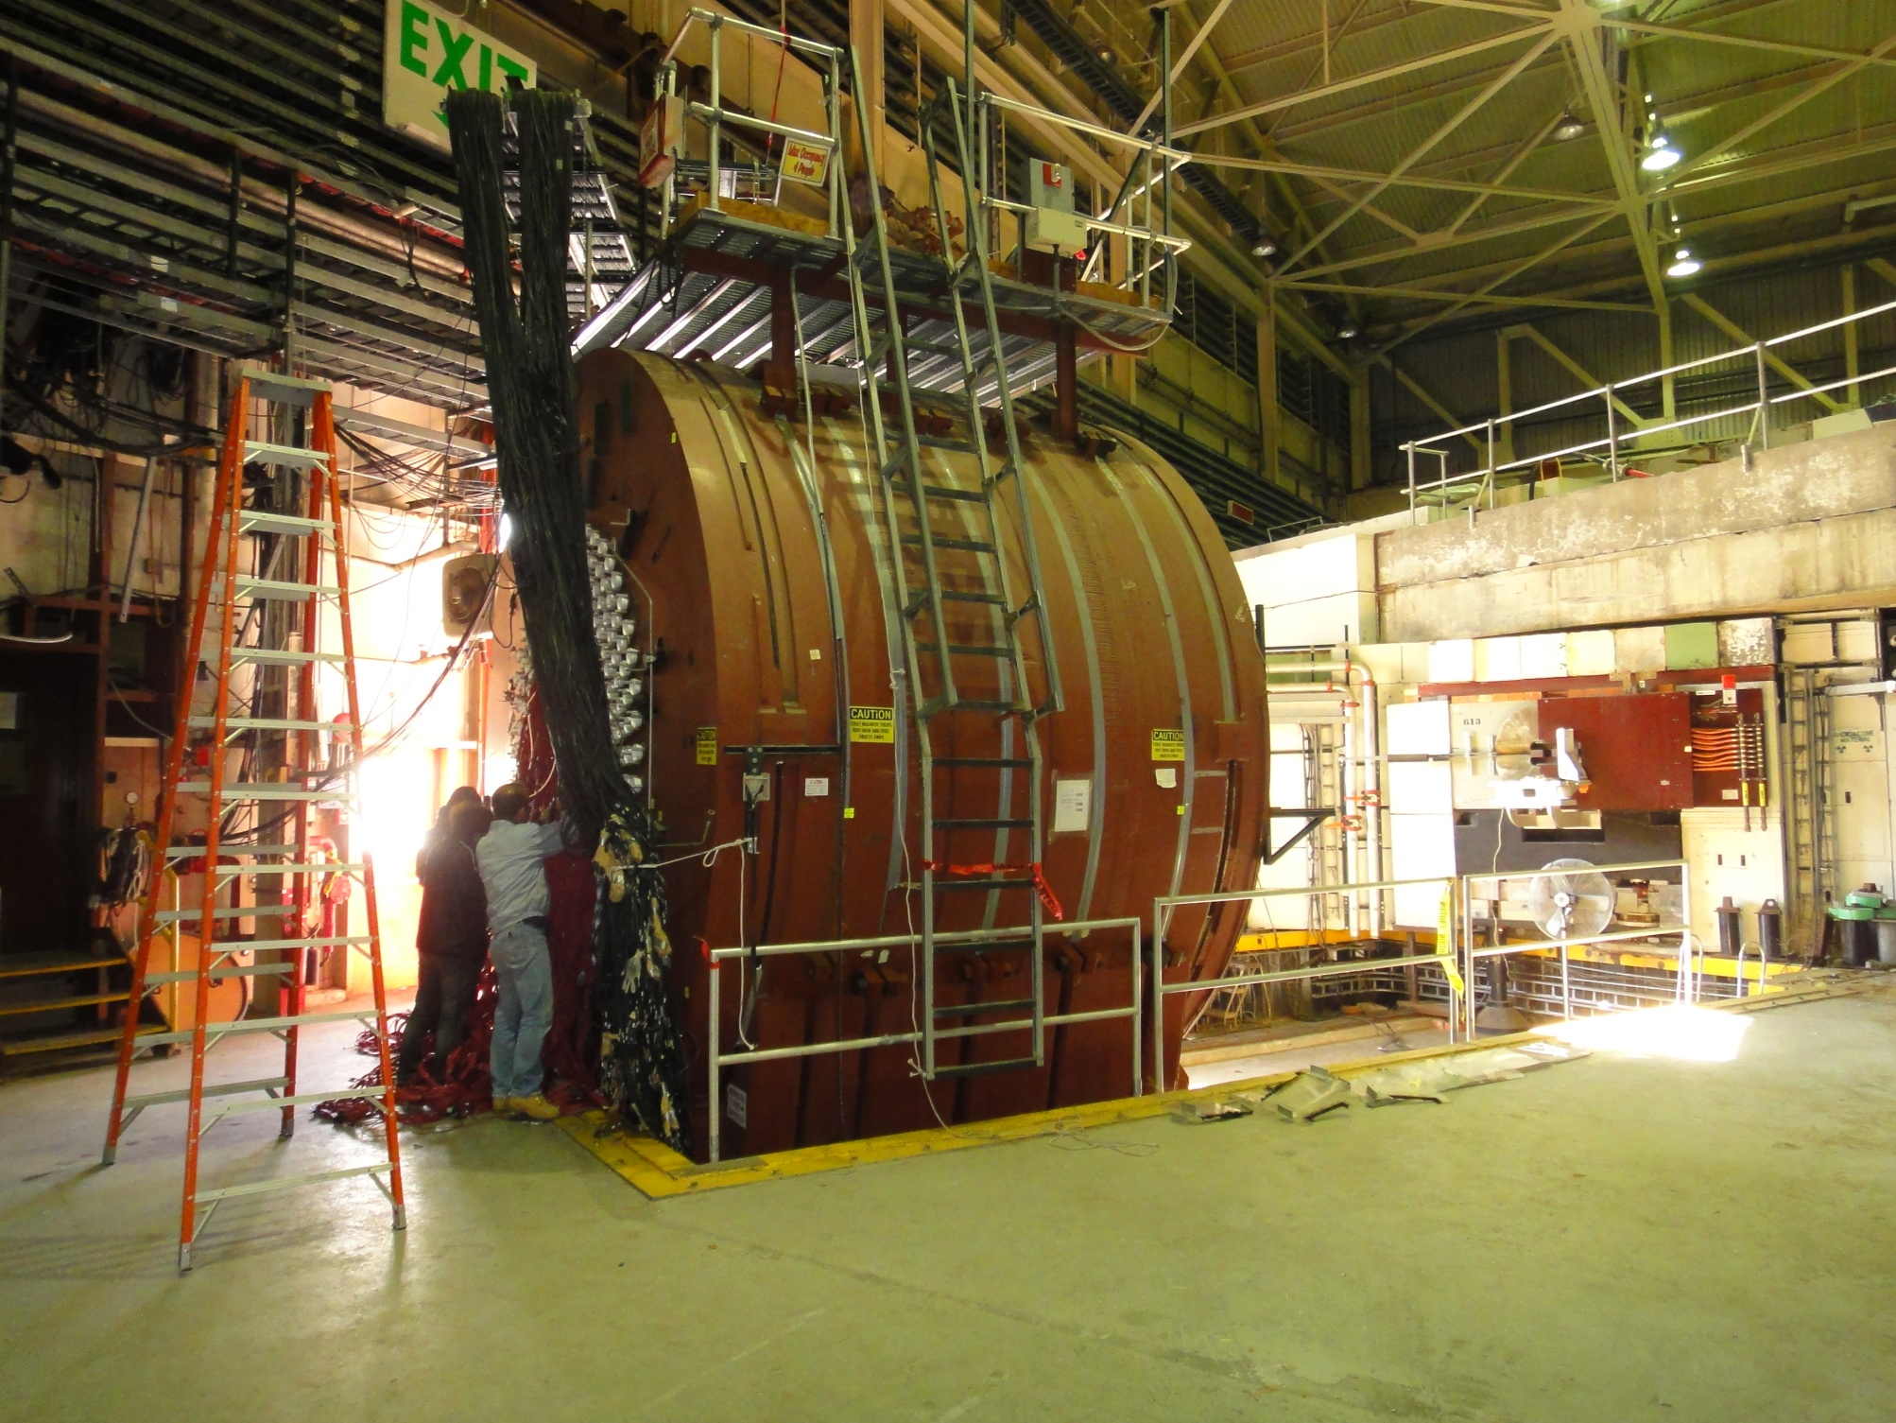
BNL-E949 detector system will be
shipped to SPring-8.

Slide 32
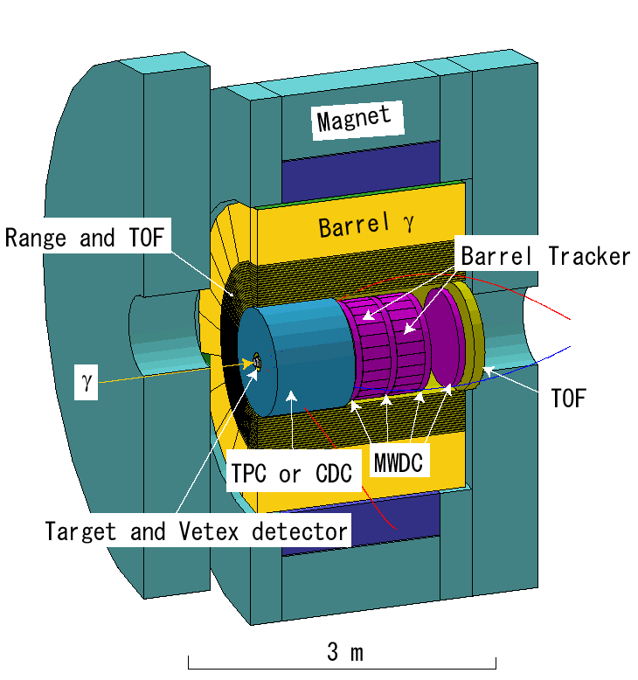
Main Detector Setup
E949 Solenoid Magnet
size: ^{Φ}5m×3.5m
weight: ~400 t
Field: 1.0 T
Target cell
γ
CFRP
SSD
Target and Vertex detector

Slide 33
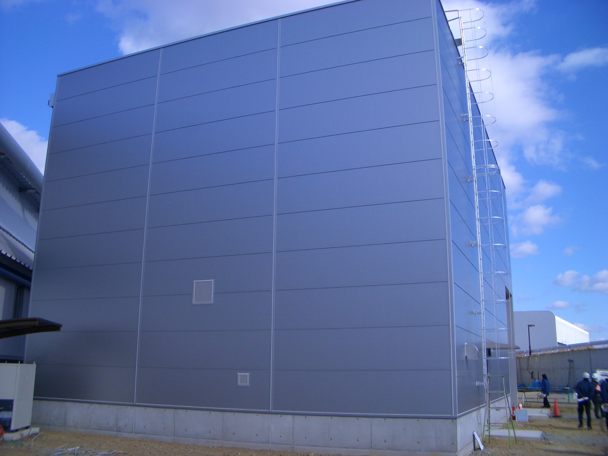
2011.1.31

Slide 34
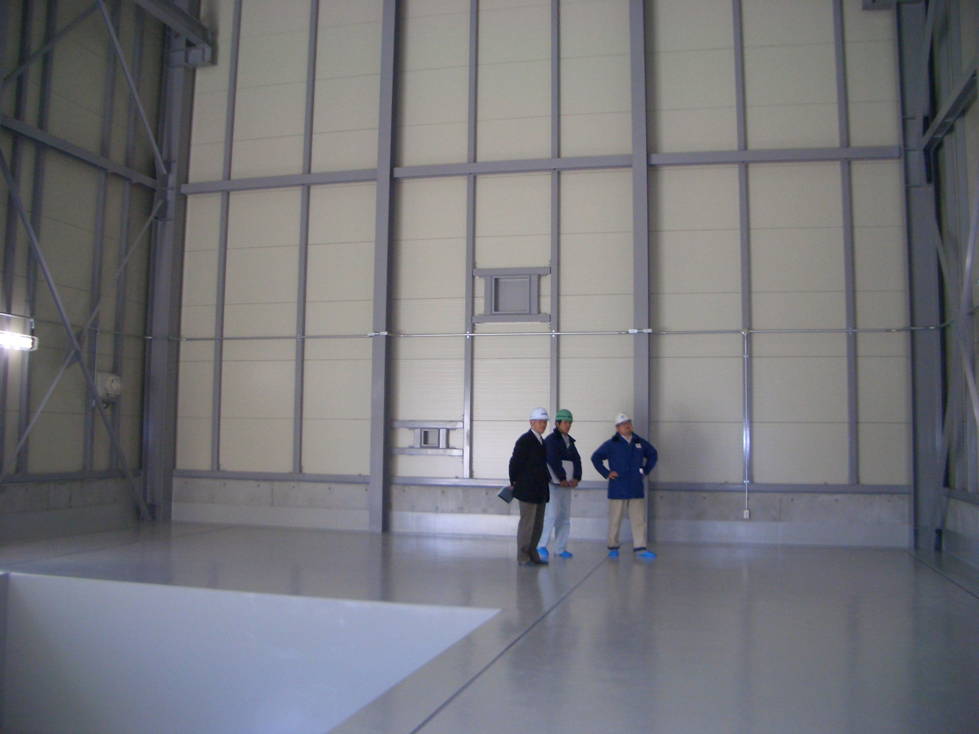

Slide 35
Summary
π⁰ / η photoproduction
energy dependence around 2 GeV
→ missing resonance?
φ meson / Λ(1405) / Σ⁰(1385) / Λ(1520) photoproduction
bump structure or remarkable energy dependence
around 2 GeV
Θ⁺ under analysis with 3 times statistics.
K* photoproduction → search for κ
under analysis
HD target is mostly ready. → double polarization
New beam line LEPS2 is going to be constructed.

Slide 36
backup

Slide 37
Recent publication:
Measurement of Spin-Density Matrix Elements for φ-Meson Photoproduction from Protons and Deuterons Near Threshold.
W.C. Chang et al., Phys.Rev.C82:015205,2010.
Near-Threshold Λ(1520) Production by the γ p + Λ(1520) Reaction at Forward K⁺ Angles,
H. Kohri, et al., Phys. Rev. Lett. 104, 172001 (2010)
Measurement of the incoherent γd→φpn photoproduction near threshold,
W.C. Chang, M. Miyabe, T. Nakano, et al., Phys.Lett.B684:6,2010
Backward-angle η photoproduction from protons at E_{γ}=1.6-2.4 GeV,
M. Sumihama, et al., Phys. Rev. C 80, 052201(R) (2009)
Near-threshold photoproduction of Λ(1520) from protons and deuterons,
N. Muramatsu, J.Y. Chen, W.C. Chang, et al., Phys.Rev.Lett.103:012001,2009
Evidence of the Θ⁺ in the γd → K⁺K⁻pn reaction,
T. Nakano, N. Muramatsu, et al., Phys.Rev.C79:025210,2009
Cross Sections and Beam Asymmetries for K⁺Σ^{*-} photoproduction from the deuteron at E_{γ} = 1.5-GeV - 2.4-GeV,
K. Hicks, D. Keller, H. Kohri, et al., Phys.Rev.Lett.102:012501,2009
Photoproduction of Λ(1405) and Σ⁰(1385) on the proton at E_{γ} = 1.5-2.4-GeV,
M. Niiyama, H. Fujimura, et al., Phys.Rev.C78:035202,2008
……

Slide 38
Evidence of resonances
BES : J/ψ ◊ Ν∗Ν ◊ π(η) ΝΝ
PRL 97, 062001(2006)
N*(1440)
N*(1535)..
N*(1650)..
N*(2070)
Particle Data Group
P₁₁(2100)
Γ(ηN)/Γ_{tot} = 0.61
in Pitt-ANL model
N* ◊ πN N* →ηN
Phys. Rep. 328, 181(2000)

Slide 39
dσ/du vs. √s
π⁰
W=√s (GeV)
Slopes are determined with the data at W<2.1 GeV.
large slope
39
Notes:
39

Slide 40
Higher energy region
u-channel process is dominant at very backward angles.
Regge theory ; dσ/du~s^{2α(u)-2} at high energy.
α(0) = −1/2 for N and N* exchange
σ=Re(α(u))
9/2
7/2
5/2
3/2
1/2
-1/2
N(2220)
Δ(1950)
N(1680)
Δ(1232)
N(938)
Baryon Regge trajectory
0 1 2 3 u=Mass2(GeV2)

Slide 41
ω
dσ/du vs. √s at small |u|
dσ/du
Smaller than Regge trajectory
0.0<u<0.02 −0.1<u<0.0
?
→ 3 GeV
s^{-3.0}
s^{-3.9}
√s (GeV)
LEPS
Daresbury data, PLB72,144(1977)

Slide 42
Polarization observables with linearly polarized photon
φ meson rest frame
ε_{γ}
K⁺
Decay Plane // γ
natural parity exchange (-1)^{J}
(Pomeron, Scalar Glueball,
Scalar mesons)
Polarization
vector of γ
K⁻
ε_{γ}
Decay Plane γ
unnatural parity exchange -(-1)^{J}
(Pseudoscalar mesons π,η)
K⁺
Decay angular distribution of φ meson
Relative contributions from natural, unnatural parity exchanges

Slide 43
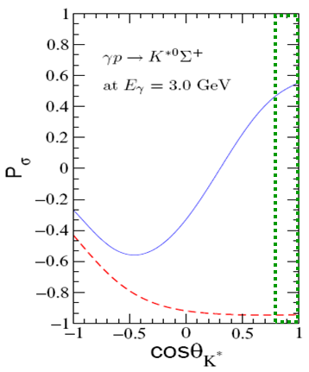

Parity spin asymmetry for the K*⁰ photoproduction
High sensitivity to the κ scalar meson for linear polarization.
Y. Oh and H. Kim, Phys.Rev.C74:015208,2006
K*Σ⁺ photoproduction form threshold to 3GeV

Slide 44
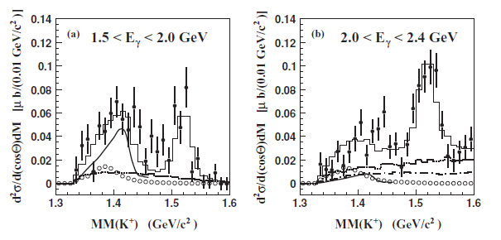
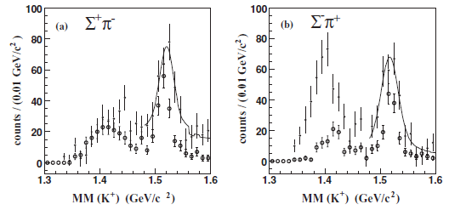
Previous Work of LEPS
M. Niiyama et al, Phys.Rev.C78:035202,2008
Differential cross sections
for γp → K⁺Λ(1405) and K⁺Σ⁰(1385) .
E_{γ} = 1.5 – 2.4 GeV
target : H₂ (CH₂ – C)
Λ(1405) / Σ⁰(1385) = 0.54 ± 0.17 at 1.5-2.0GeV
= 0.084± 0.076 at 2.0-2.4GeV
remarkable decrease of the production ratio
of Λ(1405) to Σ⁰(1385) at higher E_{γ} region.
different production mechanism and
internal structure?
different line shapes of Λ(1405)
for Σ⁺ π⁻ and Σ⁻ π⁺ decay mode.
→ Isospin interference
This work
Higher E_{γ} ➔ new information about E_{γ} dependence of the cross section of Λ(1405)
Liquid hydrogen target was used. ➔ no subtraction , more precise results
total luminosity : 3 times larger than previous work

Slide 45
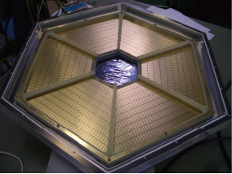
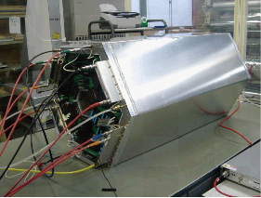
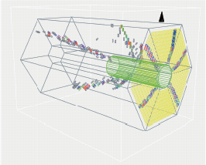
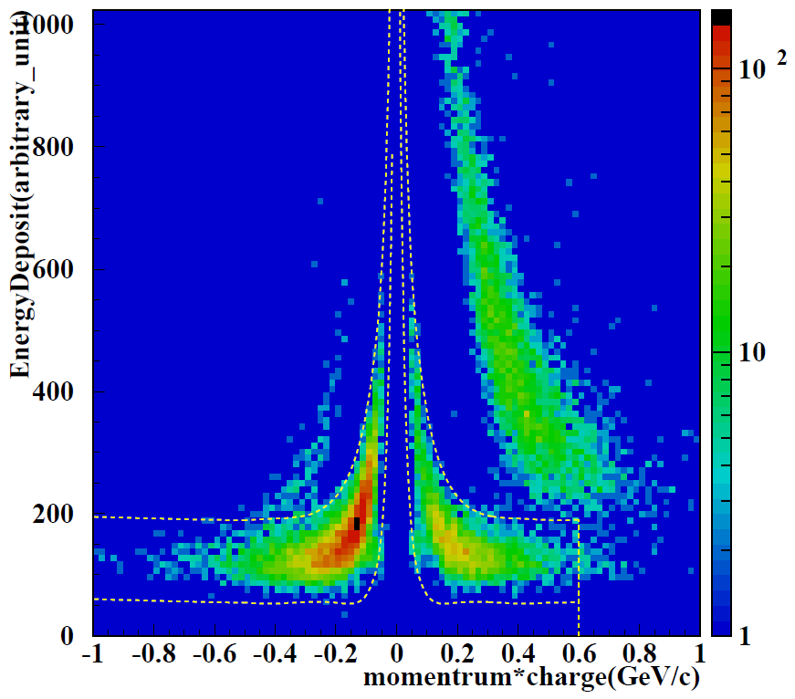
Time projection chamber
Pad plane
full view
event display
PID with TPC
x-y resolution : 200-300mm
z resolution : ~700mm
p
Measurement of
γp → K⁺Λ(1405) and K⁺Σ⁰(1385)
γp → ωp, ρp, φp ..
K⁻
π⁻
π⁺

Slide 46
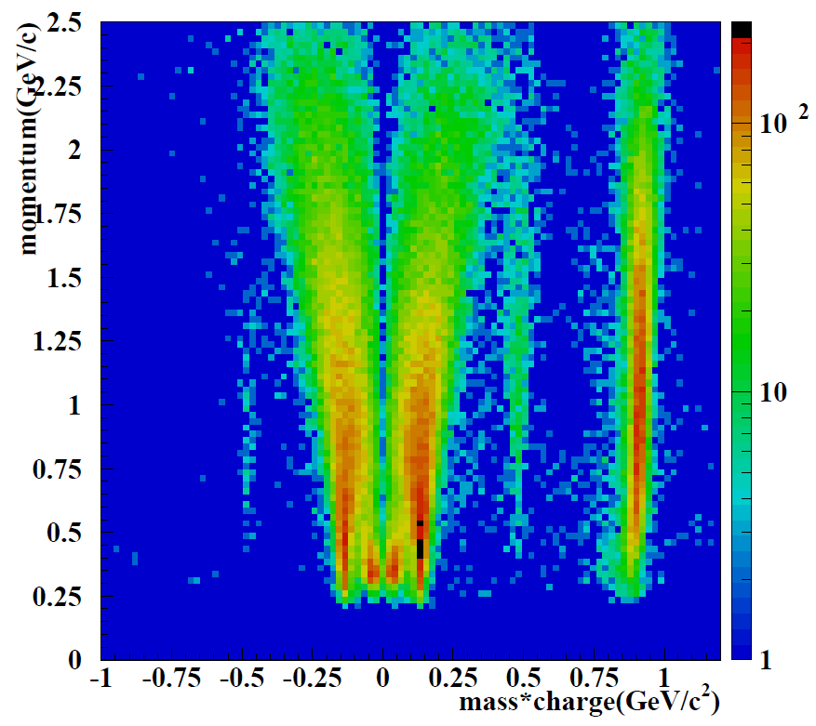
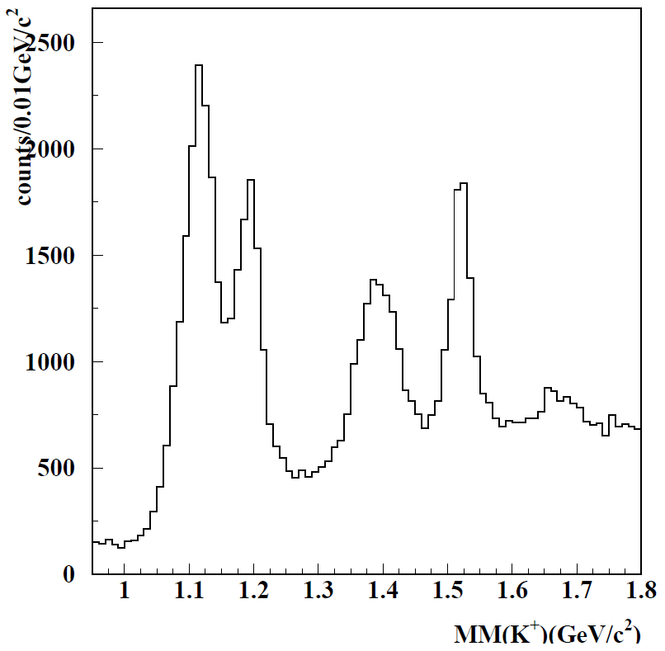
Analysis Particle Identification , Missing Mass spectrum of p (γ , K⁺) X
PID with Spectrometer
PID with TPC
momentum vs. mass x charge
Mass is calculated using track information.
(momentum, TOF, track length)
energy deposit
vs. momentum
x charge
(plot for events
in which K⁺ is
identified by
the spectro-
meter)
p
K⁻
K⁻
K⁺
π⁻
π⁺
p
π⁻
π⁺
missing mass spectrum of p(γ,K⁺)X
K⁺ is identified by forward spectrometer.
Σ⁰(1385)/Λ(1405)
Λ(1116)
The yields of Hyperons are extracted from
the missing mass spectrum of γ p → K⁺ X.
Λ(1520)
Σ⁰(1192)
Σ⁰(1385) and Λ(1405) can not be separated
due to their large width.
Selection cuts using decay products
detected by the TPC

Slide 47
LEPS2 roadmap

Slide 48



How to get the high Intensity Photon Beam
We are aiming to produce one-order higher intensity photon beam :
LEP intensity ≥ 10⁷ cps for E_{γ}<2.4 GeV beam (355 nm)
≥ 10⁶ cps for E_{γ}<2.9 GeV beam (266 nm)
Simultaneous injection of 4-lasers [x4]
Higher output power and lower power consumption CW lasers.
355 nm (for 2.4 GeV) 8 W→16 W, 266 nm (for 2.9 GeV) 1 W→2 W [x2]
Laser beam shaping with cylindrical expander [x2]
400 um
UV lasers
(355/266 nm)
laser
10 um
prism
expander
Electron beam is horizontally wide.
⇒ BCS efficiency will be increased
by elliptical laser beam.
AR-coated mirror
w/ stepping motor
Need large aperture of the laser injection line → reconstruct some BL chambers

Slide 49
Principle of polarized HD
H and D are polarized by the static method, i.e., using the thermal
equilibrium under the ultra low temperature and high magnetic field.
Special advantage:
・ Large dilution factor
・ After a few months aging
time, spin is frozen, even
under high temperature
and low magnetic field.
Longstanding effort at Syracuse, LEGS/BNL, ORSAY
10-20 mK
15-17T
>80% for H, >20% for D (vector)
20%→70% in D with DNP

Slide 50
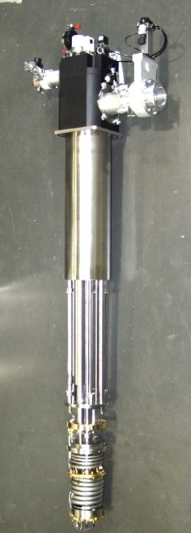
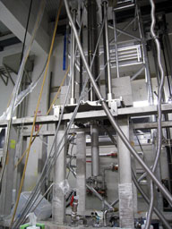
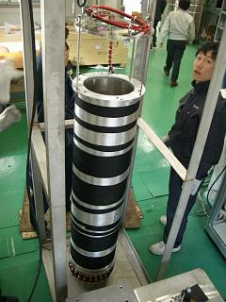
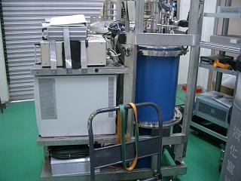
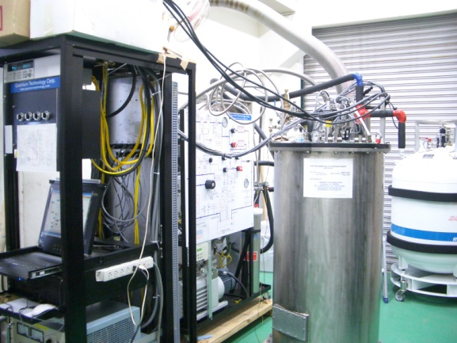
Dilution
Refrigerator
(DR)
Transfer
Cryostat
@SP8
(TC2)
17 T Magnet
Transfer Cryostat
@RCNP
(TC1)
Storage
Cryostat
(SC)
In-Beam Cryostat
(IBC)

