Slide 1
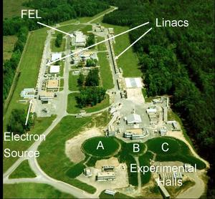

N* Electrocouplings from phenomonological analysis of the CLAS π⁺π⁻p electroproduction data
Victor I. Mokeev
Jefferson Lab
  Introduction.
  JM model for evaluation of N* parameters in analyzing the data on π⁺π⁻p electroproduction.
  Q² evolution of N* electrocouplings and what we my learn from them
  Conclusions and outlook.

Slide 2
Primary objectives in the studies of γ_{v}NN* electrocouplings with CLAS
Our experimental program seeks to determine
  γ_{v}NN* transition helicity amplitudes (electrocouplings) at photon virtualities 0.2< Q²<5.0 GeV² for most excited proton states from analyzing several meson electroproduction channels combined;
  employ advanced coupled channel approach under development at EBAC and worldwide.
This comprehensive information on Q² evolution of the γ_{v}NN* electrocouplings will allow us to
  determine the active degrees of freedom in N* structure versus distance scale;
  study the non-perturbative strong interactions which are responsible for the ground and excited nucleon state formation;
  study how N*’s emerge from QCD.

Slide 3
N* parameters from analyses of exclusive electroproduction channels
Resonant amplitudes
Non-resonant amplitudes
π, η, ππ,..
π, η, ππ,..
γ_{v}
*
N*,△
+
N
N’
A_{3/2}, A_{1/2}, S_{1/2}
G_{M}, G_{E}, G_{C}
N’
N
  Separation of resonant/non-resonant contributions represents most challenging part, and can be achieved within the framework of reaction models.
  N* ‘s can couple to various exclusive channels with entirely different non-resonant amplitudes, while their electrocouplings should remain the same.
  Consistent results from the analyses of major meson electroproduction channels show that model uncertainties in extracted N* electrocouplings are under control.

Slide 4
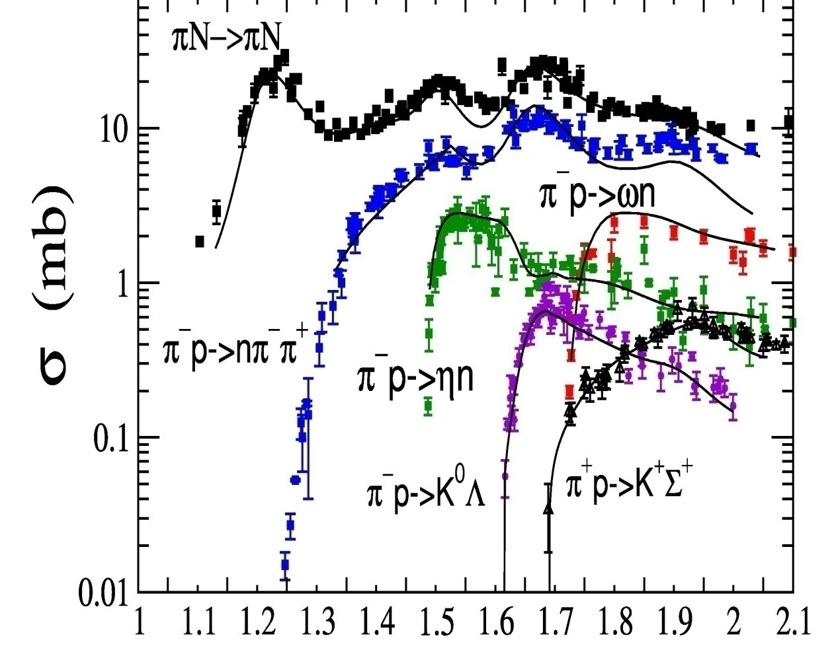
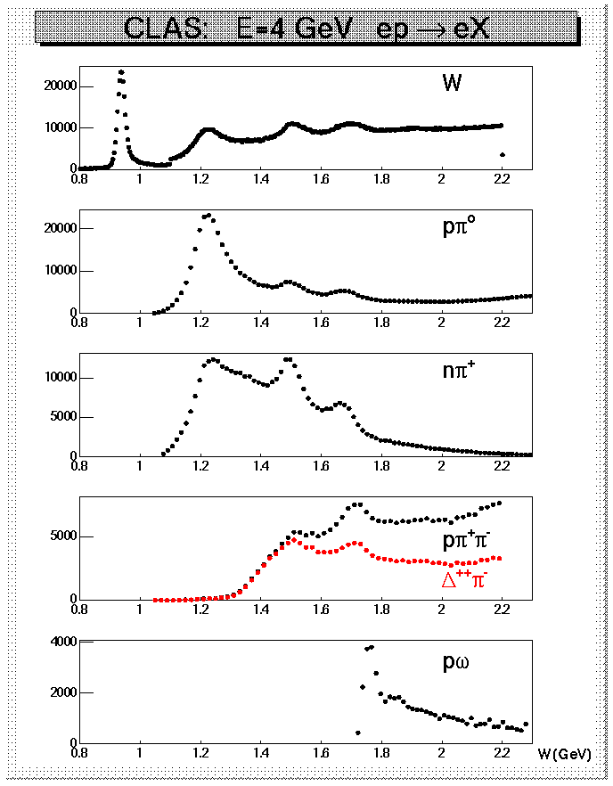
Evidence from data for a key role of Nπ & Nππ exclusive channels in meson electroproduction
CLAS data on yields of various meson
electroproduction channels (Q²<4.0 GeV²)
Cross sections of exclusive Nπ reactions
W (GeV)
Nπ/Nππ channels are strongly coupled by FSI.
N* analyses require coupled channel approaches, that account for MB↔MMB & MMB processes
Nπ/Nππ channels are major contributors to photo
electro and hadro production

Slide 5
The CLAS data on π⁺π⁻p differential cross sections and description within the JM model
G.V.Fedotov et al, PRC 79 (2009), 015204
M.Ripani et al, PRL 91 (2003), 022002
full JM calc.
π⁺Δ⁰
ρp
π⁺F⁰₁₅(1685)
π⁻Δ⁺⁺
2π direct
π⁺D⁰₁₃(1520)

Slide 6
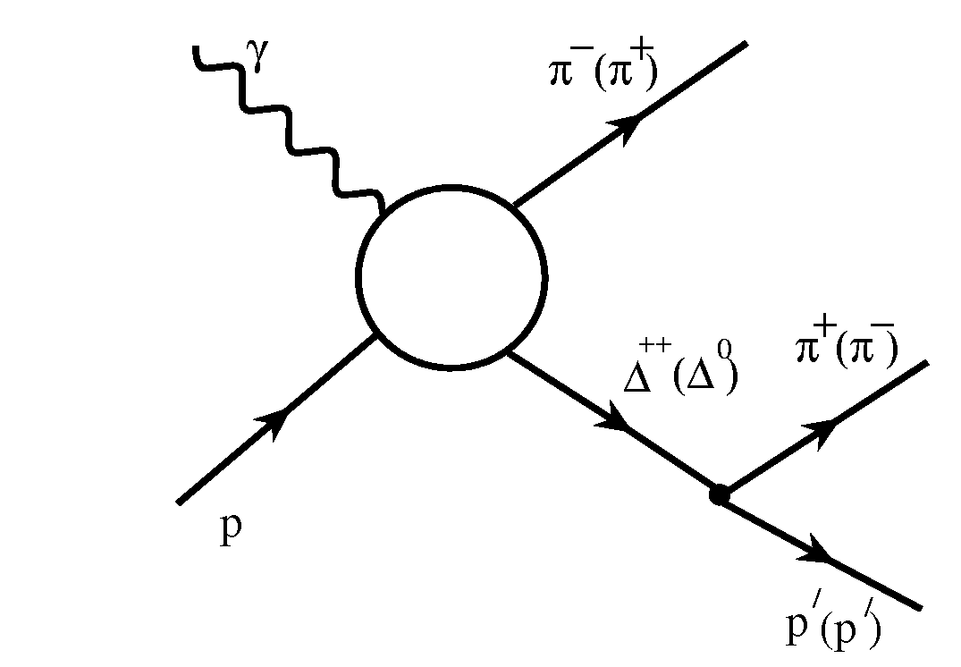
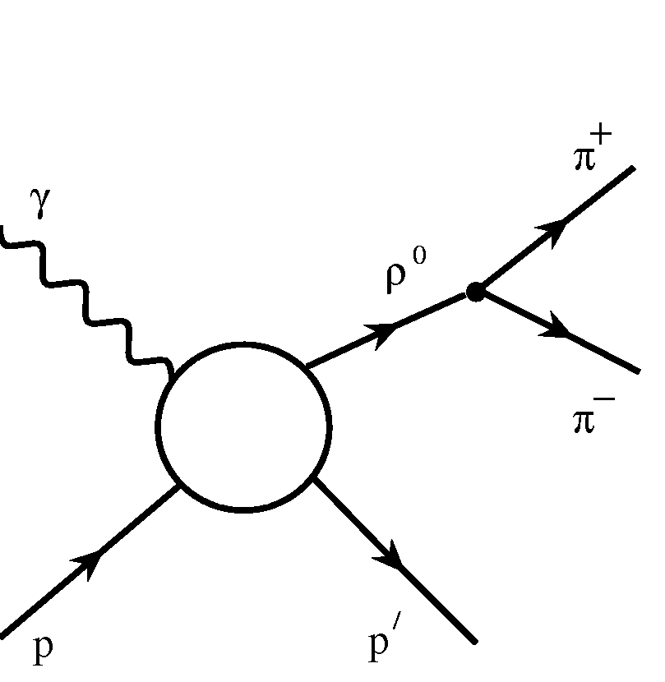
JLAB-MSU meson-baryon model (JM) for π⁺π⁻p electroproduction.
V. Mokeev , V.D. Burkert, T.-S.H. Lee et al., Phys. Rev. C80, 045212 (2009)
Isobar channels included:
3-body processes:
π⁻Δ⁺⁺
  All well established N*s with πΔ decays and 3/2⁺(1720) candidate.
  Reggeized Born terms with effective FSI and ISI treatment .
  Extra πΔ contact term.
ρ⁰p
All well established N*s with ρp decays and 3/2⁺(1720) candidate.
Diffractive ansatz for non-resonant part and ρ-line shrinkage in N* region.

Slide 7
Non-resonant contributions to πΔ channels
Minimal set of current conserving Born terms
Analytical expression for amplitudes
can be found in the paper referred in
the slide #6
contact
pion in flight (reggeized)
delta in flight
nucleon pole
still insufficient to reproduce
the data. Extra contact term
is needed.

Slide 8
Description of ISI and FSI in πΔ channels
Current phenomenological treatment in absorptive ansatz:
K.Gottfried, J.D.Jackson, Nuovo Cimento 34 (1964) 736.
M.Ripani et al., Nucl Phys. A672, 220 (2000).
Absorptive factors are determined by
elastic scattering amplitudes as:
Absorptive factors for the initial and the final state
interactions are applied to πΔ electroproduction
amplitudes decomposed over PW ‘s of total angular
momentum J :
Future development in collaboration with the EBAC:
Replace phenomenological procedure with explicit evaluation of FSI from
a global analysis of the Nπ, Nη , KY and Nππ photo, electro, and
hadroproduction data within the framework of the EBAC-DCC model.
The EBAC-DCC is the only available approach, that accounts for the MB↔MMB & MMB ↔ MMB processes.

Slide 9
Definition of N* parameters in JM model
Regular BW ansatz for resonant amplitudes
Hadronic parameters:
real

Slide 10
Definition of N* parameters in JM model
Electrocouplings:
N* electromagnetic production amplitudes and electrocouplings:
real
real

Slide 11
Unitarized Breit-Wigner Anstaz
The unitarization procedure proposed in I.J.R.Aitchison NP A189 (1972), 417 and modified to be consistent with N* propagators emplyed in JM mpdel:
where fαγp, f_{βMB}are the α-th N* electroproduction and β-th N* hadronic decay amplitude to the meson-baryon (MB) final state; S_{αβ} is the operator for resonance propagation, taking into account all transitions between α and β N* states, allowed by conservation laws in the strong interactions.
Inverse of the JM unitarized N* propagator:
N*_{α}
N*_{α}
diagonal
regular BW
Off-diagonal transitions incorporated into JM:
S₁₁(1535) ↔ S₁₁(1650)
D₁₃(1520) ↔ D₁₃(1700)
3/2⁺(1720) ↔ P₁₃(1700)
N*_{α}
N*_{β}
off-diagonal
Future plan: off-shell extension, employing the EBAC-DCC ansatz.

Slide 12
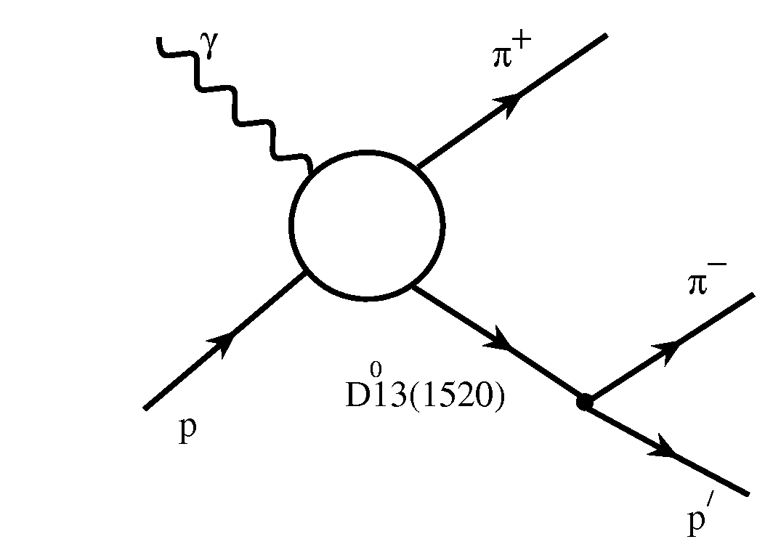
π⁺π⁻p electroproduction mechanisms determined for the first time from the analysis of the CLAS data
3-body processes:
Isobar channels included:
(π⁻)
π⁺D⁰₁₃(1520), π⁺F⁰₁₅(1685), π⁻P⁺⁺₃₃(1640) isobar channels observed for the first time in the CLAS data at W > 1.5 GeV.
(P⁺⁺33(1640))
(π⁺)
F⁰15(1685)
Direct 2π production required by unitarity:
Most relevant
at W<1.65 GeV.
Negligible at
W>1.70 GeV

Slide 13
Evidence for mechanisms contributing to π⁺π⁻p photoproduction from preliminary CLAS data. (E.Golovach talk at the CLAS Hadron Spectroscopy WG Meeting, Hall B/MSU )
ρp
Very Preliminary
Very Preliminary
π⁻Δ⁺⁺
π⁺D₁₃(1520)
First results on correlated 2D (inv. masses & CM angle of the final hadrons) cross sections.
Direct evidence for the π⁻ Δ⁺⁺, π⁺ D₁₃(1520), and ρp isobar channel contributions with t-channel processes, employed in the JM model.

Slide 14
Description of direct 2π production amplitudes in the JM model

Slide 15
Sensitivity of the CLAS data on α-angular distributions in the final π⁺π⁻p state to the phases of direct 2π production amplitudes
phase implementation allowed
us to improve description of all
differential crpss sections,
in particular α−angular
distributions
phases=0
phases fit to the data
W=1.51 GeV
Q²=0.65 GeV²
W=1.51 GeV
Q²=0.65 GeV²
Future plan: explore the
possibility to replace
phenomenological description
of direct 2π production
by explicit amplitudes:
γ_{v}(M) p→π ⁺π⁻p (direct)
MB→ π ⁺π⁻p
MMB→ π ⁺π⁻p
from the EBAC-DCC model
W=1.54 GeV
Q²=0.65 GeV²
W=1.54 GeV
Q²=0.65 GeV²

Slide 16
Fitting Procedures
Simultaneous variation of the following resonant/non-resonant JM model parameters according to the normal distribution:
-γ_{v}NN* electrocouplings with σ−parameters equal to 30% from their initial values, taken from interpolation of the CLAS/world data. For the N*’s with large helicity asymmetries the minor electrocouplings were varied in range making them comparable with the major N* electrocouplings;
-πΔ and ρp hadronic decay LS partial widths with σ−parameters, that cause total N* width float from 40 to 600 MeV;
-magnitudes of complementary contact terms in πΔ isobar channels; magnitudes of the π⁺D⁰₁₃(1520), π⁺F⁰₁₅(1685), π⁻P⁺⁺₃₃(1620) isobar channel amplitudes; magnitudes of direct 2π production mechanisms with σ-parameters range from 10 to 30 % from their starting values.
χ²/d.p. fit of nine 1-fold diff. cross sections in each bin of W and Q² were carried out . The calculated cross sections closest to the data were selected with χ²/d.p. < χ²/d.p._{max.} The χ²/d.p._{max}. were defined so that calculated cross sections selected in the fit are inside the uncertainties of measured cross sections for a major part of the data points.

Slide 17
Resonant and non-resonant parts of π+π−p cross sections as determined from the CLAS data fit within the framework of JM model
full cross sections
resonant part
non-resonant part

Slide 18
Evaluation of N* parameters
The sets of γ_{v}NN* electrocouplings, πΔ and ρp hadronic decay widths selected in data fit were averaged. Their mean values were assigned to N* parameters, while their dispersions were treated as N* parameter uncertainties
Special care for the evaluation of minor N* electrocouplings in a two step fit procedure:
1) all electrocouplings were evaluated as described in slide #16 ;
2) variations of major electrocoupling are restricted by the ranges determined in step #1, while ranges of all other JM parameters variation remain the same.
Consistent results obtained from two fits offer a reliable measure of
minor γ_{v}NN* electrocouplings.

Slide 19
γ_{v}NN* electrocouplings from the CLAS data on Nπ/Nππ electroproduction
Nππ CLAS preliminary.
A_{1/2}
S_{1/2}
Nπ CLAS
I. Aznauryan,V. Burkert, et al., PRC 80,055203 (2009).
P₁₁(1440)
P₁₁(1440)
Nπ world
V. Burkert, et al., PRC 67,035204 (2003).
A_{3/2}
A_{3/2}
D₁₃(1520)
Nπ Q²=0, PDG.
Nπ Q²=0, CLAS
F₁₅(1685)
M. Dugger, et al., PRC 79,065206 (2009).
  Good agreement between the electrocouplings obtained from the Nπ and Nππ
  channels.

Slide 20
High lying resonance electrocouplings from the π⁺π⁻p CLAS data analysis
Nππ CLAS preliminary.
A_{3/2}
S_{1/2}
A_{1/2}
Nπ world
V.D.Burkert,
et al., PRC 67,
035204 (2003).
Δ(1700)D₃₃
Nπ Q²=0, PDG.
Nπ Q²=0, CLAS
Studies of π⁺π⁻p electroproduction are needed for reliable extraction of transition γ_{v}NN* electrocouplings for high lying states with masses above 1.6 GeV. Most of them decay
preferably to Nππ final states.
Electrocouplings of S₃₁(1620), S₁₁(1650), F₃₅(1685), D₃₃(1700) ,
and P₁₃(1720) states were obtained for the first time from
the π⁺π⁻p electroproduction data within the framework of JM11 model.
M.Dugger, et al.,
PRC 79,065206
(2009).

Slide 21
Structure of P₁₁(1440) from analyses of the CLAS results
Quark models:
I. Aznauryan LC
S. Capstick LC
S_{1/2}
QM based on
relativistic
covariant
approach .
A_{1/2}
EBAC-DCC
MB dressing
(absolute values).
  The electrocouplings are consistent with P₁₁(1440) structure as a combined contribution of: a) quark core as a first radial excitation of 3-quark ground state, and b) meson-baryon dressing.
  Information on complex values of γ_{v}NN* electrocouplings is needed in order to account consistently for meson-baryon dressing in resonance structure .
  Complex γ_{v}NN* electrocoupling values will be obtained in future data fit with restrictions on N* parameters from the EBAC-DCC, Julich coupled channel analysis.

Slide 22
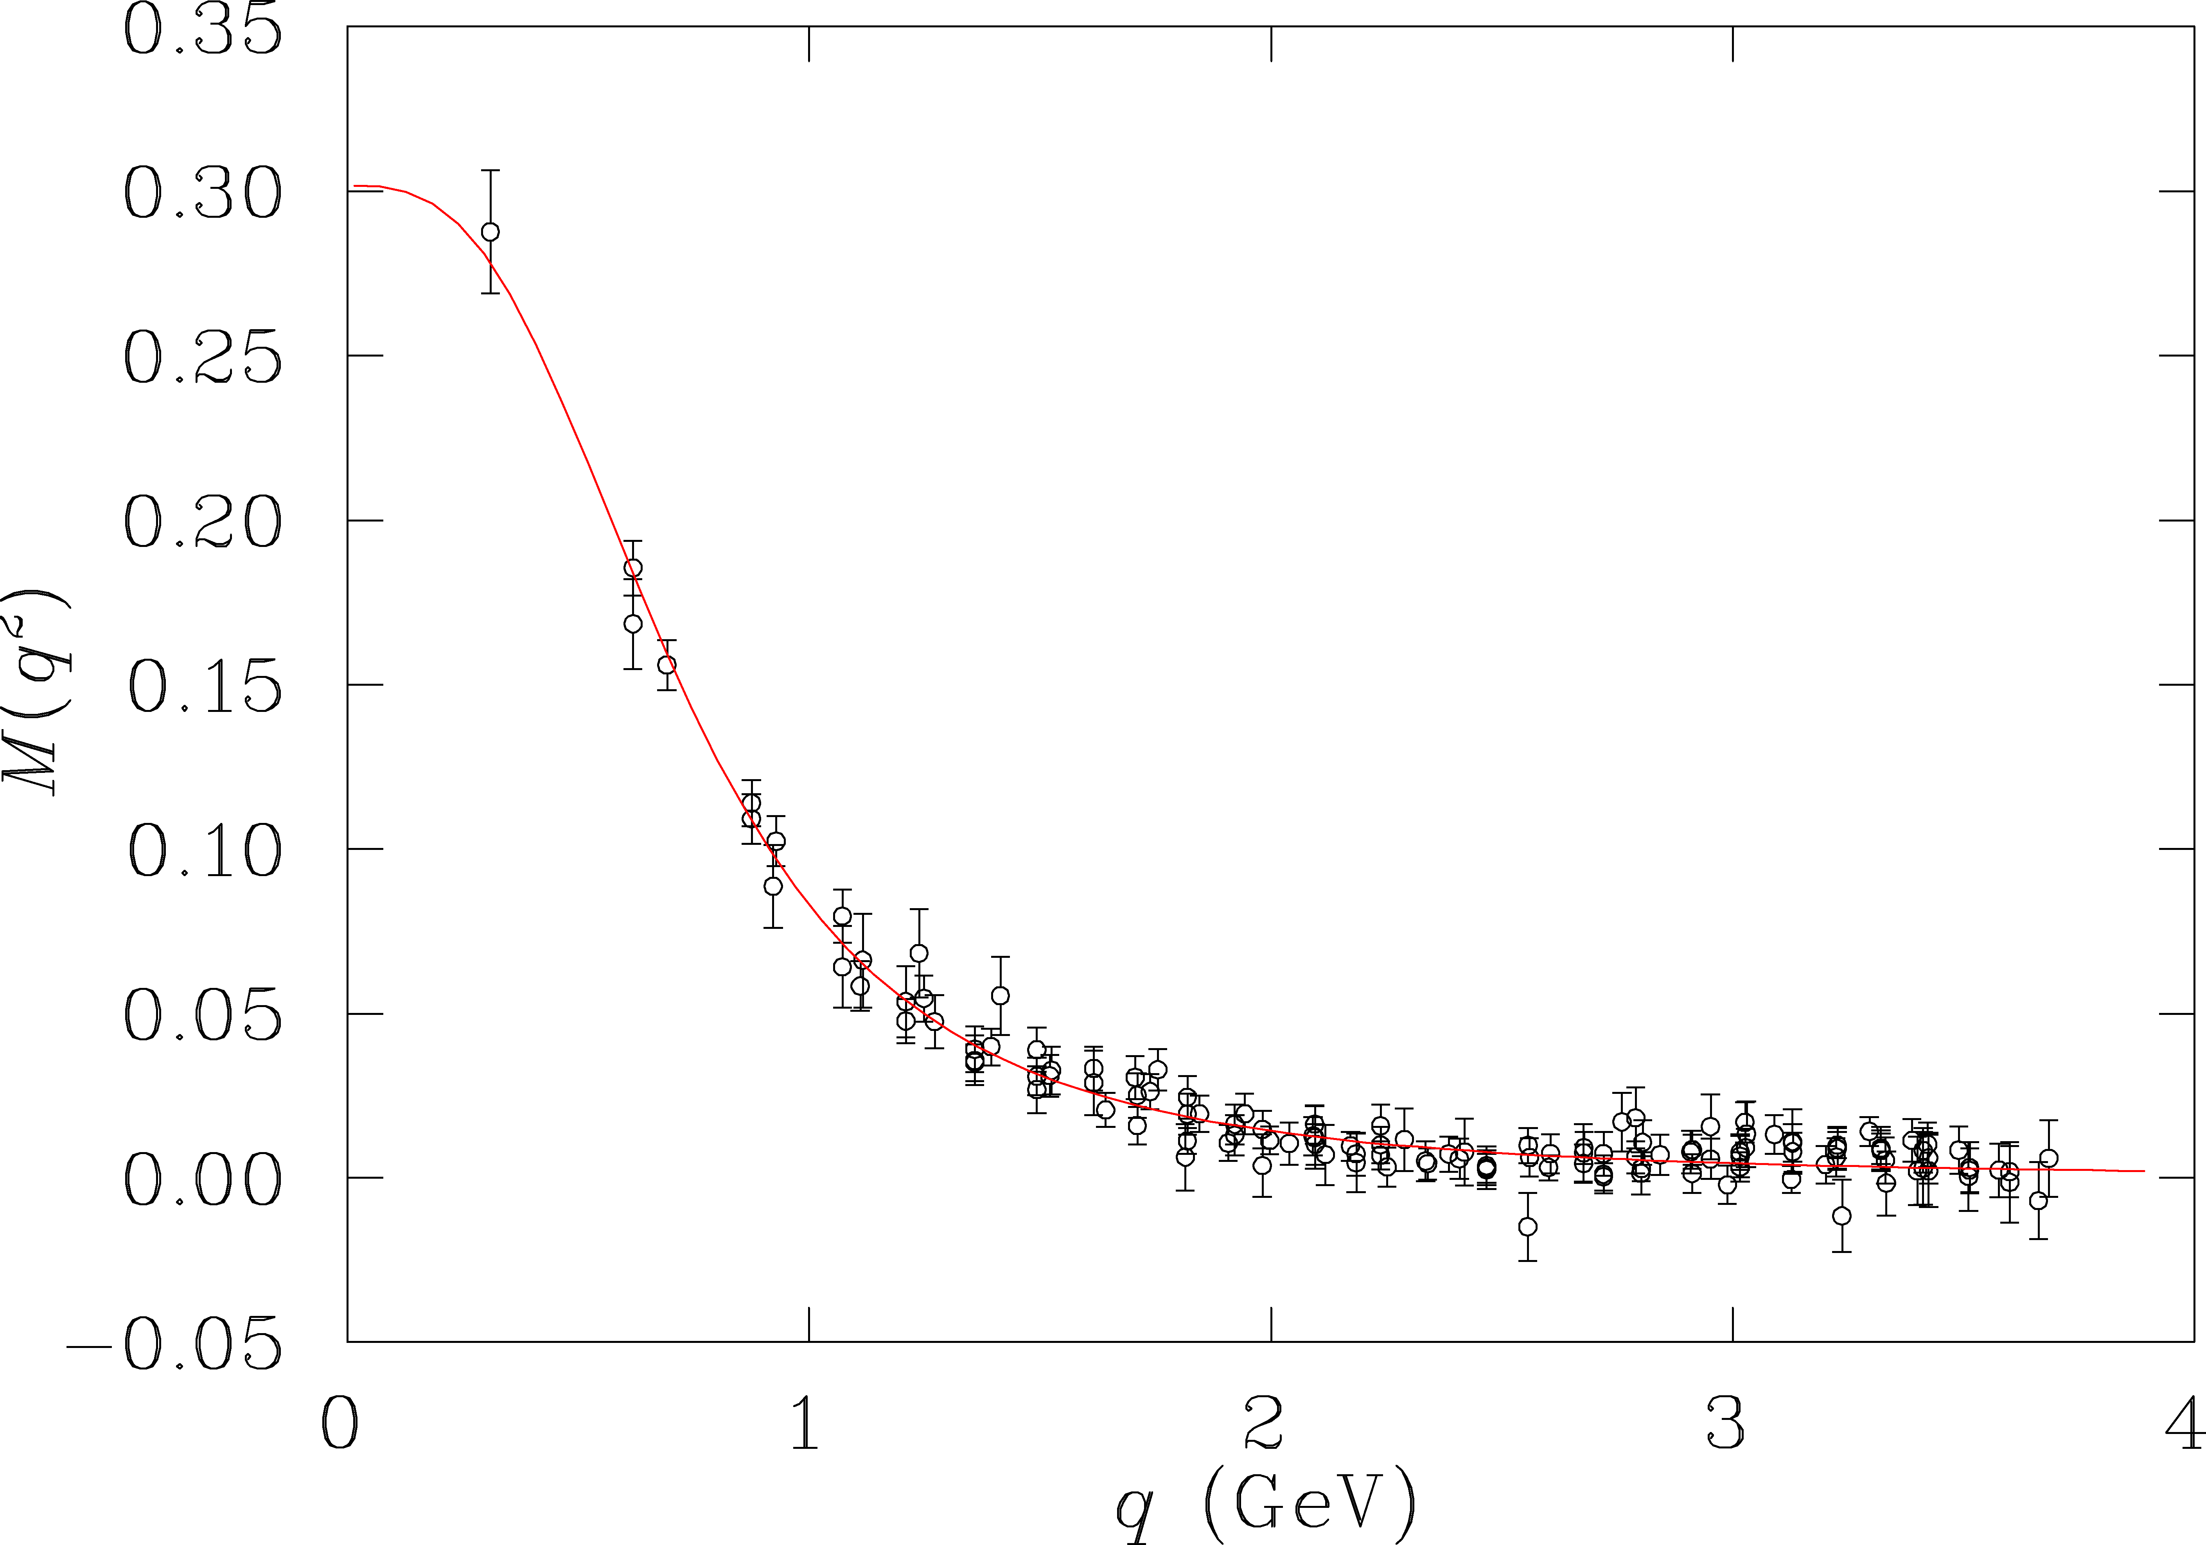
Access to active degrees of freedom in N* structure
π
resolution
of probe
low
N
DSE & LQCD
quark mass (GeV)
high
Do measurements of N* transition form factors probe m_{q}(q)?

Slide 23
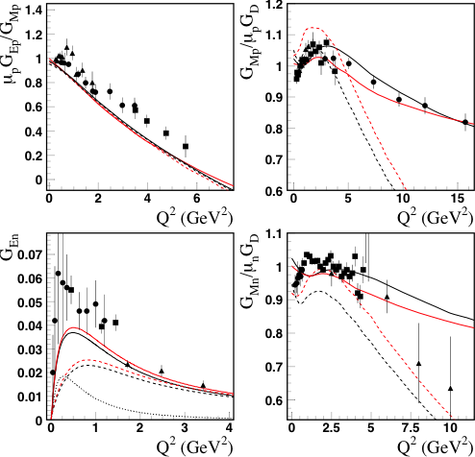
Analysis of Nucleon electromagnetic form factors within the LC model & pion dressing
m_{q}(Q²) = m_{q}(0)/(1+Q²/Λ)
I.G.Aznauryan, V.D.Burkert talk
at NSTAR2011 Conference
Λ = 60GeV²
Λ = 10GeV²
N = q³; m_{q}(0) (1)
N = q³+π; m_{q}(Q²) (2)
Pion dressing is much smaller than
3q contributions. Differences between the results (1) and (2) are mostly determined by m_{q}(Q²)
The running of m_{q}(Q²) allows for the description of G_{Mp} at Q² < 16 GeV² within the LC rel. quark model.

Slide 24
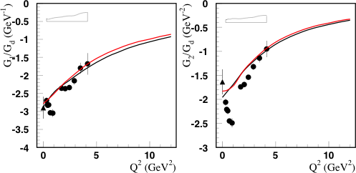
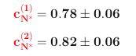
The D₁₃(1520) resonance
I.G.Aznauryan, V.D.Burkert talk
at NSTAR2011 Conference
Fit to the data
q³ weight factors:
Describe the data at
Q²>2.5GeV² successfully, employing
common for ground and excited states m_{q}(Q²) dependence.
G₁(Q²) ~ (A_{1/2} – A_{3/2}/√3)
meson-baryon dressing
G₂(Q²) = f(A_{1/2}, A_{3/2}, S_{1/2})
Measurements of N* transition form factors do probe the running of m_{q}(q)!

Slide 25
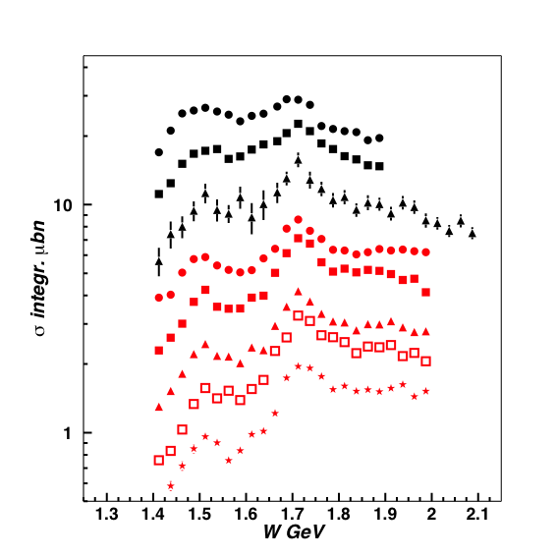
Future N* studies in π⁺π⁻p electroproduction with CLAS
γ_{v}NN*electrocouplings will become available for most excited proton states with masses less then 2.0 GeV and at photon virtualities up to 5.0 GeV²
Q² (GeV²)
E.L.Isupov,
Hall B/MSU
0.65
0.95
1.30
2.30
2.70
3.30
3.90
D₃₃, P_{13 ,}F₁₅
3/2⁺(1720)
4.60
D₁₃
Extension of JM model toward high Q²
Resonance structures become more prominent with increasing Q².
Notes:
Many higher mass states couple dominantly to the 2-pion channel and can be best analyzed in this channel. One has 9 independent cross sections available that constrain analysis. The different curves show contributions from various isobars.

Slide 26
Conclusions and Outlook
Good description of π⁺π⁻p electroproduction cross sections, achieved within the framework of JM model, allowed us to establish all essential contributing mechanisms and to provide a reliable separation of resonant/non-resonant contributions.
For the first time electrocuplings of P₁₁(1440), D₁₃(1520), and F₁₅(1685) states have become available from both Nπ and π⁺π⁻p electroproduction channels. Consistent results on γ_{v}NN* electrocouplings of these states, obtained in independent analyses of major Nπ and π⁺π⁻p electroproduction channels strongly suggest reliable electrocoupling extractioin.
Electrocouplings of S₃₁(1620), D₃₃(1700) and P₁₃(1720) states with dominant Nππ decay were determined for the first time from π⁺π⁻p electroproduction channel, that offers preferable opportunities to explore electrocouplings of high lying N*’s with masses above 1.6 GeV.

Slide 27
Conclusions and Outlook
The recent CLAS data on π⁺π⁻p electroproduction will allow for the determination of electrocouplings of most excited proton states at photon virtulalities from 2.0 to 5.0 GeV² for the first time.
Joint effort in collaboration with the EBAC is in progress with the primary objective to obtain consistent results on N* parameters determined independently in analyses of major meson electroproduction channels and in the global coupled channel analysis within the framework of the EBAC-DCC model.

Slide 28
Back-up

Slide 29
The π⁺D₁₃(1520) isobar channel
Evidence for π⁺D₁₃(1520) isobar channel in the CLAS π⁺π⁻p data
full JM results with
π⁺D₁₃(1520) implemented
W=1.74 GeV Q²=0.65 GeV²
full JM results without
π⁺D₁₃(1520) and adjusted
direct 2π production
π⁺D₁₃(1520) contribution
Born terms similar to the ones employed in πΔ channels with additional γ₅ matrix
W=1.79 GeV Q²=0.65 GeV²

Slide 30
Isobar channel cross sections derived from Nππ CLAS data
Full information on cross sections of contributing mechanisms may be found in:
http://www.jlab.org/~gleb/modeldata/
W=1.51 GeV Q²=0.43 GeV²
band of differential cross sections calculated in JM model that are closest to experimental Nππ data, being determined under
requirement : χ²/d.p.< (χ²/d.p.)__{max}
differential cross sections for contributing isobar channels:
may be used in tests of particular amplitudes incorporated to cc reaction models
π⁻Δ⁺⁺
π⁺Δ⁰

Slide 31
N* decay parameters to Nππ final states from the CLAS π⁺π⁻p electroproduction data
D₁₃(1520)
Parameters | CLAS π⁺π⁻p electro production data | PDG
Γ total, MeV | 126±7 | 100-125
πΔ BF, % | 24-33 | 15-25
ρp BF, % | 7-16 | 15-25
S₁₁(1535)
Note: uncertainties for Γ tot were obtained varying Nππ decay widths only.
Parameters` | CLAS π⁺π⁻p electro production data | PDG
Γ total, MeV | 136±8 | 125-175
πΔ BF, % | 5-11 | <1
ρp BF, % | 3.6-13.7 | <4
Nππ decays of D₁₃(1520) are close to those reported in the PDG.
For S₁₁(1535) they are bigger then the PDG values with almost equal πΔ and ρp BF’s.

Slide 32
Comparison between the CLAS and MAID results
P₁₁(1440)
S_{1/2}
A_{1/2}
MAID07
MAID08

Slide 33
Comparison between the CLAS and MAID results
D₁₃(1520)
S_{1/2}
A_{3/2}
A_{1/2}
MAID07
MAID08

Slide 34
con’d

Slide 35
Absorptive ansatz for phenomenological treatment of ISI & FSI in πΔ channels
K.Gottfried, J.D.Jackson, Nuovo Cimento 34 (1964) 736.
M.Ripani et al., Nucl Phys. A672, 220 (2000).

Slide 36
Cont’d
πΔ, ρp elastic scattering amplitudes
BW ansatz for resonant part
Exclude double counting: non-resonant ampl. &dressed gNN* verticies
T^{j}res →0.5T^{j}res f^{j}res=0
T^{j}backgr from πN data fit
Potential improvements:
New results on πΔ & ρp
elastic amplitudes

Slide 37
Extra contact terms in πΔ isobar channels
W=1.36 GeV Q²=0.43 GeV²
Parameters A(W,Q²), B(W,Q²) were taken from the CLAS data fit.
Born+
contact
Born

Slide 38
Non-resonant contributions in ρp isobar channel
Diffractive ansatz from J. D. Bjorken, PRD3, 1382 (1971).
Good approximation for t<1.0 GeV²; at larger t full ρp amplitudes are dominated by N*
b=b(L_{fluct}) from D.G.Cassel et al, PRD24, 2878 (1981).
JM model improvement A=A(W,Q²), essential in N* area at W<1.8 GeV:
L=0.77 GeV A=12
D_{λ}=0.30 GeV D=0.25 GeV
All details in:
N.V.Shvedunov et al, Phys of Atom. Nucl. 70, 427 (2007).

Slide 39
π⁺F₁₅(1685), π⁻P₃₃⁺⁺(1620) isobar channels
Evidence in the CLAS data
full JM results with
π⁺F₁₅(1685) and π⁻P₃₃(1620) implemented
full JM results without these channels
π⁺F₁₅(1685)
π⁻P₃₃(1620)
π⁺F₁₅(1685) amplitude:
π⁻P₃₃(1620) amplitude:

Slide 40
Fully integrated γ_{v}p→π⁺π⁻p cross sections, and the contributions from various isobar channels and direct 2π production
full calculation
Q²=0.95 GeV²
π⁻Δ⁺⁺
π⁺Δ⁰
π⁺ D₁₃(1520)
π⁺ F₁₅(1685)
ρ p
π⁺ P₃₃(1640)
direct 2π production

Slide 41
Input for Nπ/Nππ coupled channel analysis : partial waves of total spin J for non-resonant helicity amplitudes in π⁻Δ⁺⁺ isobar channel
J
1/2
Born terms
3/2
5/2
Extra contact terms
Will be used for N* studies in coupled channel approach developing by EBAC.

Slide 42
Meson-baryon dressing vs Quark core contribution in NΔ Transition Form Factor – G_{M.} EBAC analysis.
One third of G*_{M} at low Q² is due to contributions from meson–baryon (MB) dressing:
Data from exclusive π⁰ production
bare quark core
Within the framework of relativistic QM [B.Julia-Diaz et al., PRC 69, 035212 (2004)], the bare-core contribution is very well described by the three-quark component of the wf.
Q²=5GeV²
G_{D} =
1
(1+Q²/0.71)²

Slide 43
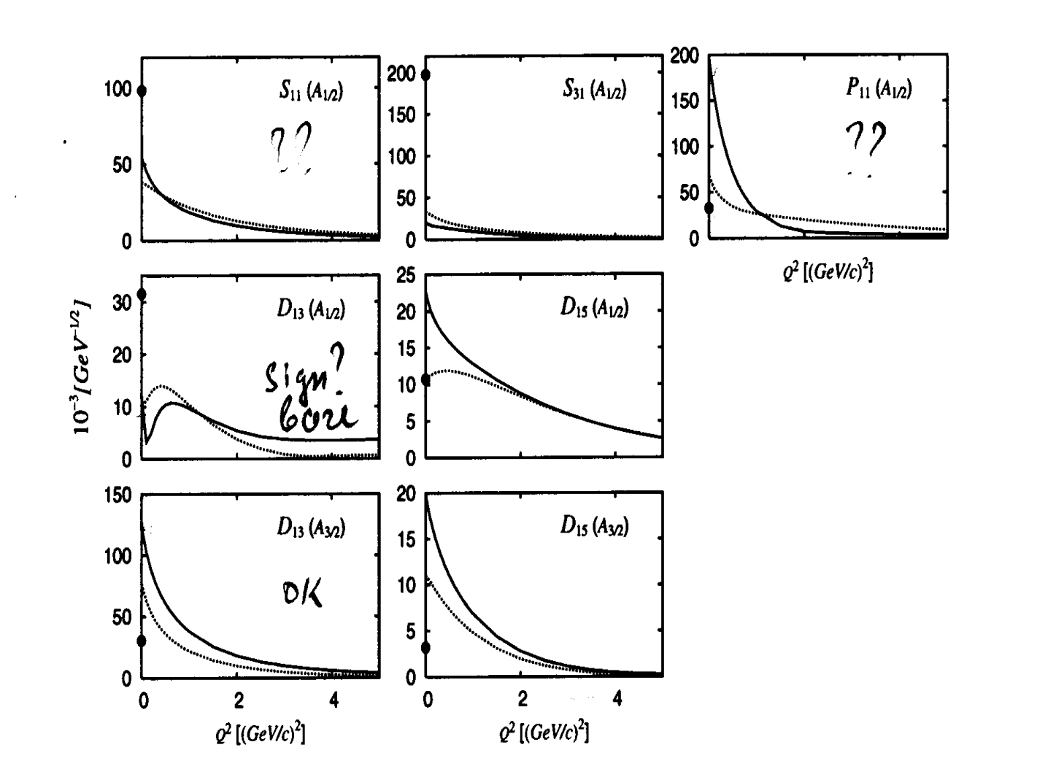
New regime in N* excitation at high Q²
EBAC calculations for meson-baryon cloud of low lying N*’s.
the photons of high virtuality penetrate meson-baryon cloud and interact mostly to quark core
data on N* electrocouplings at high Q² allow us to access quark degrees of freedom, getting rid of meson-baryon cloud.
can be obtained at 5<Q²<10 GeV² after 12 GeV Upgrade with CLAS12 for majority of N* with masses less then 3.0 GeV
B.Julia-Diaz, T-S.H.Lee, et.al, Phys. Rev. C77, 045205 (2008).

Slide 44
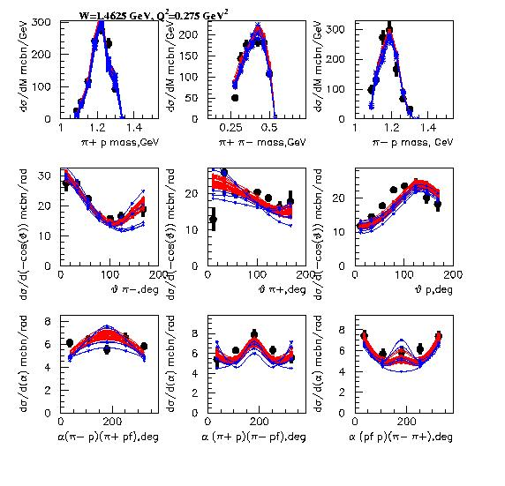
Robustness of the data on P11(1440) electrocouplings
P11 on
P11 is substituted by non-resonant mechanisms
Q² independent fit
Q² dependent fit
2.6<χ2/d.p.<2.8
3.6<χ2/d.p.<4.0

Slide 45
High lying resonance electrocouplings from Nππ CLAS data analysis
A_{1/2}
A_{3/2}
S_{1/2}
N(1685)F₁₅
The amplitudes of
unitarized BW ansatz
A_{1/2}
S_{1/2}
γ_{v}
M
N*₁
N*₁
p
diagonal
B
N(1650)S₁₁
γ_{v}
M
N*₁
N*₂
Unitarization of full BW amplitudes was achieved accounting for all interactions between N*’s in dressed resonant propagator
p
off-diagonal
B

Slide 46
Electrocouplings of [70,1-] SU_{sf}(6)-plet states from Nπ/Nππ CLAS data and their description in SQTM approach
D₁₃(1520)
SU(6) spin-flavor symmetry for quark binding interactions
Dominant contribution from single quark transition operator:
D₁₃(1520)
World data before CLAS measurements on transverse electrocouplings of D₁₃(1520) and S₁₁(1535) states (the areas between solid lines) allowed us to predict transverse electrocouplings for others [70,1-] states (the areas between solid lines on the next slide), utilizing SU(6) symmetry relations.
S₁₁(1535)
V.D. Burkert et al., Phys. Rev. C76, 035204 (2003).

Slide 47
Electrocouplings of [70,1-] SU_{sf}(6)-plet states from Nπ/Nππ CLAS data and their description in SQTM approach
SQTM predictions are consistent with major features in Q² evolution of [70,1-] state electrocouplings, offering an indication for:
relevance of quark degrees of freedom and substantial contribution to quark binding from interactions that poses SU(6) spin-flavor symmetry
considerable contribution to N* electroexcitations at Q²<1.5 GeV² from single quark transition
S₃₁(1620)
A_{1/2}
D₃₃(1700)
S₁₁(1650)
D₃₃(1700)
A_{3/2}

Slide 48
Electrocouplings of [70,1-] SU_{sf}(6)-plet states from Nπ/Nππ CLAS data in comparison with quark model expectations
Nππ preliminary
Nπ
D₁₃(1520)
D₁₃(1520)
Light front models:
S.Capstick:
each N* state is described by single h.o. 3q configuration
S₁₁(1535)
S₁₁(1650)
S.Simula:
Mass operator is diagonalized, utilizing a large h.o. basis for 3q configurations

Slide 49
Electrocouplings of [70,1-] SU_{sf}(6)-plet states from Nπ/Nππ CLAS data in comparison with quark model expectations
The CLAS data on N* electrocouplings are better described accounting for 3q configuration mixing, showing importance of this effect in the N* structure.
Remaining shortcomings may be related to more complex qq interactions than OGE, utilized in S.Simula model.
S₃₁(1620)
First information on electrocouplings of [70,1-]-plet and several other N*’s N* states, determined from the CLAS Nπ/Nππ data, open up a promising opportunity to explore binding potential and qq interaction based on the fit of all available N* electrocouplings combined within the framework of quark models and taking into account MB cloud.

Slide 50
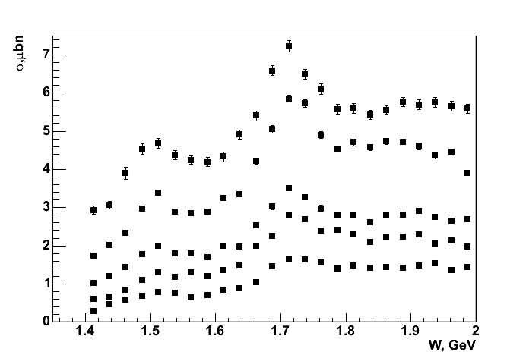
Fully integrated γp→π⁺π⁻p cross sections at 2.0<Q²<5.0 GeV²
Resonant structures are clearly seen in entire Q² area covered by CLAS detector with 5.75 GeVe⁻ beam. The structure at W~1.7 GeV becomes dominant as Q² increases
Q²=2.4 GeV²
CLAS Preliminary
Q²=2.7 GeV²
Q²=3.3 GeV²
Q²=3.9 GeV²
Q²=4.6 GeV²
D13(1520)
P11(1440)
D33(1700),P13(1720)
3/2⁺(1725),F15(1685)

